Slide 1
APES 1/16
Prepare for some brief notes on Urbanization
Then we will continue with our Land Use Plan
P.1: 8:30 is our designated assembly time

Slide 2
Urbanization
Cities, Suburbs and their Environmental Impacts

Slide 3
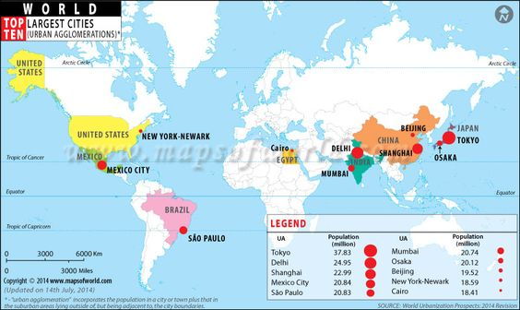
Advantages of Urbanization
Smaller footprint per capita
Decreased birth rates reduces environmental pressures
Population concentration impacts biodiversity less
What else?

Slide 4
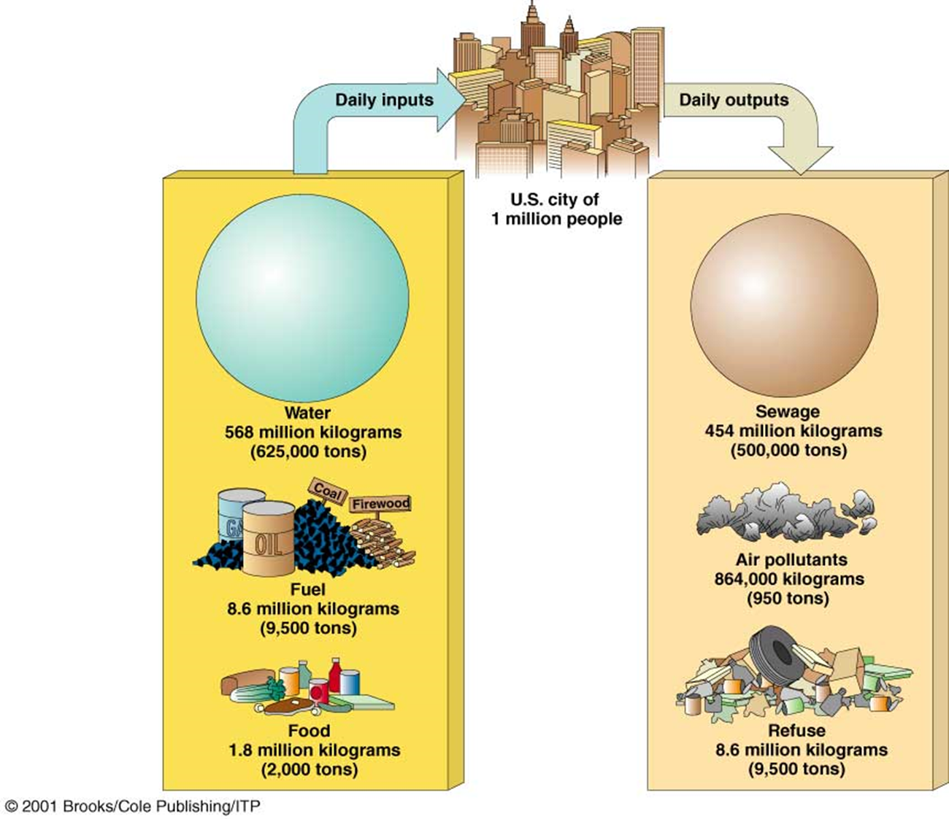
Disadvantages of Urbanization
Energy use
Biological and municipal waste
Urban heat islands
Pollution: air, water, noise
Huge overall footprint

Slide 5
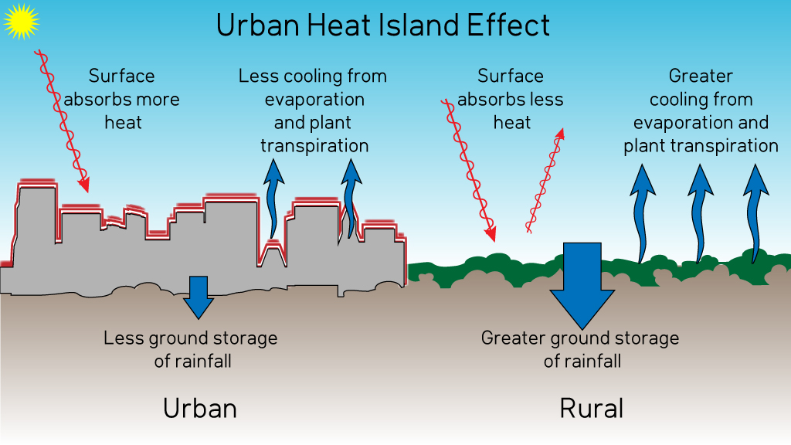
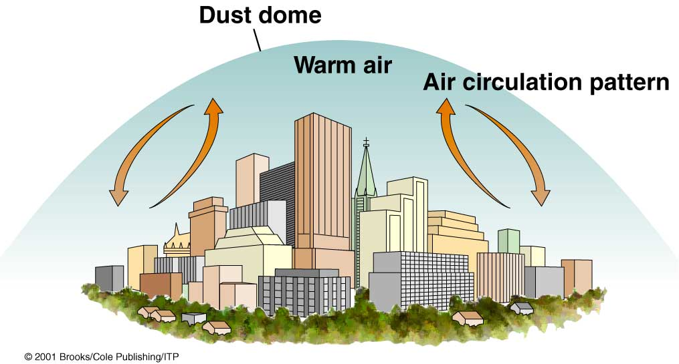
The enormous amount of heat generated creates an urban heat island
Air pollution particles trap heat
Additional heat changes climate of surrounding area

Slide 6
Disadvantages of Urbanization
Excessive noise exposure ⇒ health effects
Hearing loss, hypertension, muscle tension, migraines, headaches, higher cholesterol levels, gastric ulcers, irritability, insomnia, psychological disorders, aggression

Slide 7
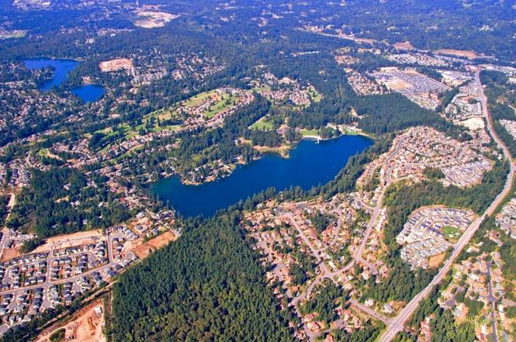
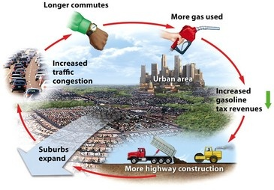
Urban Sprawl = Rise of Suburbs
Induced demand caused by policies like the Highway Trust Fund, which uses federal gas taxes to fund new highway construction

Slide 8
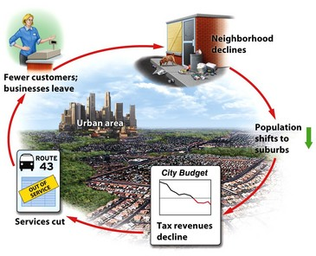
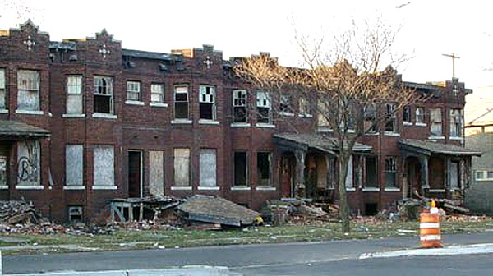
Urban Sprawl leads to Urban Blight

Slide 9
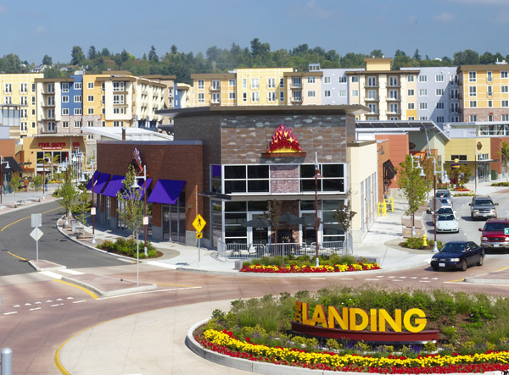
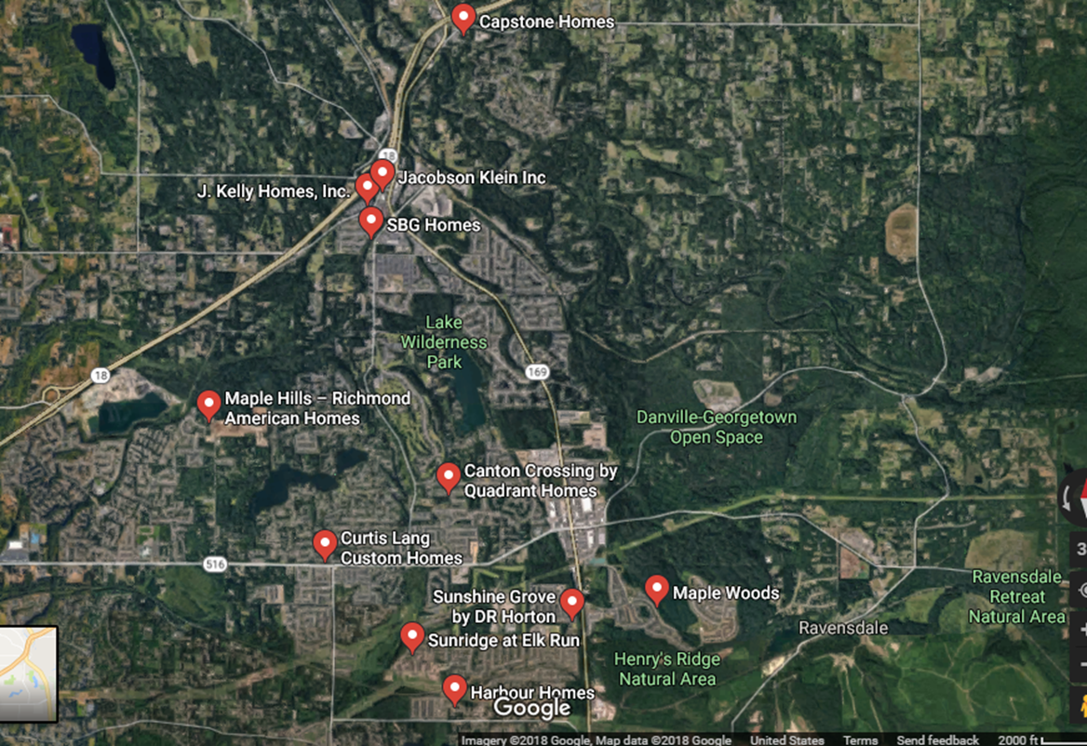
Smart Growth Tools
Zoning for Mixed-Use Structures
In-filling
Transit-oriented development
Urban growth boundaries
(see more in the textbook)
King County passed the Growth Management Act in 1990, which requires these (and other) Smart Growth principles.

Slide 10
Test on Thursday
Chapter 8: AP Level! Review PowerPoints, reading guides, textbook
Chapter 10
Know all bolded definitions and be able to give an example
Know the categories of public lands in the U.S., which federal agency is in charge of them, and what’s allowed there (don’t worry about U.N./International Categories- they’re similar)

