Slide 1
APES 1/22/18
Please take out your Chapter 11 Reading Guide
I’ll be checking off Modules 31-32

Slide 2
Check your answers
Module 31
Module 32
E
B
C
A
A
C*
D
D
E
E

Slide 3
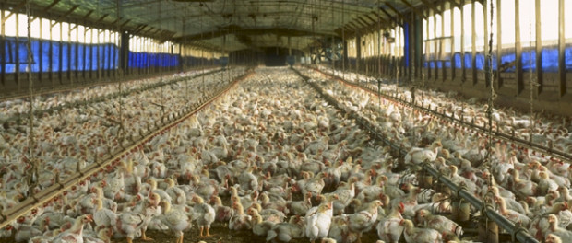
Modern Food Production
What are some negative externalities of your chicken nuggets?

Slide 4
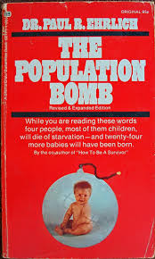
Today’s Food Production
Food production currently exceeds
population growth
We produce food through technology
Fossil fuels, irrigation, fertilizer, pesticides, crossbreeding, GMOs
Predictions of mass starvation in 1960s did not happen (population bomb, Malthus)
Why? Agricultural technology kept pace

Slide 5
What lead to this increase in production?

Slide 6
Too little and too much food
Undernourishment = get less than 90% of daily caloric needs
Poverty in developing countries
31 million Americans are food insecure
Overnutrition = too many calories
In the U.S., 25% of adults are obese
Worldwide, more than 300 million people are obese
Malnutrition = a shortage of nutrients the body needs
lacks adequate vitamins and minerals

Slide 7
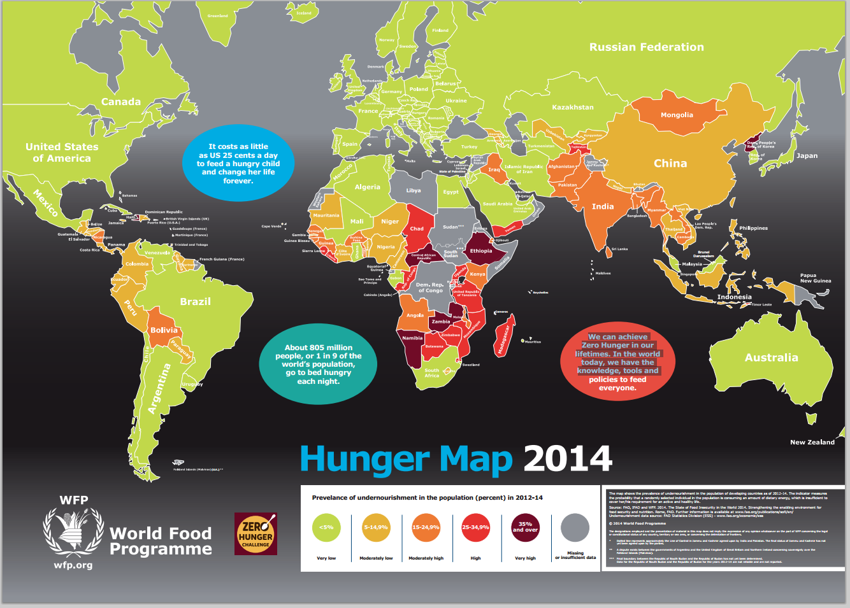

Slide 8
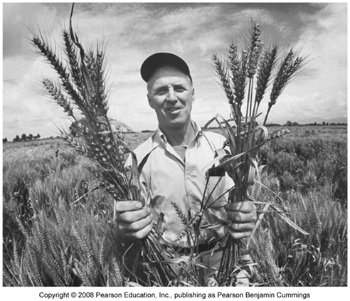
The Green Revolution
A significant increase in agricultural productivity beginning in the 1940s
Why? introduction of high-yield varieties of grains
Use of pesticides
Monocultures are easy to manage
Norman Borlaug
1940’s Mexico
Selective Breeding
Disease resistant crops
High Productivity crops

Slide 9
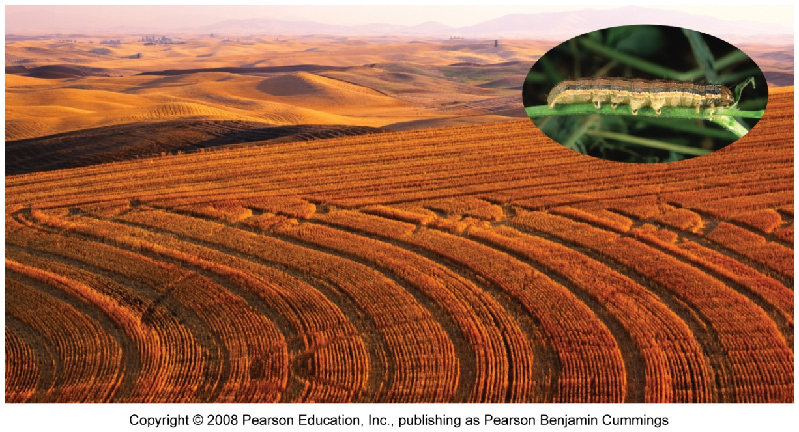
Pros/cons of Monocultures
Monoculture = a large expanse of a single crop
More efficient, increases output
Devastates biodiversity
Susceptible to disease and pests
Narrows human diet: 90% of our food comes from 15 crop species and 8 livestock species
Armyworms easily defoliate monocultures

Slide 10
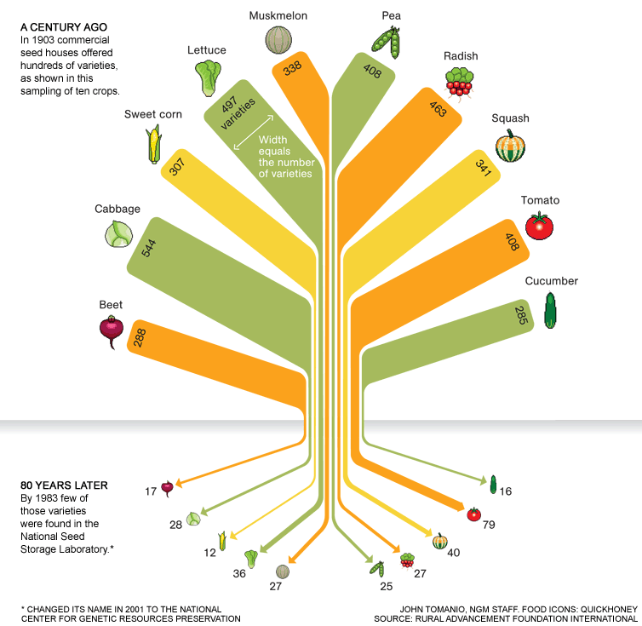

Slide 11
Key terms in Agribusiness
Industrial agriculture :
Agriculture that applies the techniques of mechanization and standardization. (agribusiness)
Energy subsidy
The amount of human and fossil fuel energy required per calorie of food produced.
Economies of scale
Average costs of production fall as output increases ($$$ incentive to grow a lot of one thing!)

Slide 12
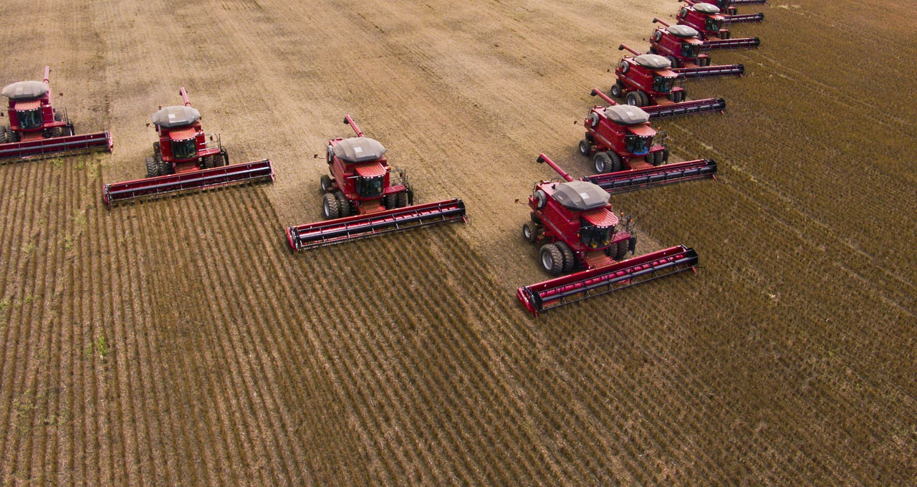
Energy Subsidies
Most energy subsidies are in the form of fossil fuels used to:
produce fertilizers and pesticides
harvest food and prepare it for transport
transport food from farm to your plate

Slide 13
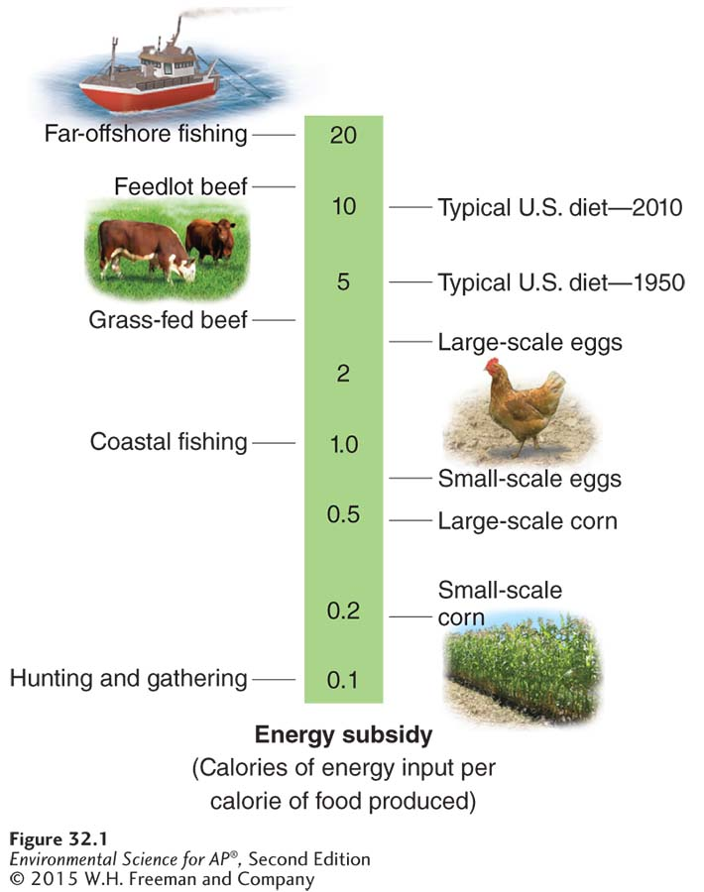
The Energy Subsidy in Agriculture
Energy input per calorie of food grown is greater for modern agriculture than for subsistence agriculture.
subsistence ag = grow enough just for survival

Slide 14
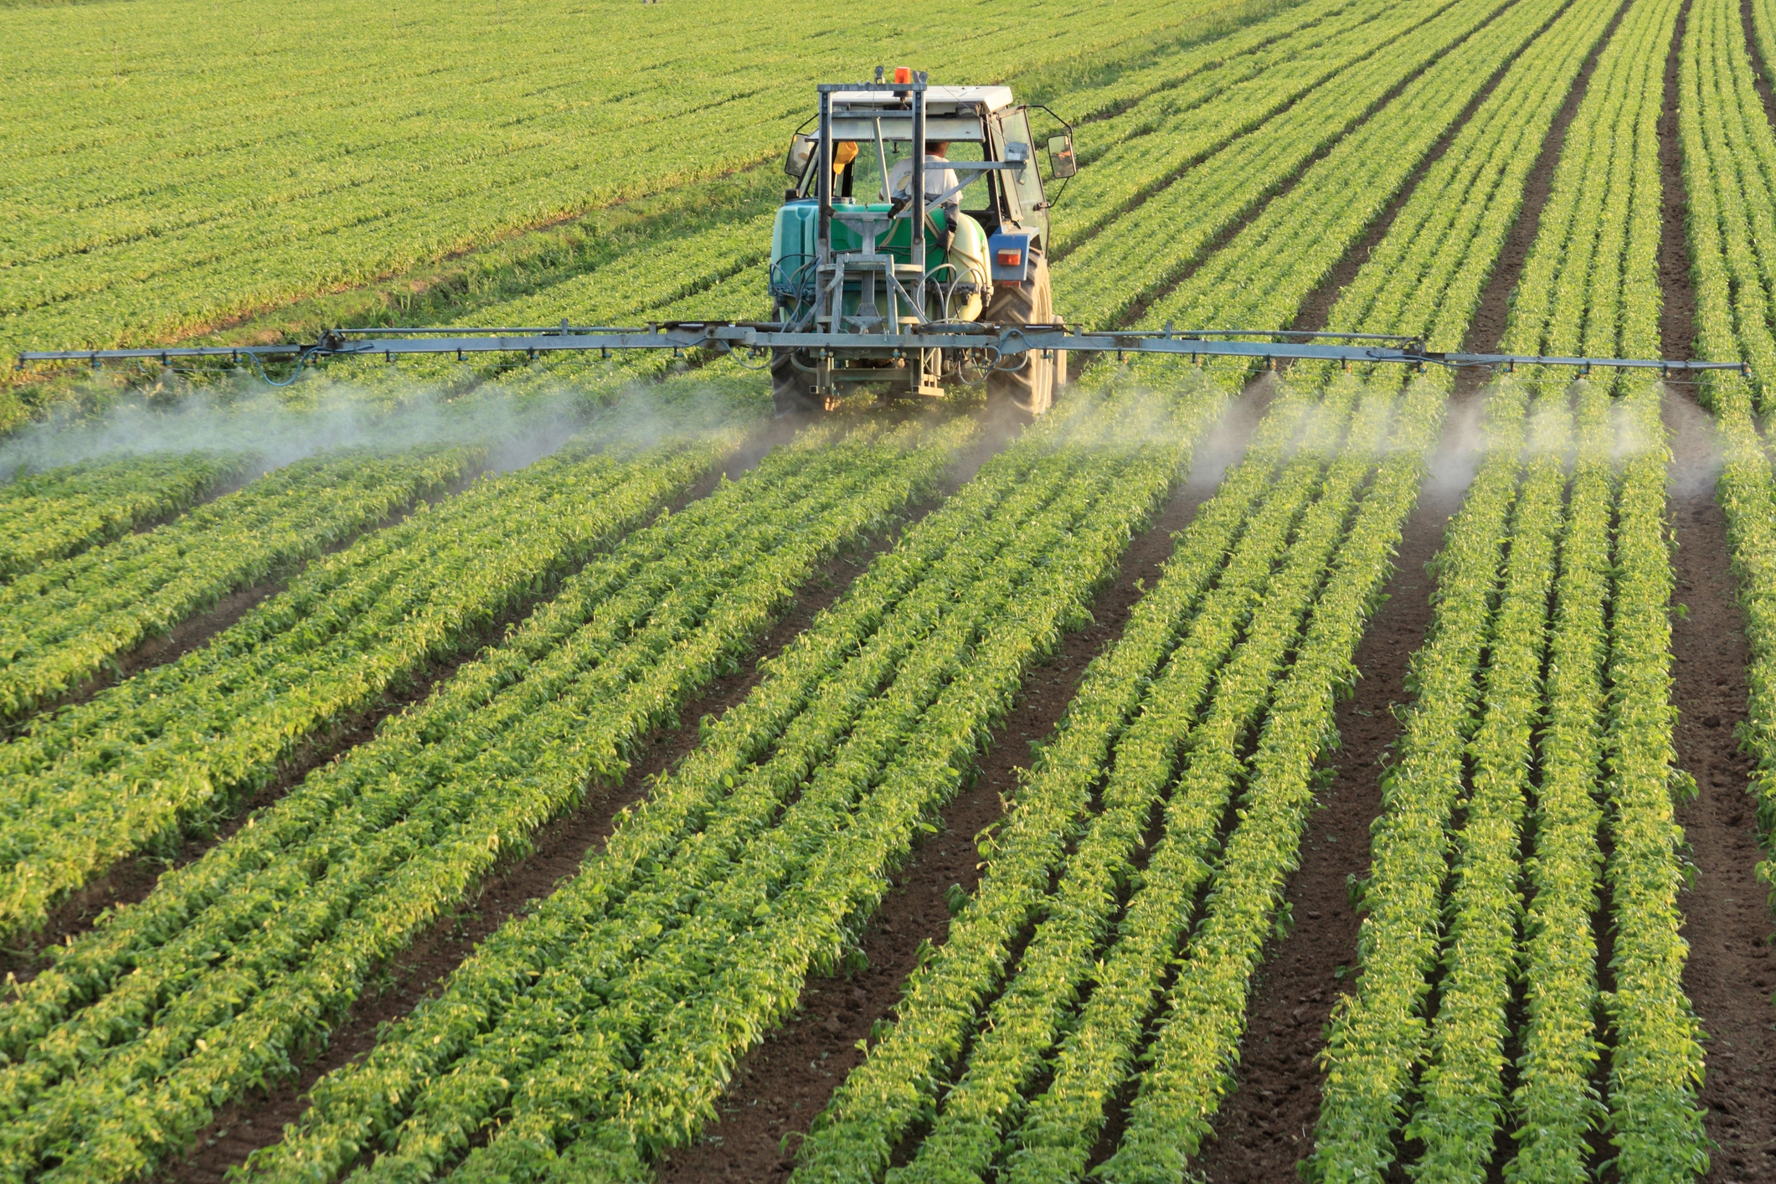
The Green Revolution: Fertilizers
Organic fertilizer Fertilizer composed of organic matter from plants and animals.
Synthetic fertilizer Fertilizer produced commercially with the use of fossil fuels.
Huge amount of N, P, K added

Slide 15
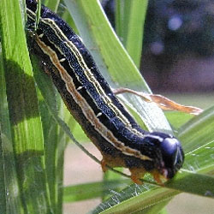
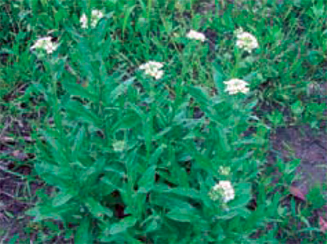
The Green Revolution: Pesticides
Pesticide: A natural or synthetic chemical, that kills/controls insects and other pests
Can be selective or broad-spectrum
Can be persistent (stay around for a long time) or non-persistent
Can be insecticides (target bugs)or herbicides
(target plants)
Army worms and Hoary Alyssum
http://ipm.ncsu.edu/AG271/contents.html
http://www.ipm.msu.edu/agriculture/field_crops/identifying_weeds_in_field_crops

Slide 16
The Green Revolution: Pesticides
Pesticide resistance: survival of the fittest; some plants survive and reproduce
Causes Pesticide treadmill: cycle of pesticide development pest resistance new pesticide development.

Slide 17
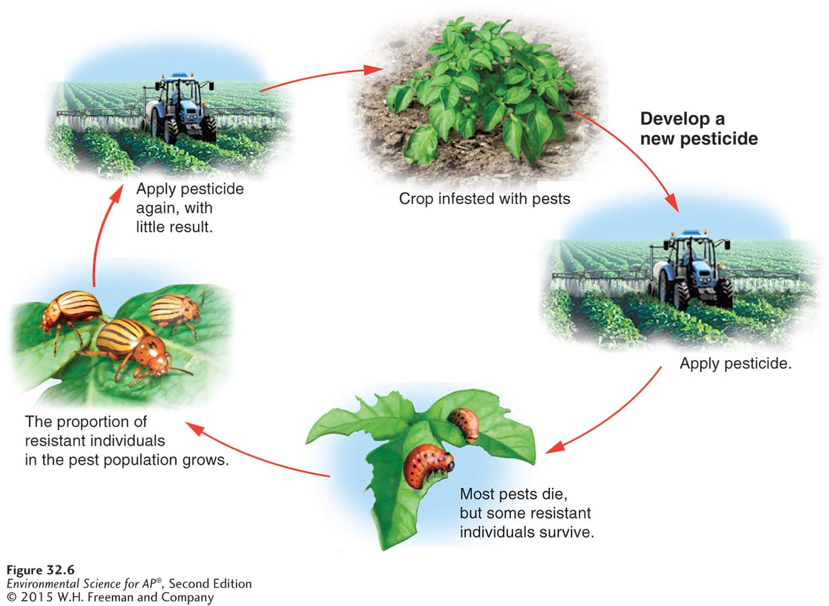
The Green Revolution: Pesticides

Slide 18
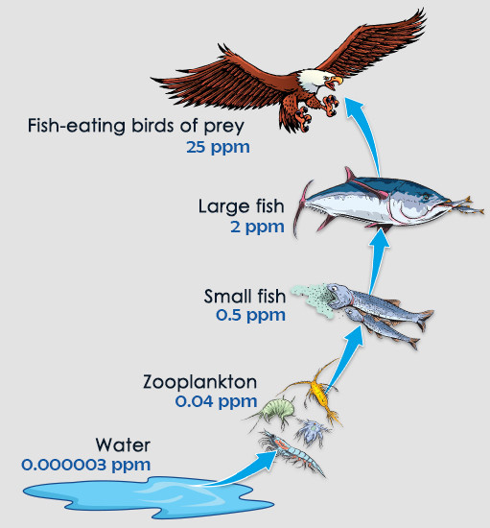
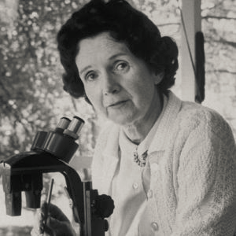
Silent Spring by Rachel Carson
1962: Marine biologist Rachel Carson publishes Silent Spring and raises awareness of DDT’s harmful effects
DDT: broad spectrum pesticide (banned in US in 1972)
Builds up in predatory bird species to toxic levels by biomagnification
Why? Each consumer level has to eat numerous of the one below to survive!

Slide 19
Let’s Investigate Farming!
Watch the first half of “Sustainable”
Look for examples of the terms in Module 32

Slide 20
Homework for Wednesday
Do Module 33 and the end-of-chapter Multiple Choice

Slide 21
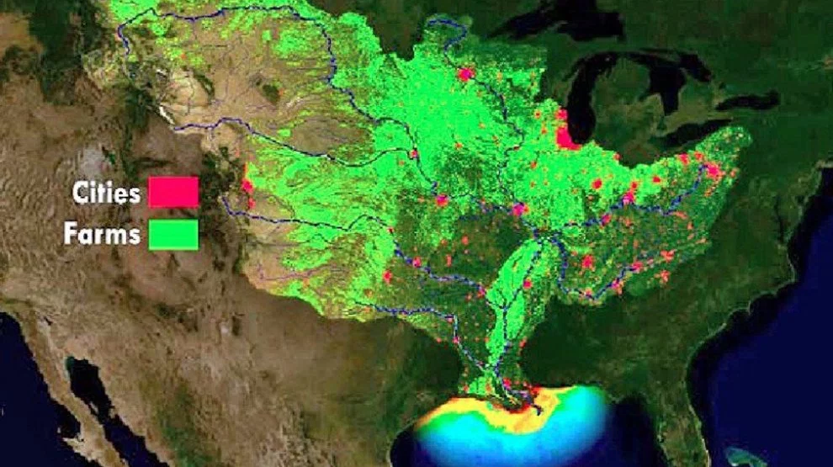
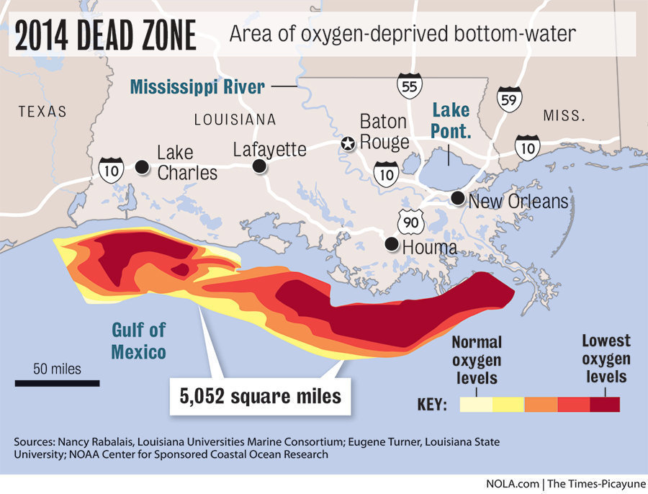
Environmental Consequences of Agribusiness

Slide 22
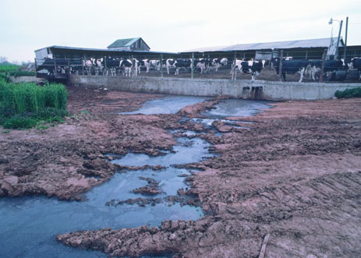
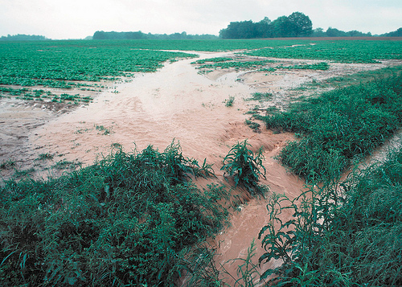
Soil Degradation by Harvesting
Huge, heavy machinery harvests all plants, exposing topsoil to erosion by wind/water
Erosion clogs nearby streams and pollutes with fertilizer/animal waste run-off
Algal blooms kill off aquatic life

Slide 23
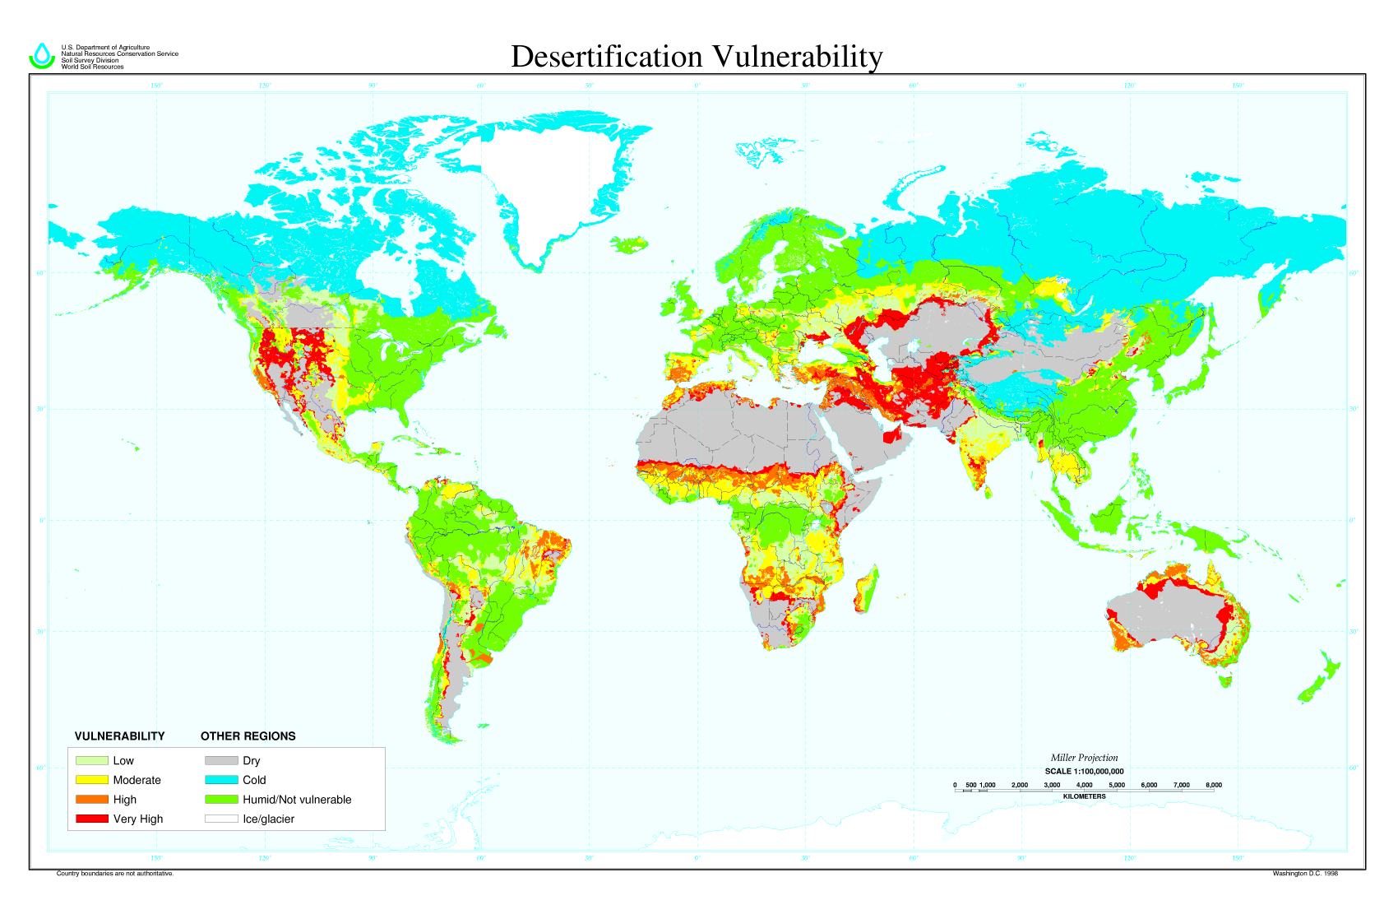
Desertification
1/3 of world’s arable (farmable) land has been lost to desertification or other degradation (WWF.com)
Repeated loss of fertile topsoil makes land infertile

Slide 24
Soil Degradation by Irrigation
Irrigation creates:
Waterlogging: Soil remains under water for prolonged periods, causing roots to rot
Salinization: Small amount of salts in irrigation water becomes concentrated on the soil surface through evaporation.

Slide 25
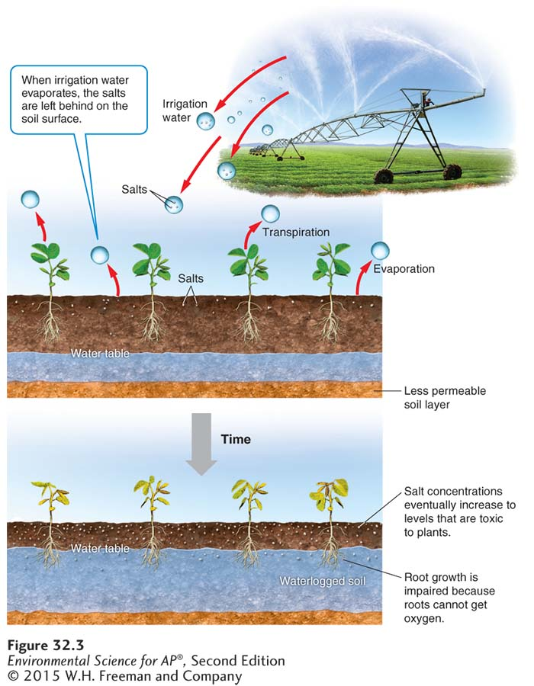
Soil Degradation by Irrigation

Slide 26
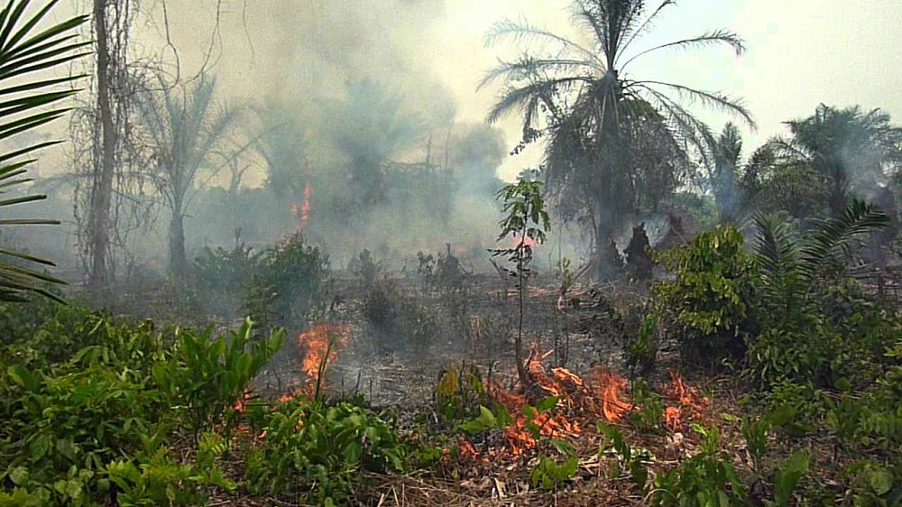
Slash and Burn Agriculture
Used most often in Stage 2 countries
Major source of deforestation
Making room for palm oil plantations

Slide 27
Relevant Laws
1996: Food Quality Protection Act
EPA sets limits on combined pesticide exposure
EPA = Environmental Protection Agency
Enforced by FDA (Food and Drug Admin.) and USDA (U.S. Dept. of Agriculture)

Slide 28
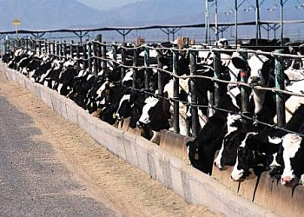
Modern agribusiness includes farmed meat and fish
Conc. animal feeding operation (CAFO): A large
indoor or outdoor structure w/maximum output
Fishery: A commercially harvestable population of fish within a particular ecological region.
Fishery collapse The decline of a fish population by 90 percent or more.
Bycatch The unintentional catch of non-target species while fishing.

Slide 29
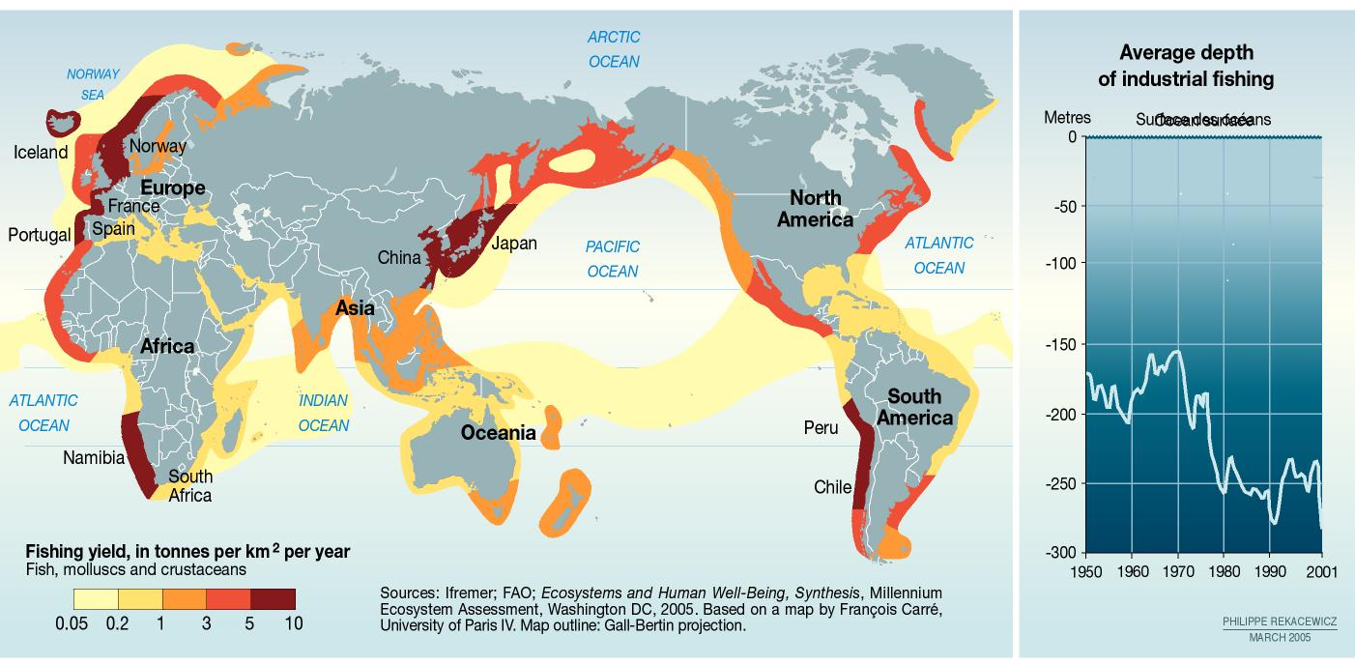
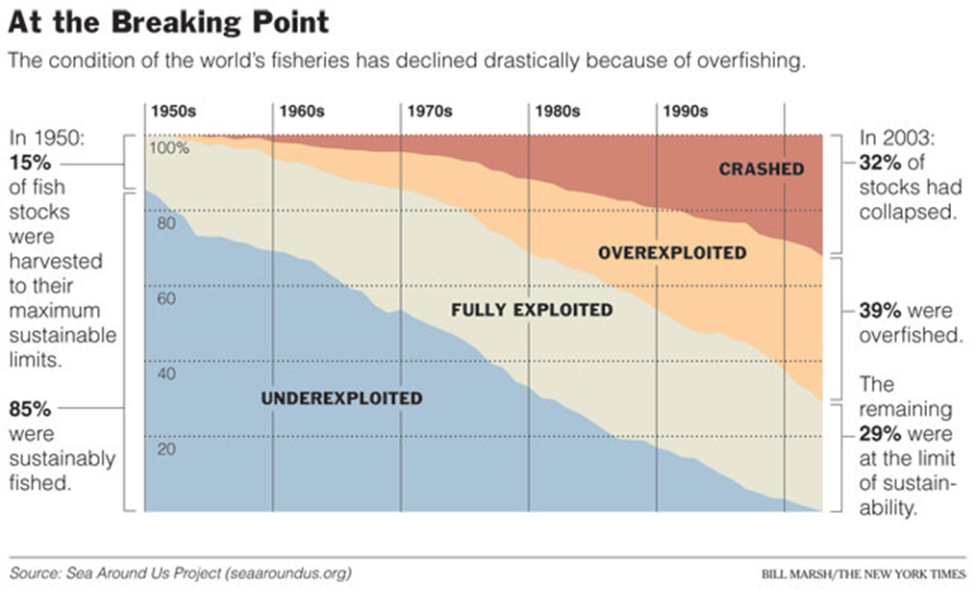

Slide 30
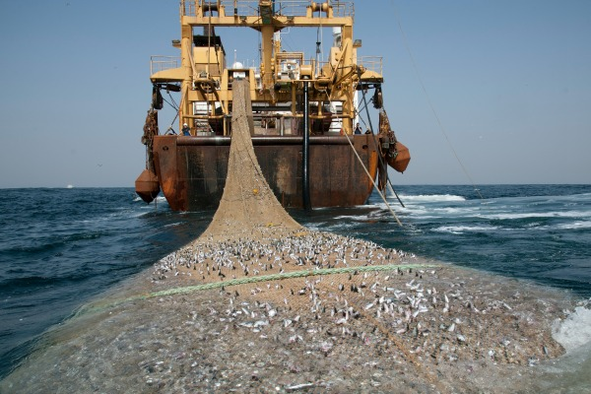
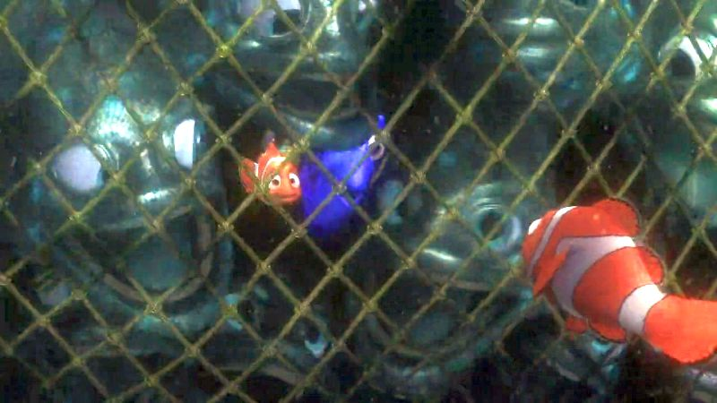
Major fishing practices
Long-line fishing: up to 80 miles of line with thousands of hooks strung out
Purse-seine fishing: huge net around a school of fish
Drift-net fishing: up to 40 miles of netting hang in water
Trawler fishing: large metal baskets hold nets are dragged across ocean floor

Slide 31
More Sustainable Fishing
The Sustainable Fisheries Act passed in 1996 (U.S.)
shifted fisheries management from a focus on economic sustainability to a species- sustainability approach.
Individual transferable quota (ITQ):
individual fishers are given a total allowable catch of fish in a season that they can either catch or sell.

Slide 32
Aquaculture
Aquaculture Farming aquatic organisms such as fish, shellfish, and seaweeds.
Aquaculture involves constructing an aquatic ecosystem with enclosures
Pro: alleviates some of the human-caused pressure on overexploited fisheries
Provides protein for the more than 1 billion undernourished people in the world.
Con: neg. impacts on env. (construction of enclosures); lost biodiversity

Slide 33
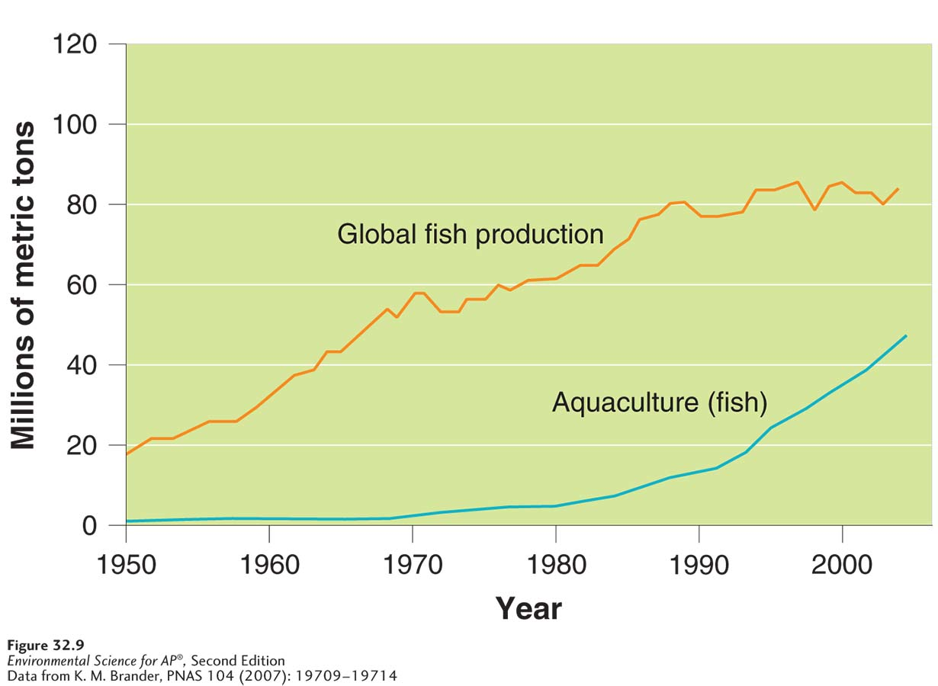
Aquaculture’s Impact
Global fish production. Global fish production has increased by more than 30 percent since 1980 due to aquaculture.
The graph shows data for aquaculture-raised fish (blue) and global fish production (orange), which includes both wild-caught fish and aquaculture-raised fish.

Slide 34
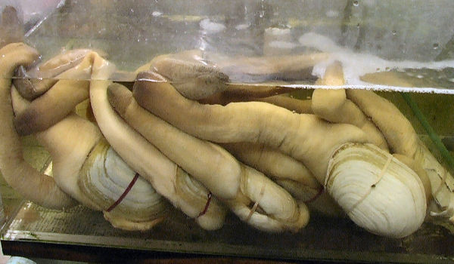
Taylor Shellfish Video
Taylor Shellfish in Shelton is world’s largest oyster producer
https://www.youtube.com/watch?v=QRmWXKbKQYw
http://www.dnr.wa.gov/programs-and-services/aquatics/shellfish/geoduck-aquaculture

