Slide 1
APES 1/22/18
Please take out your Chapter 11 Reading Guide
I’ll be checking off Module 33
You also need a computer
You need a textbook to share

Slide 2
Module 33
B
C
D
E
B

Slide 3
End of Chapter 11
C 11. B
E 12. E
D 13. C
B 14. D
B 15. E
A 16. B
B 17. E
C 18. C
E 19. B
B 20. E

Slide 4
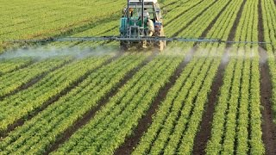
Environmental Impacts of the Green Revolution

Slide 5
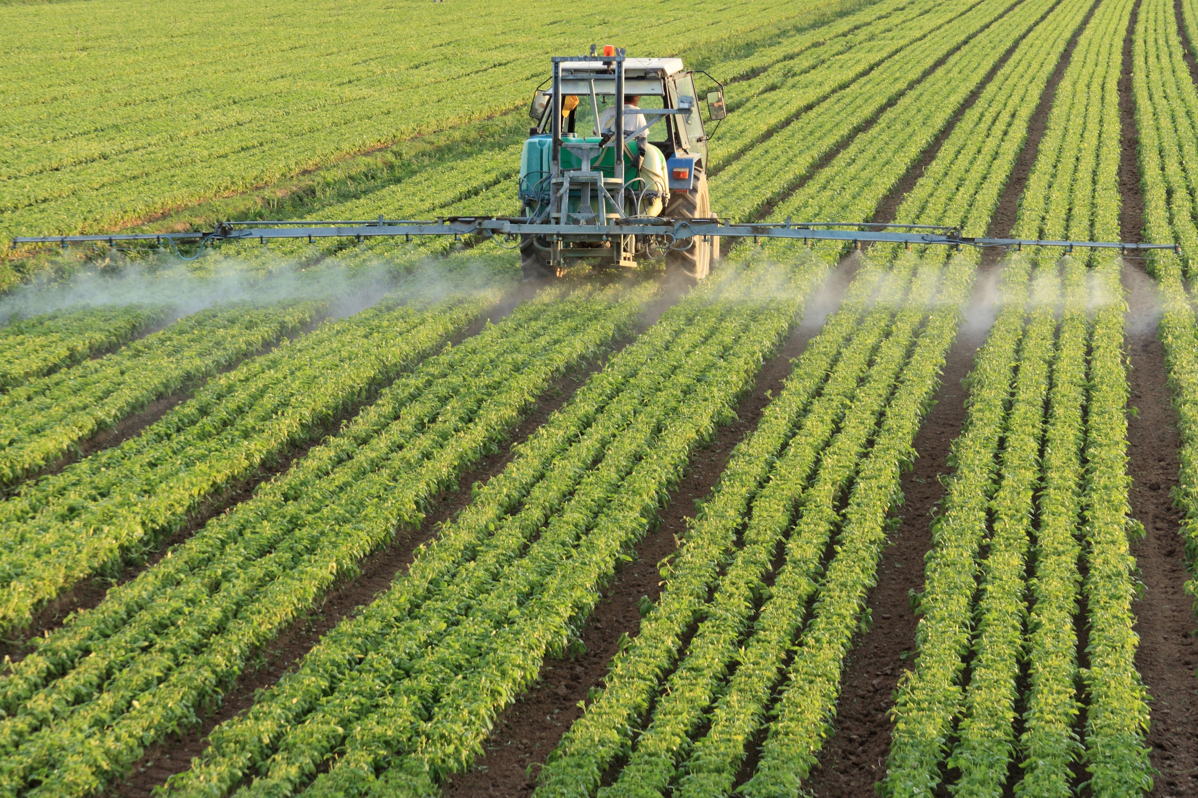
The Green Revolution: Fertilizers
Organic fertilizer Fertilizer composed of organic matter from plants and animals.
Synthetic fertilizer Fertilizer produced commercially with the use of fossil fuels.
Huge amount of N, P, K added

Slide 6
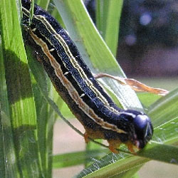
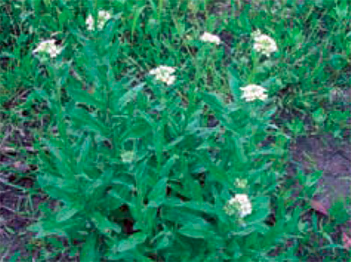
The Green Revolution: Pesticides
Pesticide: A natural or synthetic chemical, that kills/controls insects and other pests
Can be selective or broad-spectrum
Can be persistent (stay around for a long time) or non-persistent
Can be insecticides (target bugs)or herbicides
(target plants)
Army worms and Hoary Alyssum
http://ipm.ncsu.edu/AG271/contents.html
http://www.ipm.msu.edu/agriculture/field_crops/identifying_weeds_in_field_crops

Slide 7
The Green Revolution: Pesticides
Pesticide resistance: survival of the fittest; some plants survive and reproduce
Causes Pesticide treadmill: cycle of pesticide development pest resistance new pesticide development.

Slide 8
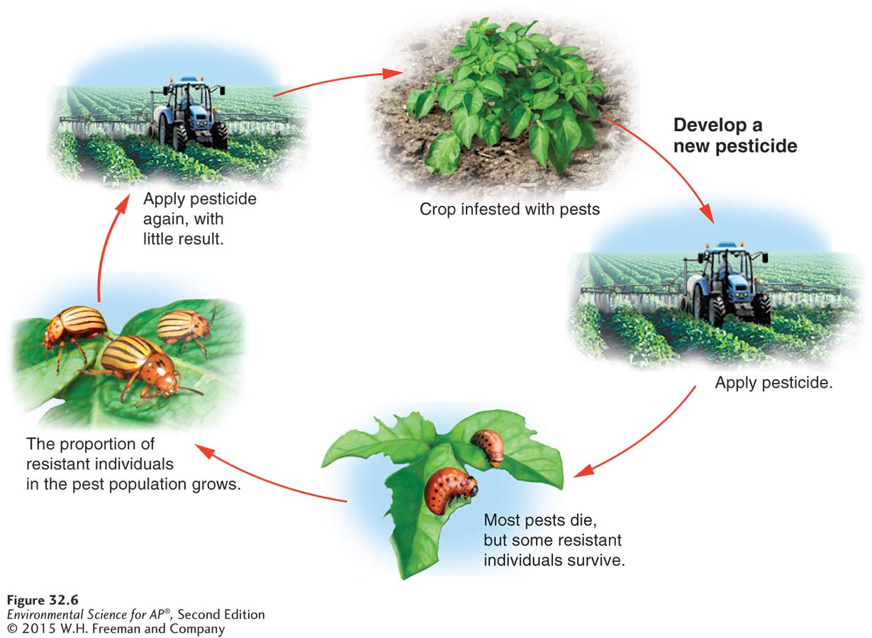
The Green Revolution: Pesticides

Slide 9
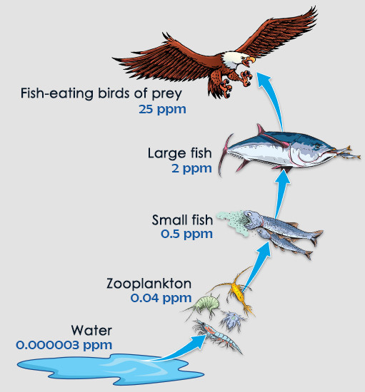
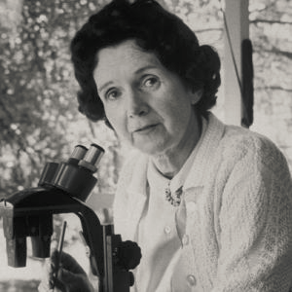
Silent Spring by Rachel Carson
1962: Marine biologist Rachel Carson publishes Silent Spring and raises awareness of DDT’s harmful effects
DDT: broad spectrum pesticide (banned in US in 1972)
Builds up in predatory bird species to toxic levels by biomagnification
Why? Each consumer level has to eat numerous of the one below to survive!

Slide 10
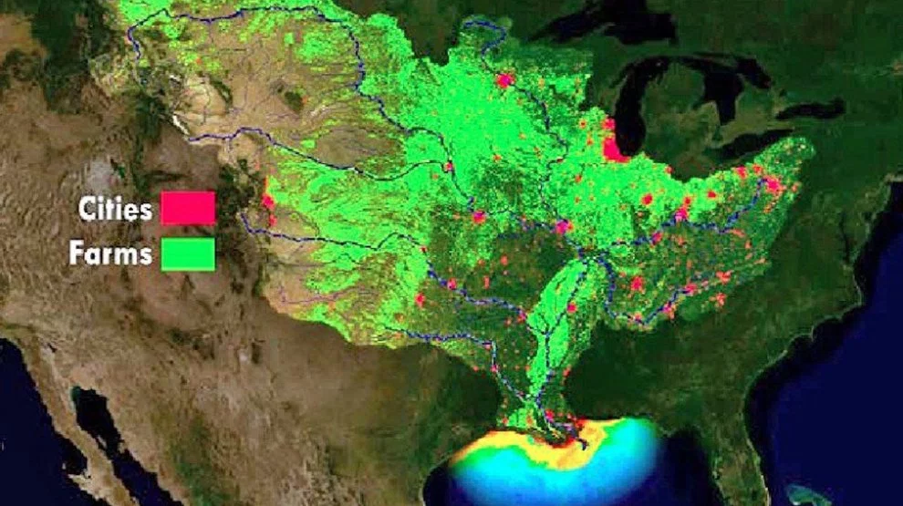
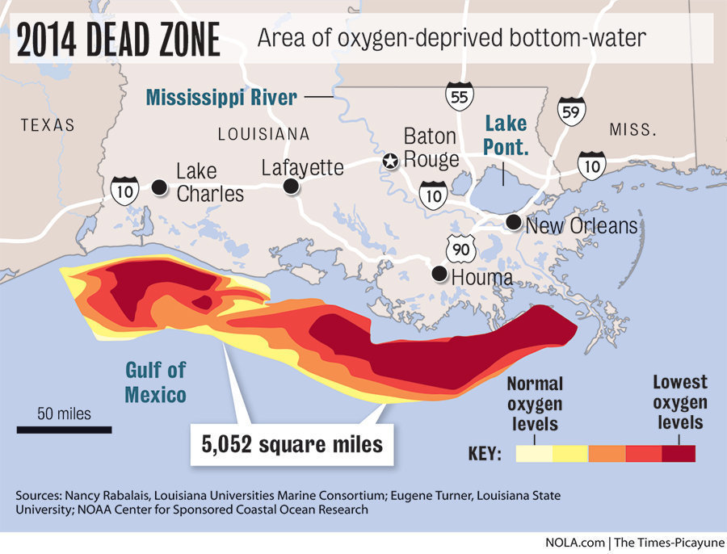
Environmental Consequences of Agribusiness

Slide 11
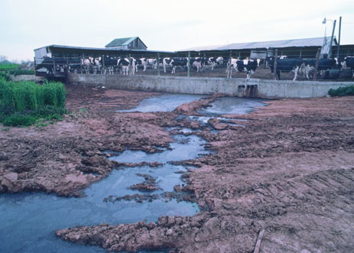
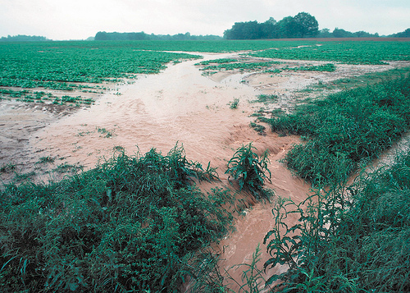
Soil Degradation by Harvesting
Huge, heavy machinery harvests all plants, exposing topsoil to erosion by wind/water
Erosion clogs nearby streams and pollutes with fertilizer/animal waste run-off
Algal blooms kill off aquatic life

Slide 12
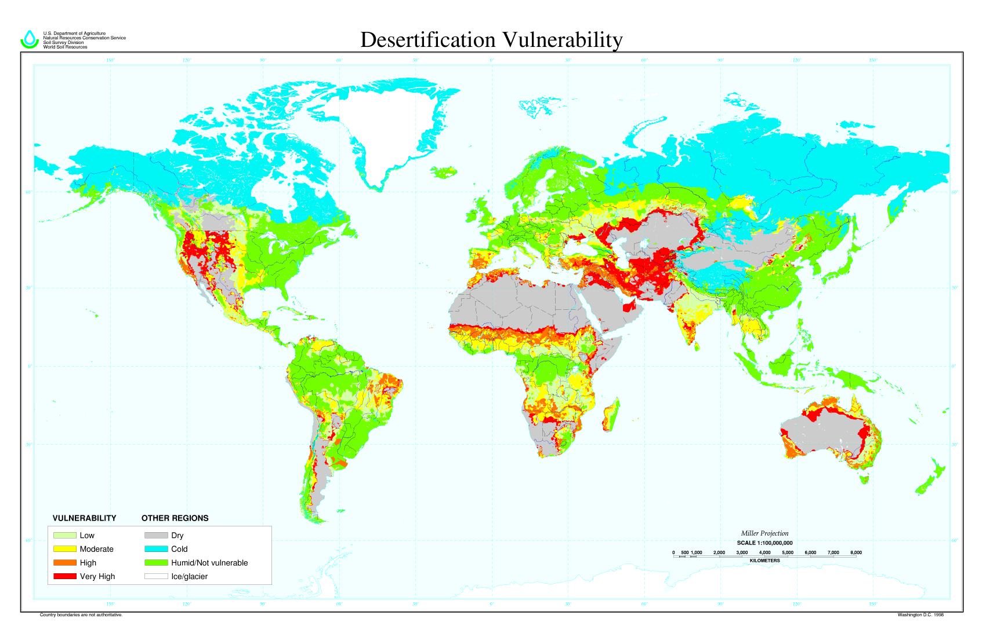
Desertification
1/3 of world’s arable (farmable) land has been lost to desertification or other degradation (WWF.com)
Repeated loss of fertile topsoil makes land infertile

Slide 13
Soil Degradation by Irrigation
Irrigation creates:
Waterlogging: Soil remains under water for prolonged periods, causing roots to rot
Salinization: Small amount of salts in irrigation water becomes concentrated on the soil surface through evaporation.

Slide 14
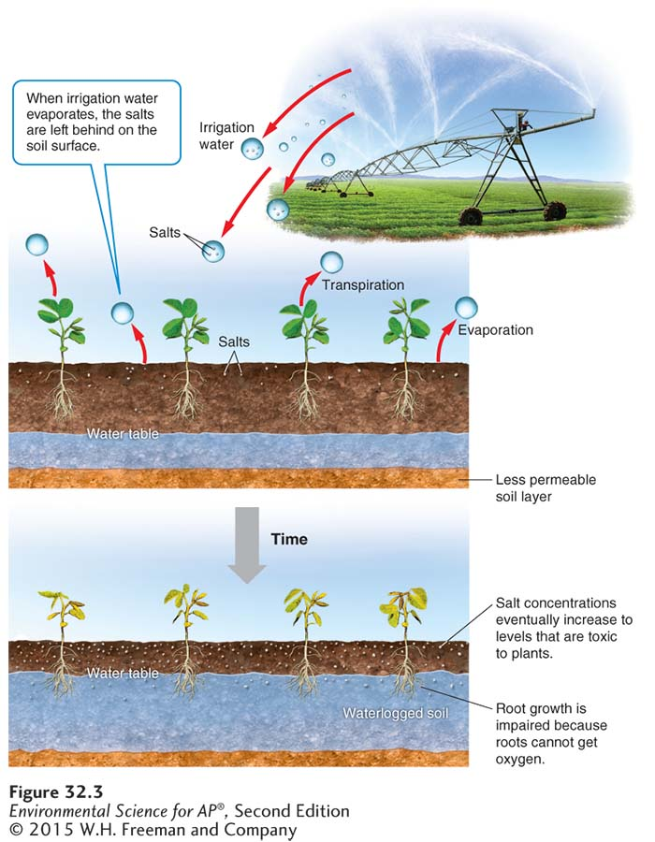
Soil Degradation by Irrigation

Slide 15
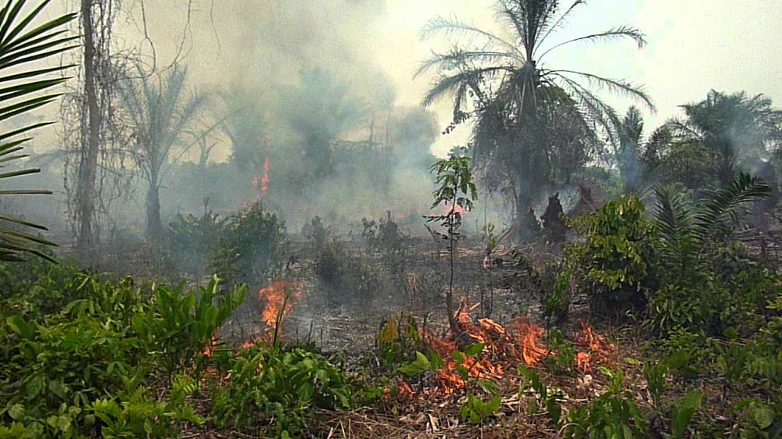
Slash and Burn Agriculture
Used most often in Stage 2 countries
Major source of deforestation
Making room for palm oil plantations

Slide 16
Relevant Laws
1996: Food Quality Protection Act
EPA sets limits on combined pesticide exposure
EPA = Environmental Protection Agency
Enforced by FDA (Food and Drug Admin.) and USDA (U.S. Dept. of Agriculture)

Slide 17
Sustainable Video
Look for examples of the methods in Module 33
Organic agriculture
No till farming
Integrated pest management
Contour plowing
Crop rotation
Agroforestry
Intercropping

Slide 18
Chapter 8 and 10 Test
MC out of 27
FRQ out of 10

Slide 19
Homework
Choose TWO of the articles about pesticides on my website.
Read them and fill in half of the pesticides chart

