Slide 1
APES 10/26
Please log in to a computer.
Period 3: turn in your convection currents lab and take out your Chapter 4 Reading Guide
Grab a textbook to share.

Slide 2
Chapter 4 Multiple Choice Answers
Module 9:
E
B
B
C
C
Module 10:
B
A
C
A
D
A
D

Slide 3
Chapter 4 Multiple Choice Answers
Module 11
E
B
B
If polar water as cold and salty due to melting glaciers, it won’t sink as well and create thermohaline circulation
4. A
It would cause decreased upwelling, because warm surface waters aren’t being blown away and replace with colder, nutrient rich waters
5. D Gyres don’t involve the deep ocean

Slide 4
EcoColumns Time
Measure/record pH, temp, D.O., nitrate, phosphate, observations, and additions/subtractions
Write your change in nitrate, phosphate, and D.O. on the whiteboard for discussion

Slide 5
Homework for Tuesday
Ecocolumn reflection #2: Biogeochemical cycles
Handout found in Google classroom, but do on paper.
FYI: Test on Chapters 3-4 next Thursday. No Module 8 or Aquatic/terrestrial biomes.

Slide 6
Where we’ve been
Air currents and their effects on climate
http://www2.palomar.edu/users/pdeen/animations/23_weatherpat.swf

Slide 7
Ocean Currents
Notes:
http://oceanservice.noaa.gov/education/yos/resource/JetStream/ocean/circulation.htm

Slide 8
Ocean Currents
Warm currents flow away from the equator.
Cold currents flow toward the equator.
Caused by unequal sunlight, wind, Coriolis effect, gravity

Slide 9
Unequal Energy from the Sun
Energy from the Sun heats the water.
Warm water is less dense, so it rises and cold water sinks.
As warm water rises, cold water moves it to replace it.
It’s convection of water!

Slide 10
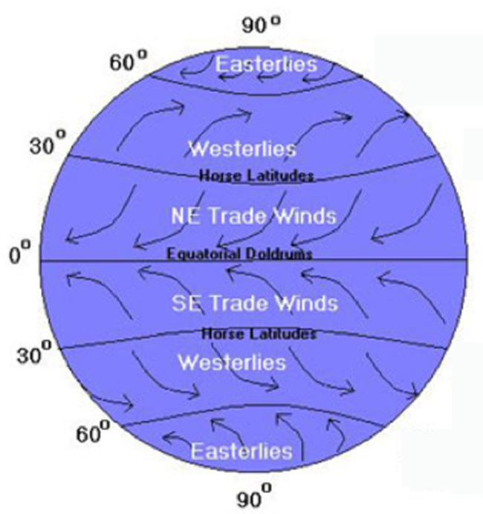
Wind and Surface Currents
Winds blow across the surface of the water, causing surface currents
Make up 10% of ocean water
Up to maximum depth of 400 m

Slide 11
Surface Currents
Notes:
http://upload.wikimedia.org/wikipedia/commons/c/cc/Ocean_surface_currents.jpg

Slide 12
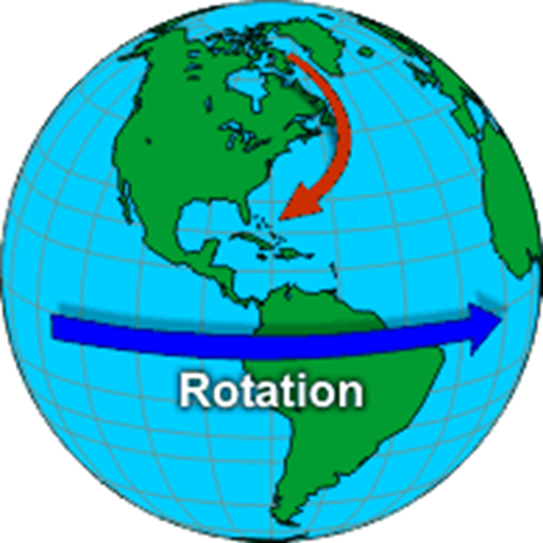
The Coriolis Effect
Causes water to move to the right in the Northern Hemisphere
Causes water to move to the left in the Southern Hemisphere
https://www.youtube.com/watch?v=i2mec3vgeaI

Slide 13
Gyres
Vertical columns or mounds of water at the surface and flow around them
Produce enormous circular currents
Five major locations:
North Pacific - clockwise
South Pacific - counterclockwise
Indian Ocean - counterclockwise
South Atlantic - counterclockwise
North Atlantic - clockwise

Slide 14
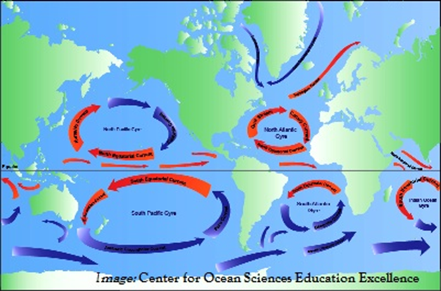
Oceanic Gyres
Notes:
http://commons.wikimedia.org/wiki/File:Oceanic_gyres.png

Slide 15
Gulf Stream
A strong surface current
Begins at the tip of Florida
Flows up the eastern coastline of the U.S.
Crosses the Atlantic Ocean
Causes warmer climate in NW Europe

Slide 16
Upwelling
Winds and Coriolis deflect surface waters
As less dense surface water moves off shore, cold, deep, denser waters come to the surface to replace them.
Major source of nutrients from the benthic layer
Areas with upwelling tend to have greater food chains/fisheries!

Slide 17
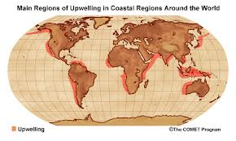
Upwelling
Notes:
http://oceanmotion.org/html/background/upwelling-and-downwelling.htm

Slide 18
Deep Water Currents
Make up about 90% of ocean water
Differences in density cause them to move
Caused by diff. temperature and salinity
Mixing of surface and deep water called Thermohaline Circulation
Crucial for heat energy and nutrient transport globally

Slide 19
The Great Ocean Conveyor: Helps maintain Earth’s Balance
Notes:
http://oceanservice.noaa.gov/education/yos/resource/JetStream/ocean/circulation.htm

Slide 20
Thermohaline Circulation
When polar water freezes or evaporates, it leaves behind saltier water.
The cold, salty water sinks because it is denser
Warmer surface currents rise and flow in the opposite direction
Convection

Slide 21
Ocean Currents & El Nino
Ocean currents move in a predictable way, also due to unequal solar energy and the Coriolis Effect.
https://earth.nullschool.net/
However, sometimes these currents move in an abnormal way!
http://esminfo.prenhall.com/science/geoanimations/animations/26_NinoNina.html

Slide 22
El Nino
Abnormally high surface ocean temperatures off the coast of South America
Causes unusual weather patterns across
the globe

Slide 23
El Nino
Starts because the easterly trade winds weaken and allow warm waters in the W. Pacific to move east toward South America
Causes rain where it usually doesn't occur and drought where it usually rains

Slide 24
El Nino Winter
Notes:
http://www.srh.noaa.gov/crp/?n=education-elninoandlanina

Slide 25
El Nino Summer
Notes:
http://www.srh.noaa.gov/crp/?n=education-elninoandlanina

Slide 26
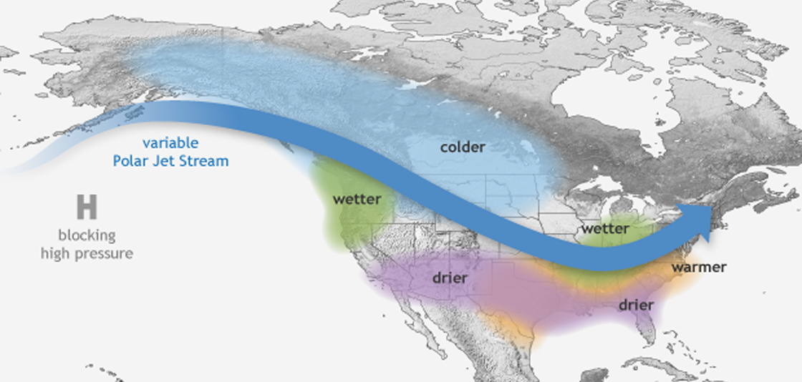
La Nina- exactly the opposite

Slide 27
Ocean Currents & El Nino
Ocean currents move in a predictable way, also due to unequal solar energy and the Coriolis Effect.
https://earth.nullschool.net/
However, sometimes these currents move in an abnormal way!
http://esminfo.prenhall.com/science/geoanimations/animations/26_NinoNina.html

