Slide 1
Apes 10/31
Please put ecocolumn reflection #2 in the inbox
Get a laptop

Slide 2
Today:
review/demo ocean currents (20)
October current event- in google classroom (30 minutes of work + 10 minutes to discuss)
Test topics (5)
Biomes project overview/begin

Slide 3
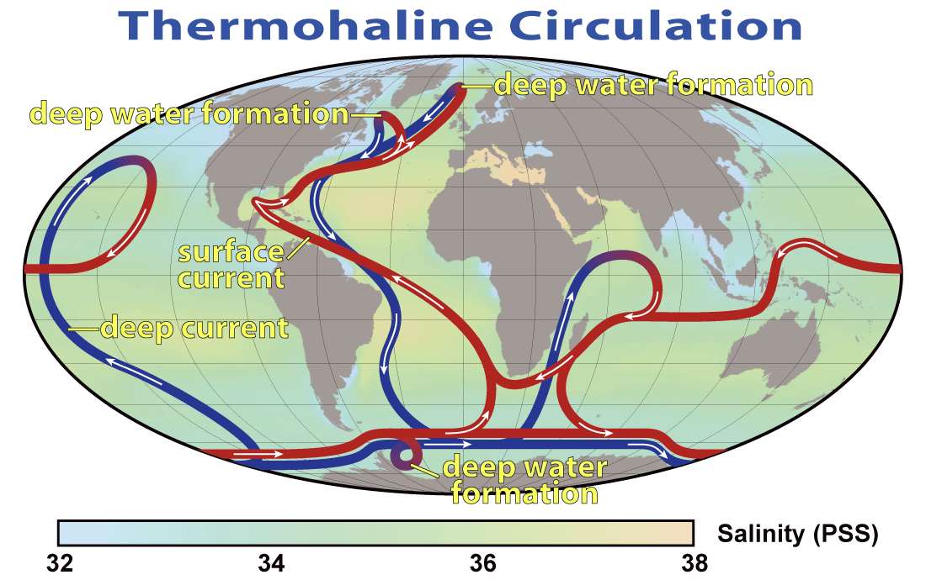
Surface vs. Thermohaline Currents
Surface currents are moved by sun/wind/Coriolis
Cold Thermohaline currents are deeper and driven by gravity/density
They interact because warm water rises near the equator, and cold, saltier water sinks at the poles

Slide 4
Ocean circulation demo
I will add the following to the box of water:
25 ml ice water (blue)
25 ml hot water (red)
25 ml ice water with salt (green)
25 ml room temp water with salt (yellow)
How will the layers arrange themselves
and why?
How does each layer fit into the ocean circulation model?

Slide 5
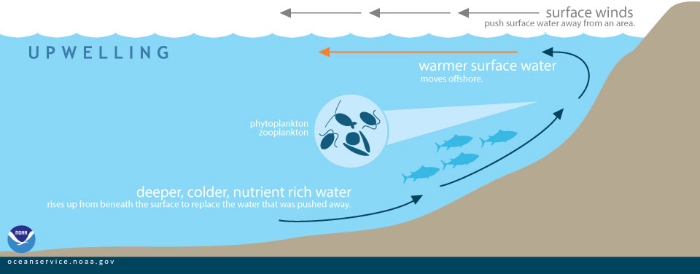
Upwelling: another phenomenon that occurs

Slide 6
October current event
Find it in Google classroom- we will complete and discuss it in the next 40 minutes!

Slide 7
Test on thursday
Chapter 3: module 6 (the movement of energy), 7 (the movement of matter)
Chapter 4: module 9 (the unequal heating of earth), 10 (air currents), 11
(ocean currents)
About 35 mc and 1 frq
Study your notes and reading guides!

