Slide 1
Apes 10/10
Welcome back!
Please take out your nutrient cycles packet

Slide 2
Soil salinization lab- 28 points
Question: 2 pts.
Hypothesis: 2 pts.
Sample calc: 2 pts.
Data table: 4 pts.
Graph: 4 pts.
Clevr conclusion: 6 points
8a: 4 pts
8B: 4 pts.

Slide 3
Ecocolumns: today’s tasks
Fill your aquatic chamber about 2/3 full bucket water
Add rinsed gravel, elodea (plant) and a fish!
Make a shared data table with these measurements and dates:
10/10, 10/16, 10/26, 10/31, 11/6
pH, nitrate, phosphate, temperature, dissolved oxygen, items added/subtracted
4. Rotate through the stations to get your measurements. D.O., nitrate, and phosphate take a while!

Slide 4
Homework: module 7 in ch. 3 reading guide
Do module 7 + end of module 6 + 7 multiple choice!

Slide 5
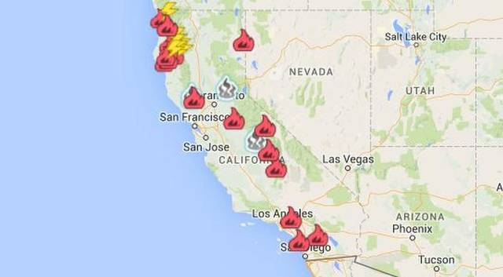
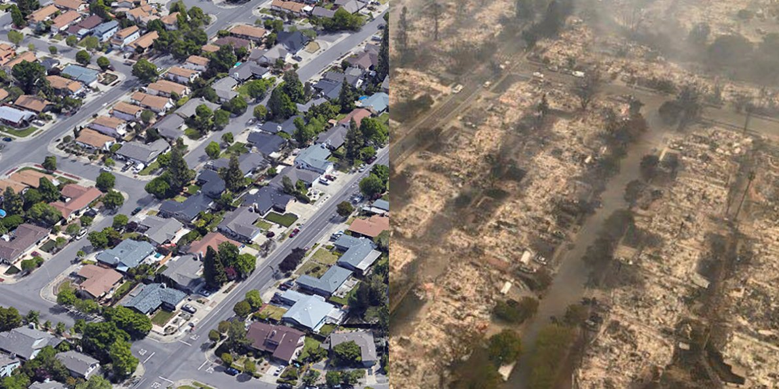
https://www.nytimes.com/interactive/2017/10/05/climate/trump-environment-rules-reversed.html

