Slide 1
APES 11/15
Get a computer and find your endangered species case study
Do this Mental warm-up:
Why is biodiversity important?
Why is measuring biodiversity important?

Slide 2
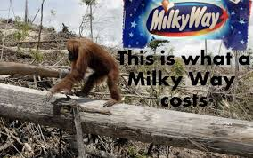
Endangered Species Share-Out
Each person gets 3 minutes
TYPE the major threats, how humans are using the organism/habitat, and whether it is protected by CITES/ESA into your notes for each organism.

Slide 3
Measuring Biodiversity
Using a biodiversity index
Scientists use different biodiversity indices depending on the situation
We will use the Simpson index to measure biodiversity on a scale of 0-1 (1 = most biodiverse)
Takes into account:
Species richness- total # species in one area
Species evenness- how evenly distributed the species are

Slide 4
Evenness vs. Richness

Slide 5
Simpson’s Index Practice
D is the Simpson’s Index
n is the total number of organisms of a particular species
N is the total number of organisms of all species
∑ means “add up”!
D = 1-
∑ n(n - 1)
N(N - 1)

Slide 6
Simpson’s Index Practice
n
n - 1
n(n - 1)
D
∑ n(n - 1)
= 1-
N(N - 1)
Species A | 12 | 11 | 132
Species B | 3 | 2 | 6
Species C | 7 | 6 | 42
Species D | 4 | 3 | 12
Species E | 9 | 8 | 72
∑ n(n - 1) |  |  | 264
Numerator

Slide 7
Biodiversity Lab
Do the Pre-Lab to practice your Simpson skillz
Make your prediction
Half your group will collect data and calculation the index # for the student lot
The other half will do the faculty lot
This entire lab is due next time! Finish it today!

Slide 8
Invasive Species
Remember, Invasive Species are one of the 6 threats to biodiversity:
Habitat Destruction/Fragmentation
Invasive Species
Population Growth
Pollution
Climate Change
Overexploitation
www.youtube.com/watch?v=Q0Nk9EJpQWU

Slide 9
Native vs. Alien
Native Species = species that live in their historical range; thrive there due to natural selection
Endemic species = only live in a small area; at greatest risk (i.e. hot springs fish)
Alien Species = species living outside its historical range
Invasive Species= alien species that spreads rapidly across large areas

Slide 10
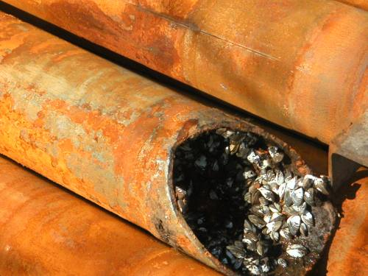
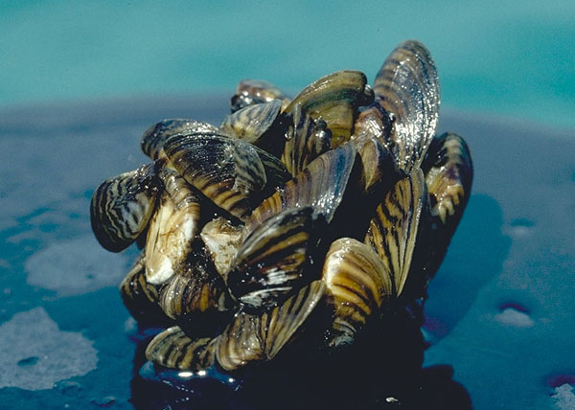
Example: Zebra Mussels
Native to Black Sea and Caspian Sea (Europe, W. Asia)
Cargo ships carrying seawater came over to St. Lawrence River and the Great Lakes in the 1980’s and dumped their unneeded water
Zebra mussels colonized the Great Lakes, killing off native mussels
Can multiply so fast (1 female = 30,000 eggs) that they clog industrial pipes!

Slide 11
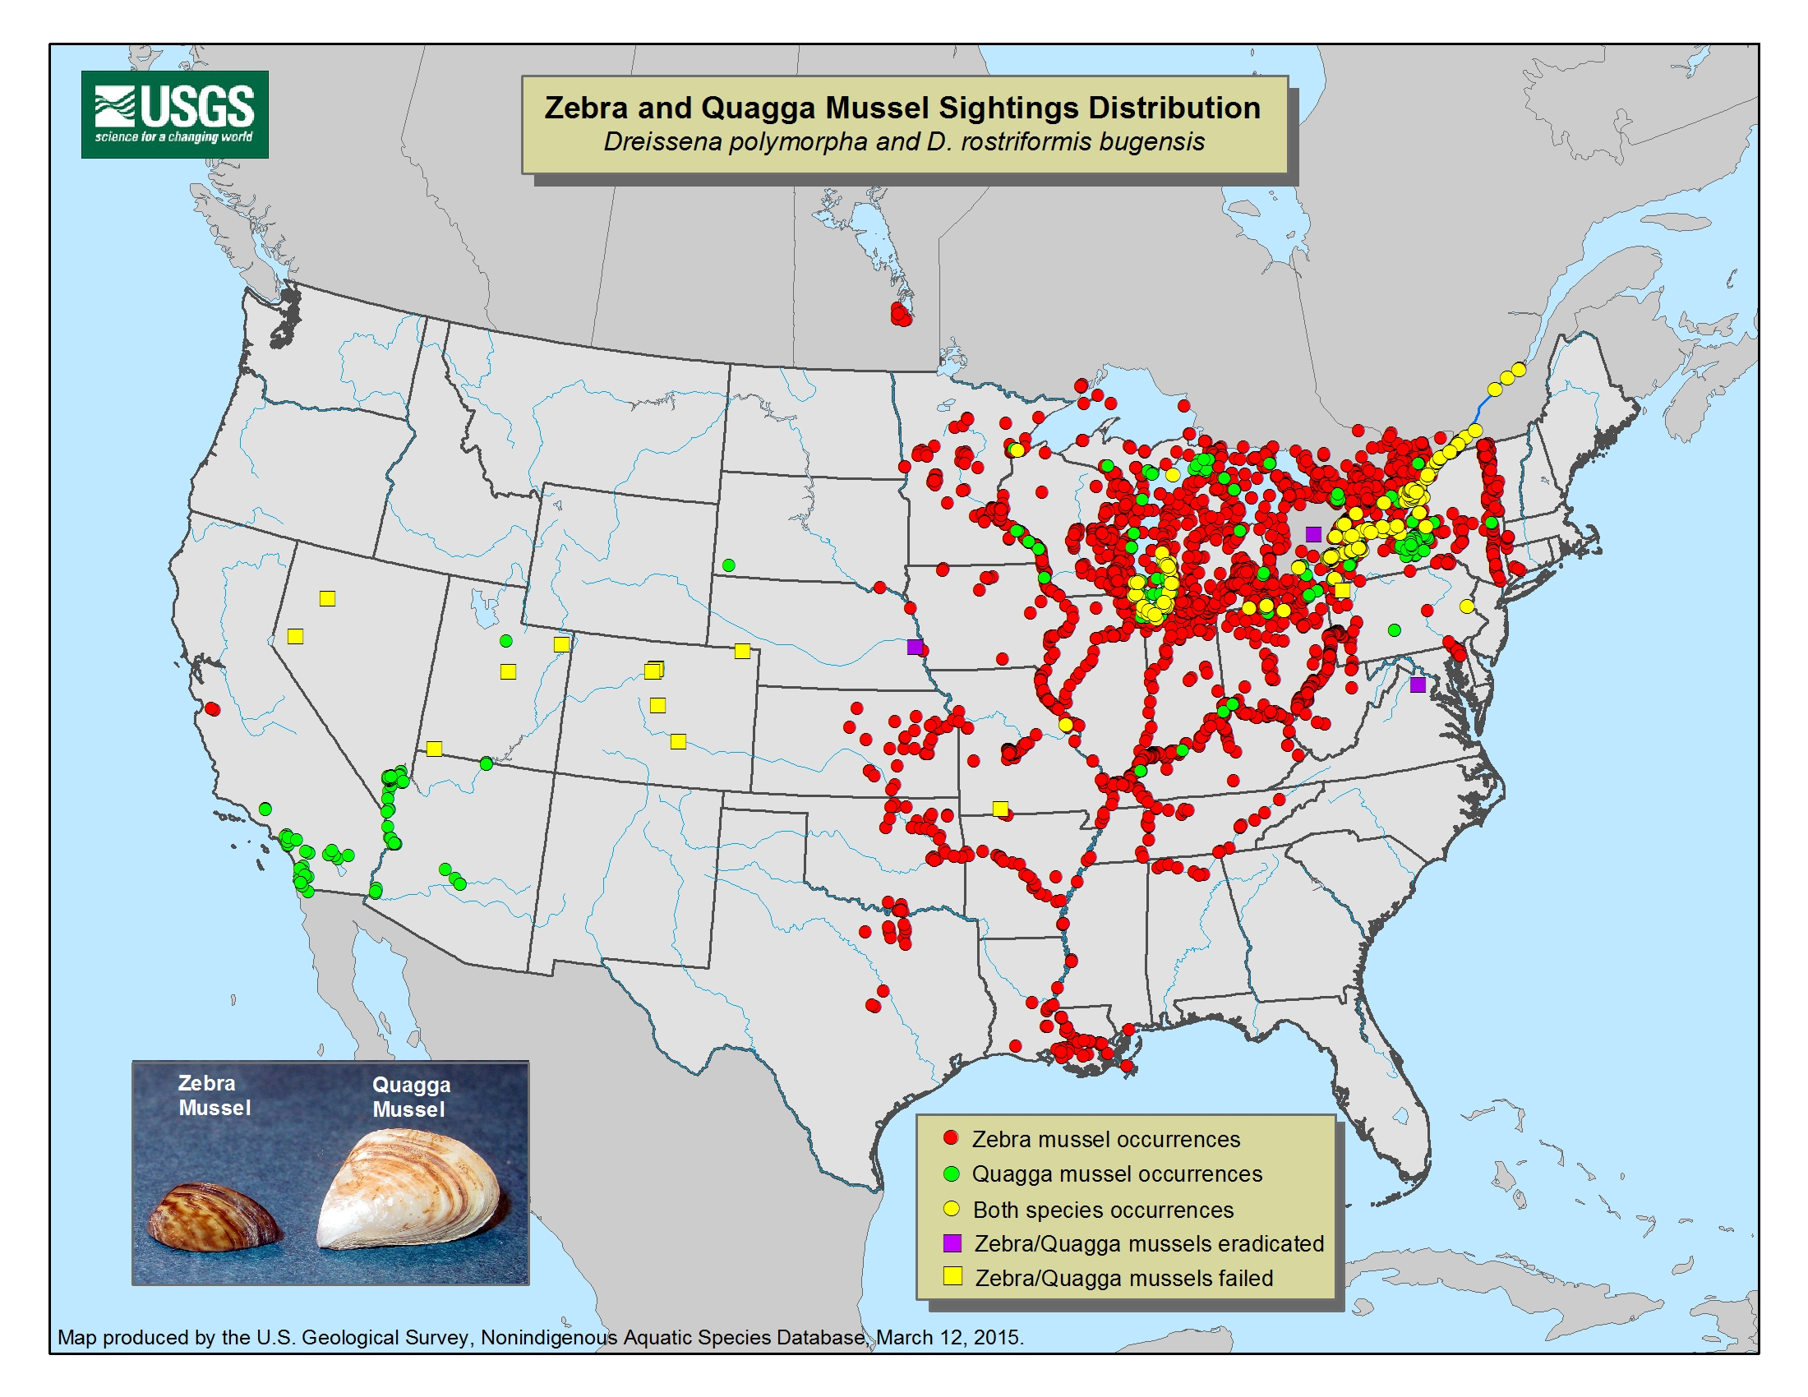
http://wdfw.wa.gov/ais/dreissena_polymorpha/
/

Slide 12
Due Next Time
Biodiversity Lab
Zebra Mussels FRQ- do not copy the internet

