Slide 1
APES 11/17
Take out your Invasive Species FRQ for scoring
Turn in your Biodiversity Lab
Grab a book and computer

Slide 2
Invasive Species FRQ Scoring
Trade and Grade!
Use pages 11-14 in the online scoring guide

Slide 3
Invasive Species Research
For your species:
1. What they look like
2. Where they’re from
3. Current range
4. How they spread
5. Why they are so effective at colonizing new area
6. Consequences to native ecosystems
Number off by 4’s
1’s: Asian carp
2’s: Scotch broom
3’s: Lionfish
4’s: Asian longhorn beetle

Slide 4
 | What they look like | Where they’re from | Current Range | How they spread | Why Effective? | Consequences
Asian Carp
Scotch Broom
Lionfish
Asian Longhorn Beetle

Slide 5
Module 15-16 Check for Understanding
Find your Chapter 5 + 18 Reading Guide
Highlight where you defined the following key terms:
Microevolution vs. Macroevolution
Artificial selection
Gene flow
Genetic drift
Bottleneck effect
Founder effect
Allopatric speciation
Sympatric speciation

Slide 6
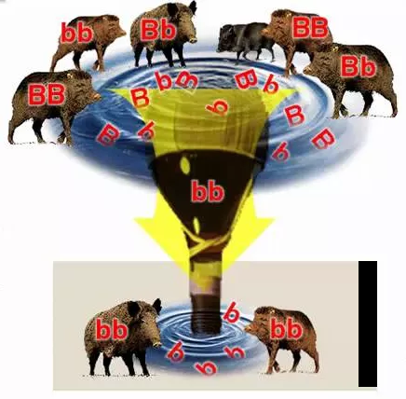
This is an example of ____ because_____.

Slide 7
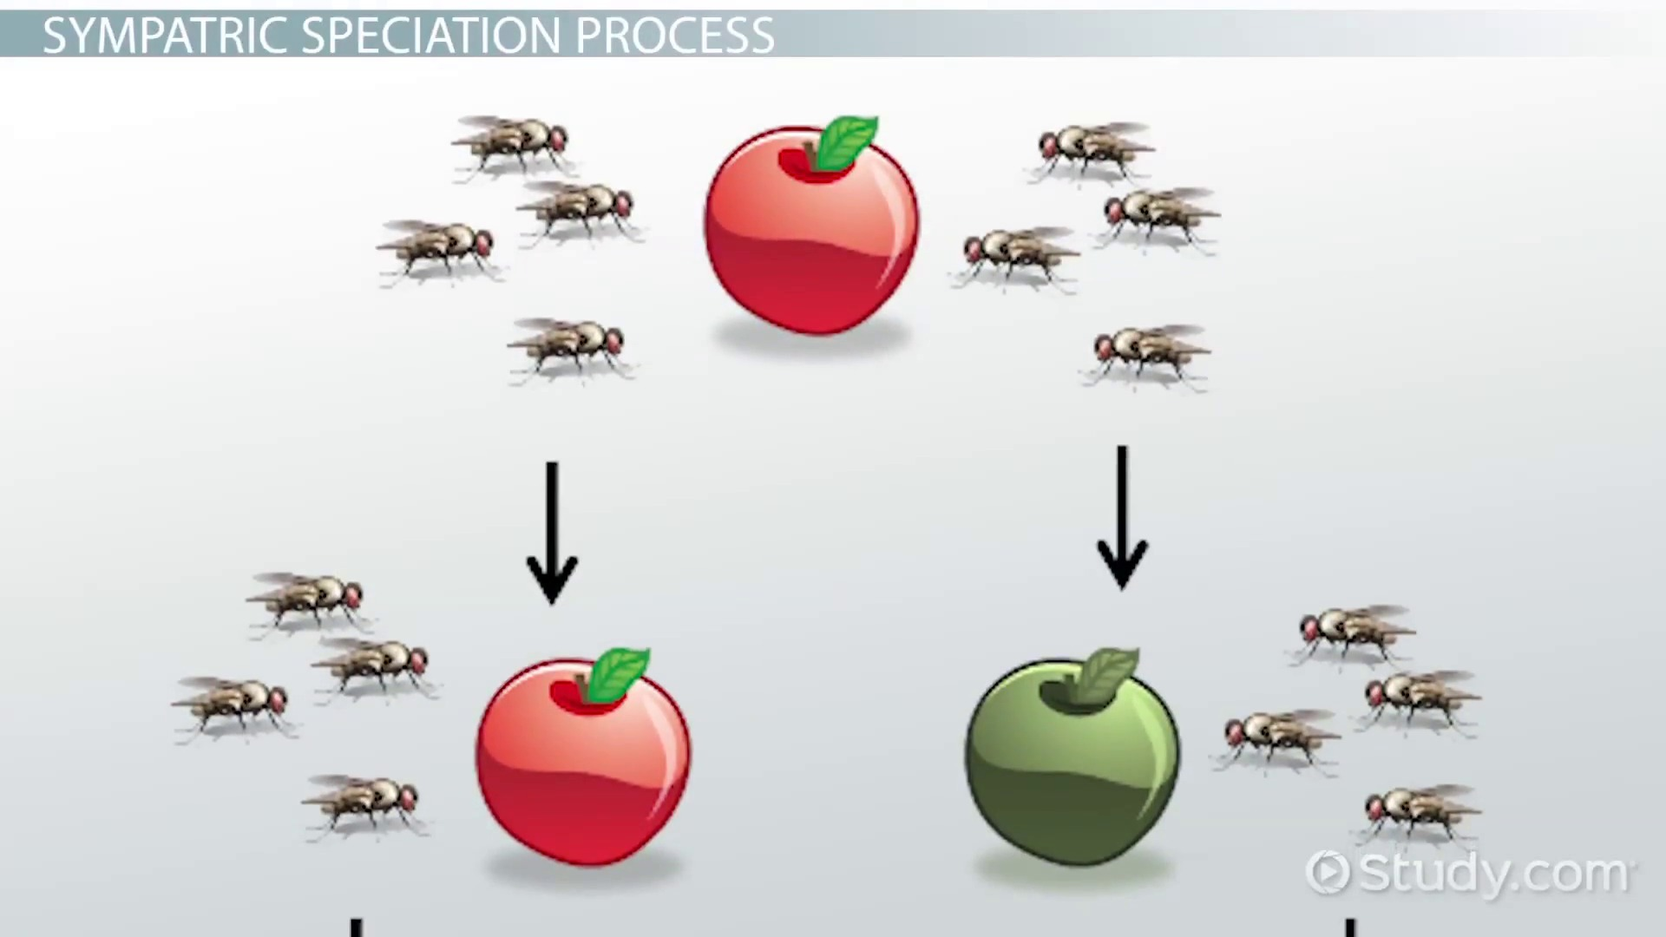
This is an example of ____ because_____.

Slide 8
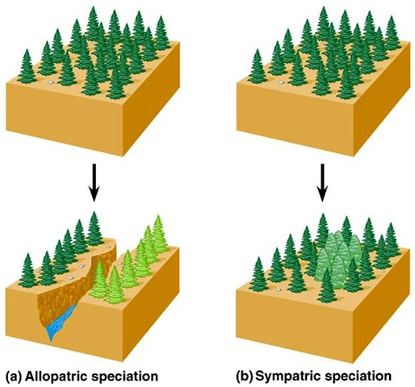

Slide 9
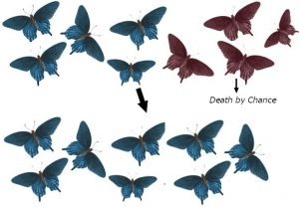
This is an example of ____ because_____.

Slide 10
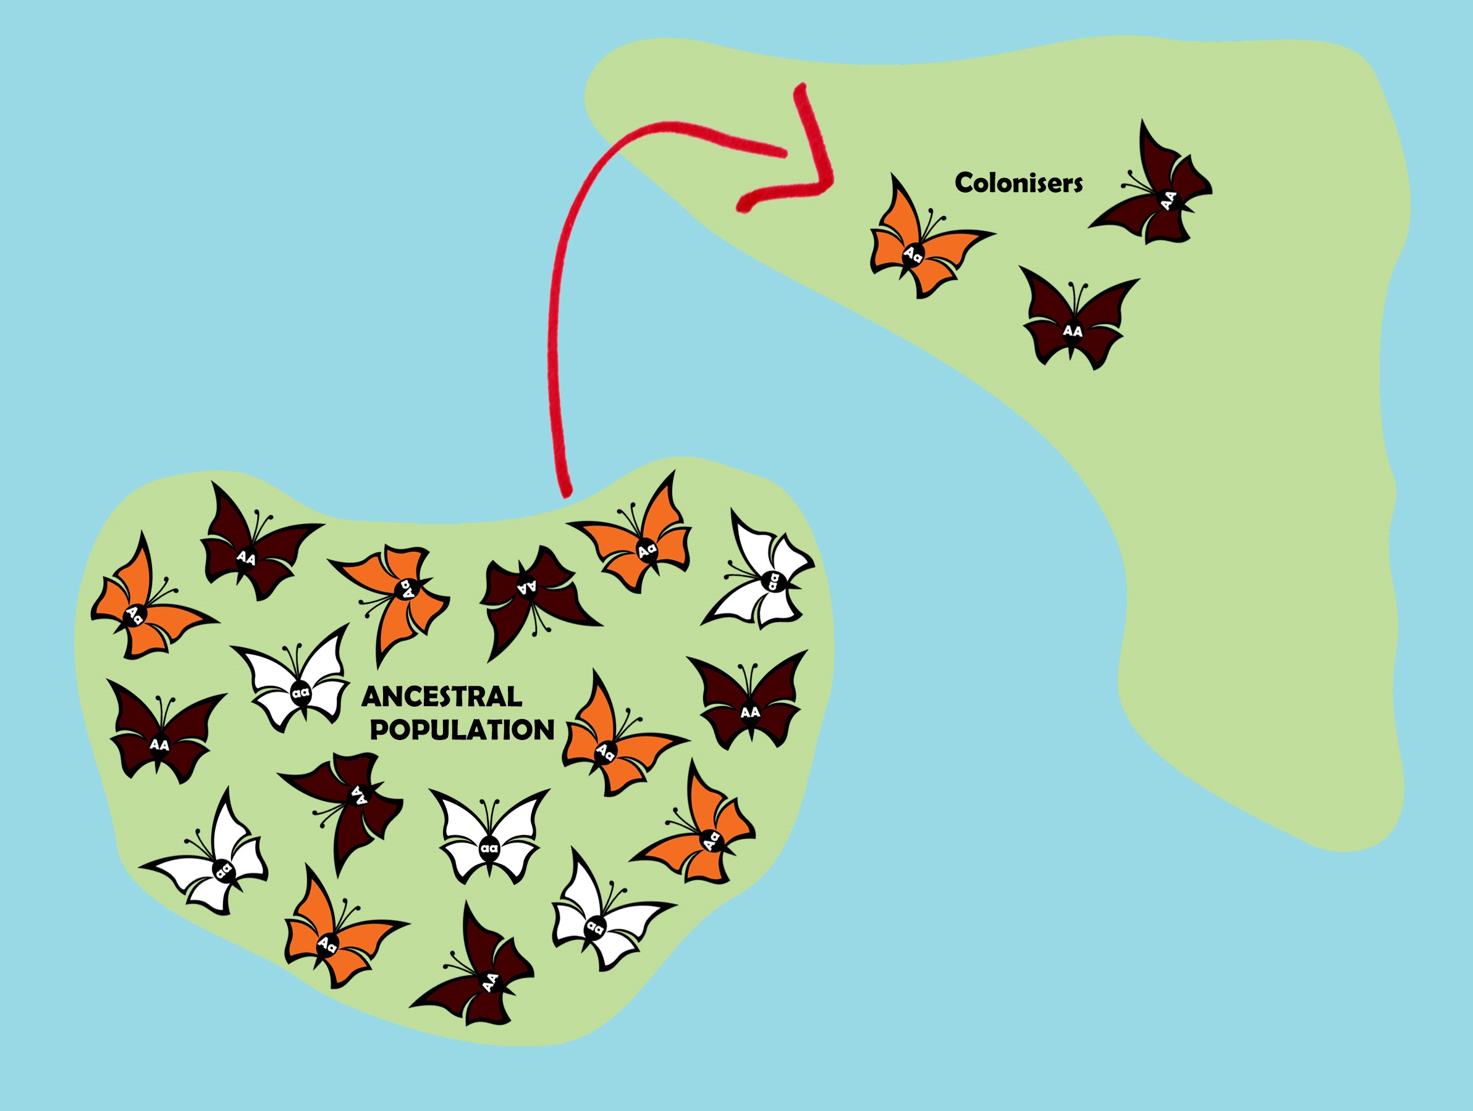
This is an example of ____ because_____.

Slide 11
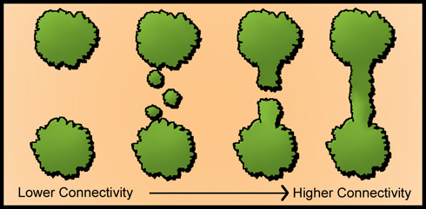
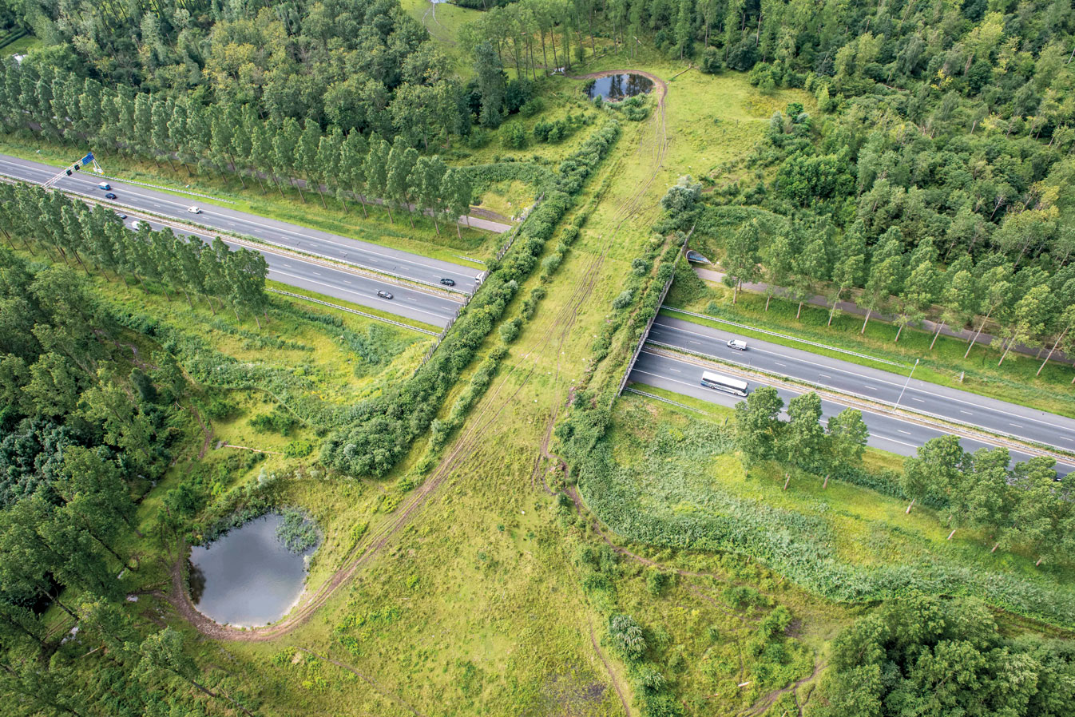
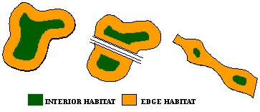
Notes Time- extra terms/laws
Habitat corridor: a stretch of land connecting habitats; ensures gene flow and maintains genetic biodiversity
Edge habitat: Area where two communities meet. It is ideal to protect large areas of land instead of many small, because otherwise the interior species don’t have enough land.

Slide 12
Notes Time- Extra terms/laws
1. Endangered Species Act and CITES- know these
https://www.nbcnews.com/politics/politics-news/trump-administration-lifts-ban-importing-heads-hunted-elephants-n821331
2. Lacey Act (1900): a U.S. Act that prohibits the shipping/trade of illegally harvested plants and animals between states
3. Marine Mammal Protection Act (1972): prohibits import/export of marine mammal parts and killing of marine mammals (US only)
https://news.nationalgeographic.com/2016/09/wildlife-taiji-dolphin-hunt-begins/

Slide 13
Due Next Time
Chapter 6 Reading Guide

