Slide 1
APES 12.19
Please take out modules 24 and 25 for check-off!
Get a computer for short notes

Slide 2
Module 25 Multiple Choice
D- acid rain only causes chemical weathering. Erosion is a natural process
E- main soil formation factors are climate, parent material, topography, organisms, time
D- correct horizon order is OE/ABC
A- clay isn’t as permeable and won’t allow as much water to seep out
E- aluminum would lower the base saturation because (Al and H are the main soil acids)
E- tailings are the waste materials from mining

Slide 3
Homework Accuracy Check
Module 24: #7
Module 25: #8

Slide 4
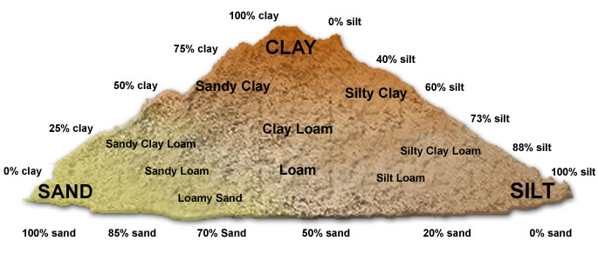
Soil Formation and Properties

Slide 5
Soil Formation
The type of soil found in an ecosystem is determined by:
Parent material (underlying rock)
Climate (affects amount of decomp., types of vegetation)
Topography (losing/gaining sediment from erosion)
Organisms (decomposers, detritivores, etc.)
Time (usually more time = more nutrients)

Slide 6
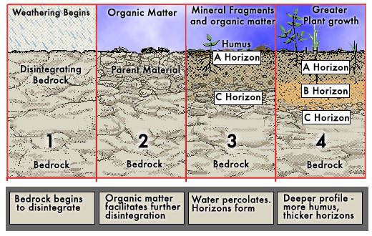
Soil Formation

Slide 7
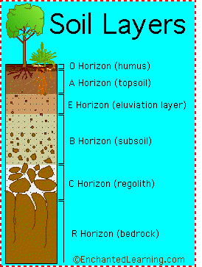
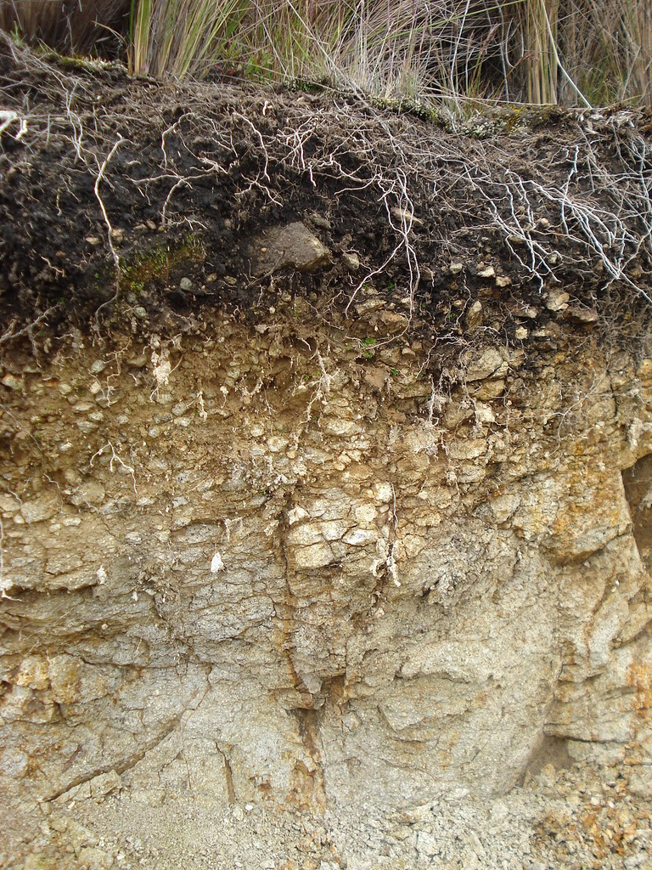
Soil’s profile is made up of several distinct horizontal layers called Horizons

Slide 8
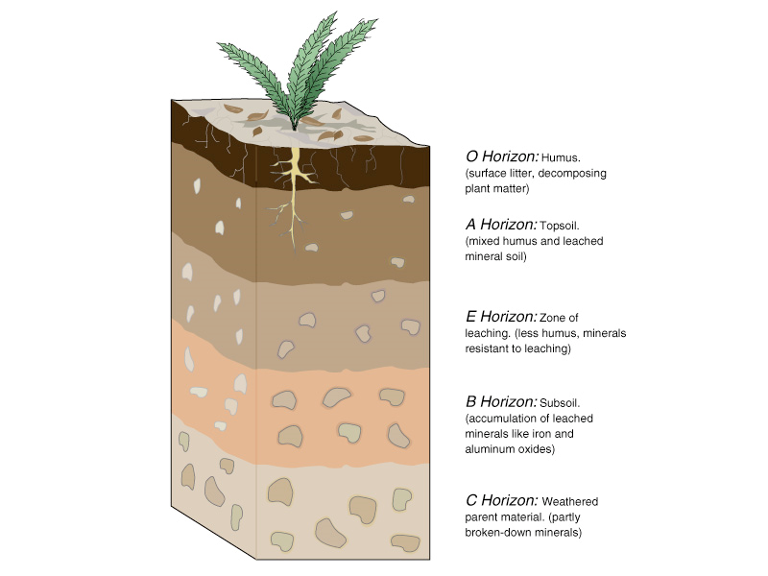
O Horizon – “Organic” Layer, contains dead/decomposing plants & animals; supplies nutrients for the soil
A & E Horizon – Topsoil (darker brown); where majority of roots located, thickness dependent on amount of decomposed material
B Horizon – Subsoil (Lighter/Cinnamon) ; materials from A & O deposited, few roots
C Horizon – Parent material (gray); weathering of this horizon creates upper horizons

Slide 9
Leaching and Accumulation
From the top → Decomposition and the leaching of water through the soil move nutrients
From the bottom → Weathering causes the parent material to break apart

Slide 10
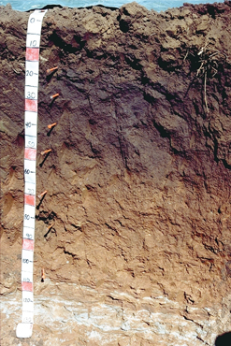
Soil Profile
O
Eluviation/Zone of Leaching – water percolates down the soil, transporting materials. Happens in Horizons A & E
A
E
Illuviation/Zone of Accumulation – where transported materials are deposited. Happens in Horizon B.
B
C

Slide 11
Soil Analysis Lab

Slide 12
Soil Lab Steps
Do this on the provided graph paper.
Intro: Summarize the three soil types and their relative ability to create a healthy environment.
Test 1: Just do 1-4 today. Leave your labeled container out over break. Also do the “feel test” and record results.
3. Test 2: Soil Porosity (percent pore space)
Read the background and answer:
- What is porosity and why is it important?
- What is a rock type with high porosity? Low
porosity?

Slide 13
Soil Lab Steps
Test Two: Porosity
Calculation:
[Vol. of water (represents blank space)/total volume]/100
Do this for all three samples (sand, gravel, your sample)
Dump samples in the bucket, not the sink!!!!!!!

Slide 14
Soil Lab Steps
Lab 3- Soil Permeability
Read the background and answer:
What is permeability and why it is important?
How does permeability differ from porosity?
Measure permeability for all three samples (sand, gravel, your soil)

Slide 15
Getting Soil
Send someone out with your beaker to completely fill it with soil. Dig down deep enough to get away from the topsoil.
Rest of group: read handout, strategize, set up equipment

Slide 16
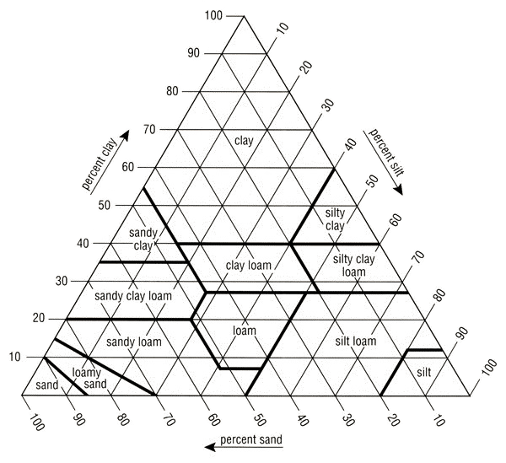
Soil Texture
Find
40% Sand
45% Silt
15% Clay
Loam
Mixture of all 3
Loam?
http://www.isa-arbor.com/education/onlineresources/CDDemos/triangle.swf
Notes:
Really only need to find 2 of the 3 points. 3rd point acts as a clarifier
Sandy loam would be a mixture of all 3, that has a significantly higher percentage of sand

Slide 17
Eastern WA soil is more suited for farming than Western WA. Why?
Eastern WA
No glaciers → sandy soil that weathers easily
Hotter → Speeds up decomposition
Less dense canopy → more water hits soil and soaks in
Grasslands → Easily decompose
Western WA
Glaciers → Gravel and silt
Colder → Slower decomposition
Dense canopy → A lot of rain caught in trees
Conifers → Needles very acidic and don’t decompose

Slide 18
Upcoming Homework
Winter Break Homework:
Chapter 10 Reading Guide
We will finish the Soil Lab and the rest of Chapter 8 when you return!!! ☺

