Slide 1
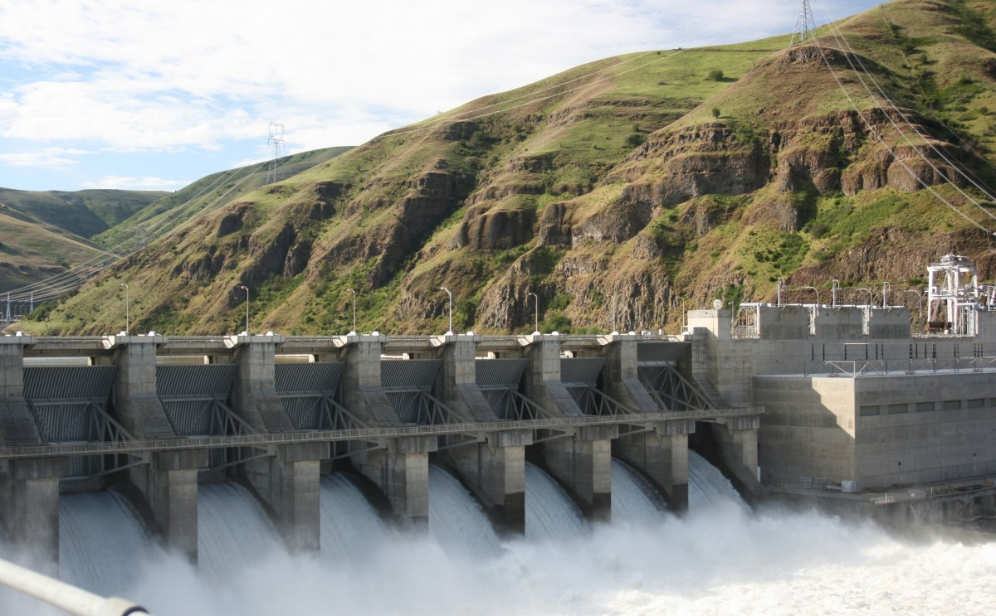
Apes 2/2
Take out your chapter
12 reading guide
for check off!

Slide 2
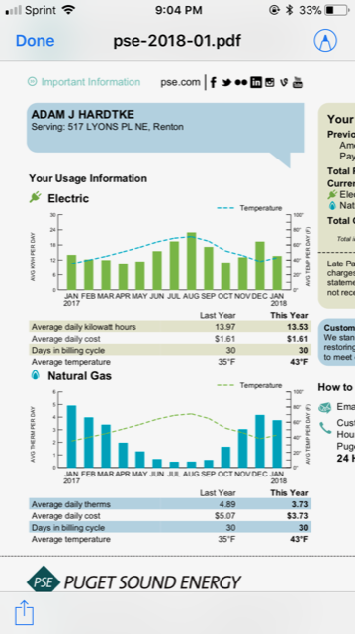
Mental warm-up
Last month my family used 406 kWH of electricity
and 112 therms of natural gas.
There are 58 therms in one barrel of oil
There are 1700 kWh in one barrel of oil
How many barrels of oil did we use in January?

Slide 3
Module 35 concepts to know
Energy efficiency = amount of energy actually captured
First and second law of thermodynamics
Conversions: see APES Energy handout
Equation: Energy = Power x Time
Ex: 100 watts is the amount of power a lightbulb has
The amt. of energy used is 100 watts x 12 hrs. = 1200 watt hours

Slide 4
Practice time
Let’s do #1 and 2 together
Then you do the rest!
1 kWh = 3600 kJ

Slide 5
Due next time
APES Energy Problems
Examining our Washington Energy Use (Google Classroom)

