Slide 1
APES 2/6
Please take out your apes math practice to check your answers
Get a laptop for note-taking

Slide 2
Classroom Heating Lab
Purposes:
To calculate how much energy is lost through our windows each year
To calculate how much money is wasted
To practice our dimensional analysis skills
Today: Do practice questions, Part A-D, Student questions 1-4

Slide 3
U.S. Fossil Fuel Trends

Slide 4
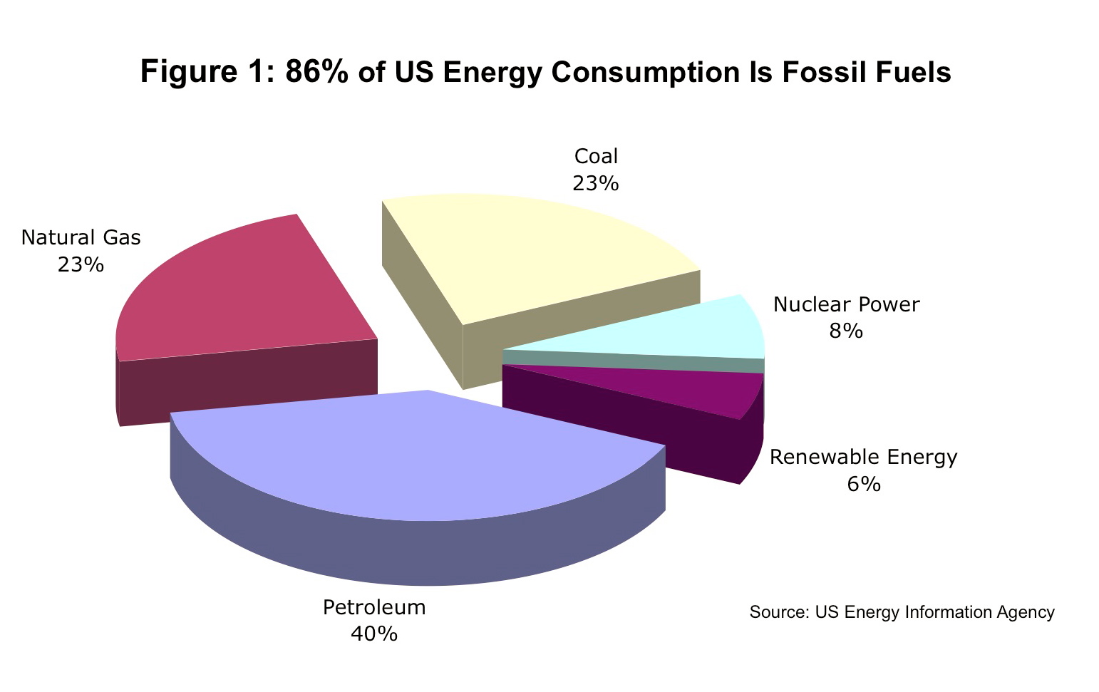
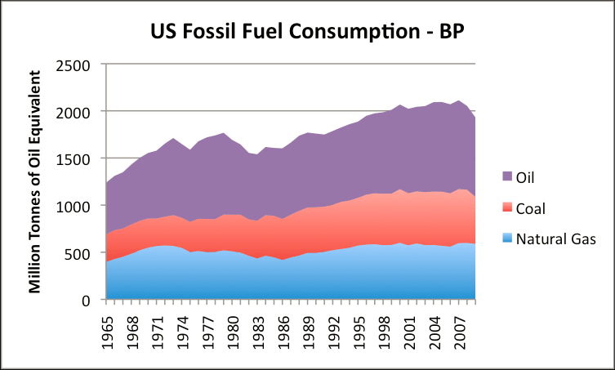

Slide 5
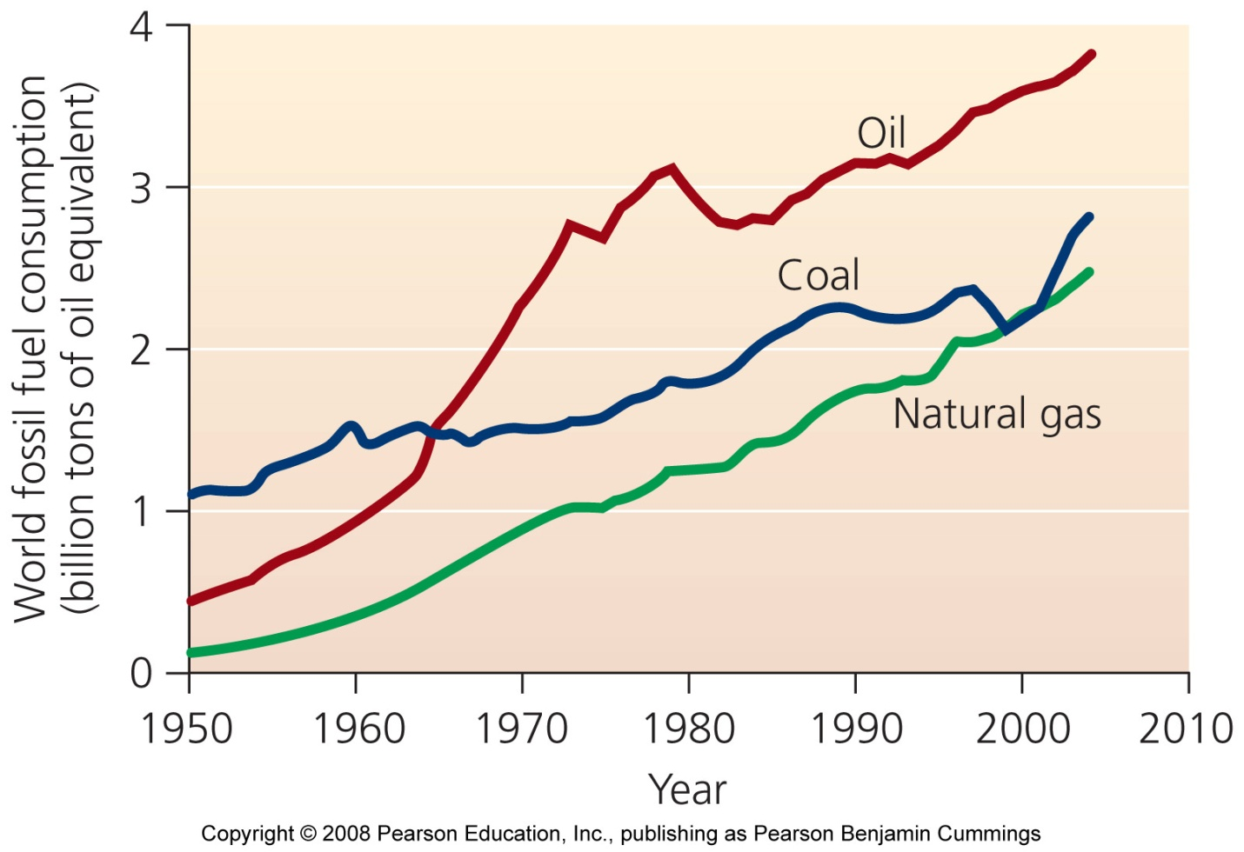
How Did We Get Here?
Industrial Revolution
Exponential Growth
Energy Crisis

Slide 6
Energy Crisis
Pre 1970 - Oil was plentiful and cheap
Formation of OPEC – started in 1960
Algeria, Angola, Ecuador, Iran, Iraq, Kuwait, Libya, Nigeria, Qatar, Saudi Arabia, UAE, and Venezuela
79% of world reserves & 44% of world production
Goals:
Safeguarding interests by setting the price of a barrel of oil
ensuring stable supply and demand in int’l oil markets

Slide 7
Events of the 1970’s
Arab members of OPEC refuse to ship oil to the U.S. and most of Western Europe (1973)
Wanted countries to stop supporting Israel in Yom Kippur War with Syria & Egypt
U.S. was using cheap oil to make other products (particularly plastics) and selling them back to OPEC countries at up to 300% mark up
Revolution in Iran slows production (1979)

Slide 8
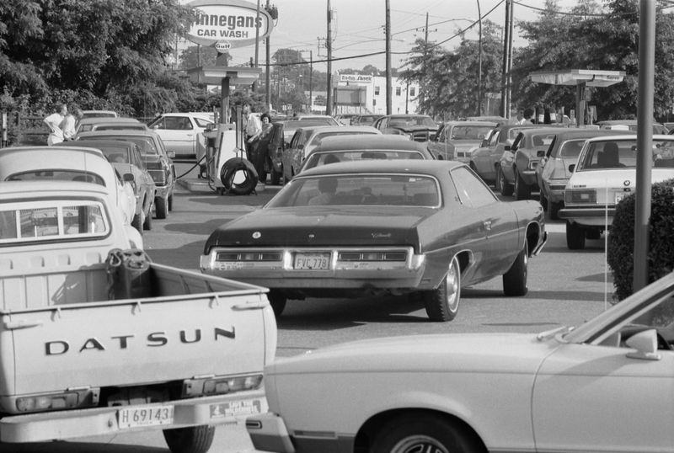
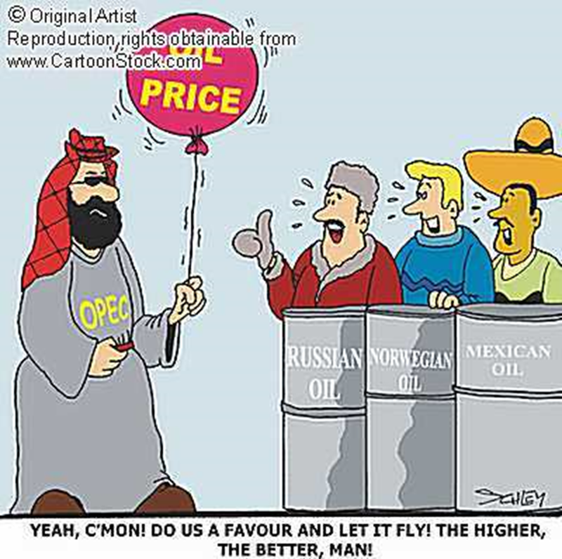

Slide 9
Consequences
Petroleum prices quadruple
Schools close in the winter for lack of heating oil
Manufacturing plants close or lay people off
Increased interest in alternative energies
Global recession

Slide 10
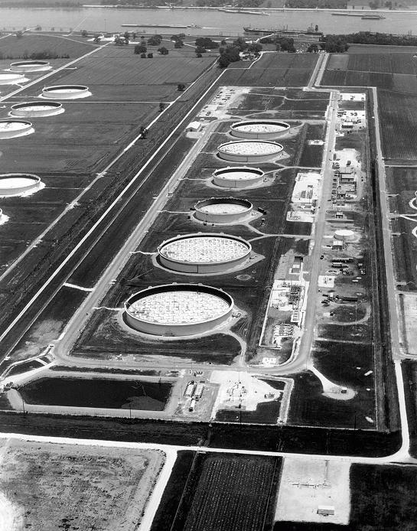
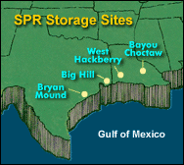
Establishment of Strategic Petroleum Reserves in 1975
Emergency supply of crude oil in salt caverns along the Gulf of Mexico
Currently holds around 1 billion gallons of oil
Approximate 57 day supply

Slide 11
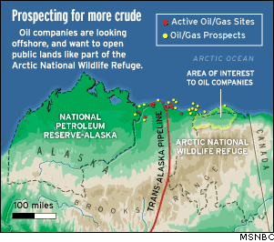
National Petroleum Reserve
Formalized in 1976
Largest area of undisturbed wilderness in U.S.
Approx. 896 mill. barrels of oil
Development started in 1990’s
Disagreements with Inupiat’s & env. groups – lots of lawsuits
Notes:
1960 → President Eisenhower creates the Arctic National Wildlife Refuge by executive order; prohibits development for drilling, but has loophole for a future act of Congress to permit it
1968 → Oil is discovered at Prudhoe Bay
1987 → Reagan Administration supports full leasing of coastal area to oil companies
1989 → Exxon Valdez spills 11 million gallons of oil into Prince William Sound, ruins 1500 miles of beach and kills 250,000 birds, along with seals, otters, & whales
Public Outcry against future drilling
1991 → After Persian Gulf War George H.W. Bush proposes opening for leasing; is killed in Senate by filibuster
1994-95 → Republicans control house, attach permits for drilling on appropriations bill; Clinton vetoes
1998-2000 → Several bills to make ANWR a permanent wilderness introduced, but never heard in committee – Alaska’s representatives controlled relevant committee’s in both House and Senate
2000 → Voted to allow
202 00 → Vote overturned
2005 → Voted to allow, but was attached to the government’s budget bill which the democrats refused to sign, so legislation was dropped
December 2005 → Showdown with Ted Stevens and Maria Cantwell on Senate floor, bill was attached to defense spending. Filibuster that democrats won
Obama has said he opposes drilling – has not received a lot of attention recently

Slide 12
Arctic Nat’l Wildlife Refuge
ANWR created in 1960 to protect wildlife
90% of Alaska’s state rev comes from gas/oil taxes
Trans-Alaska is running at 1/3 capacity and Alaska is having a budget crisis
http://time.com/5129852/donald-trump-alaska-oil-drilling/

Slide 13
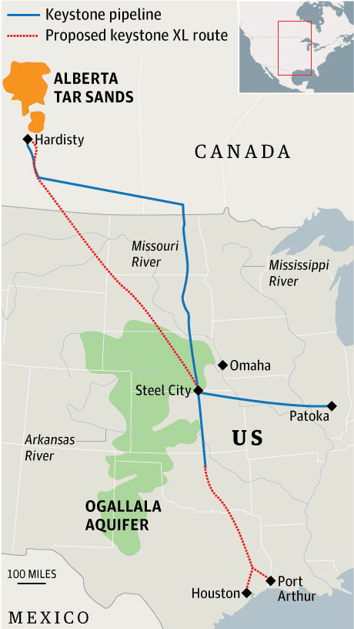
Keystone XL Pipeline
Site of Dakota Access Pipeline protests
https://daplpipelinefacts.com/

Slide 14
Due Friday
Classroom Heating Lab
Module 35 (Fossil Fuels)

Slide 15
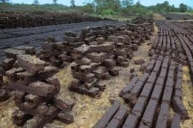
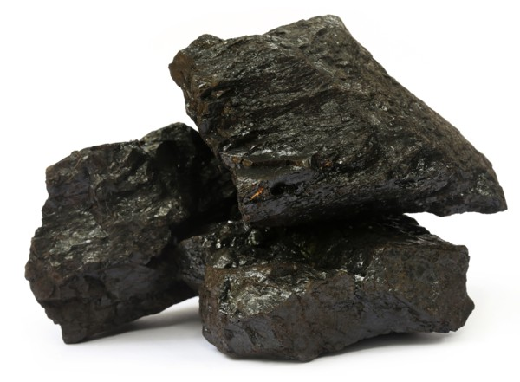
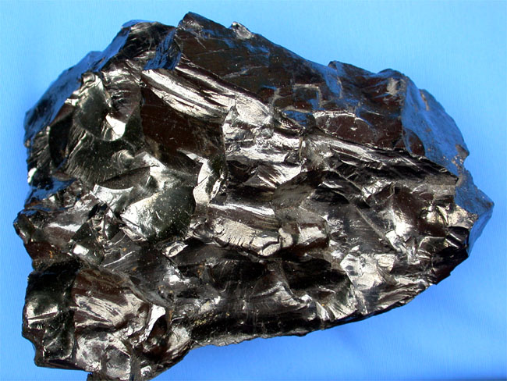
Types of Fossil Fuels: Coal
Most abundant; from decomposed plant materials under high pressure
50% of U.S. energy and 78% for China!
Varies in potential energy
Peat- least compressed/most water
Lignite
Bituminous (most common in U.S.)
Anthracite- most compressed
Coal also varies in impurities (sulfur, mercury, arsenic)

Slide 16
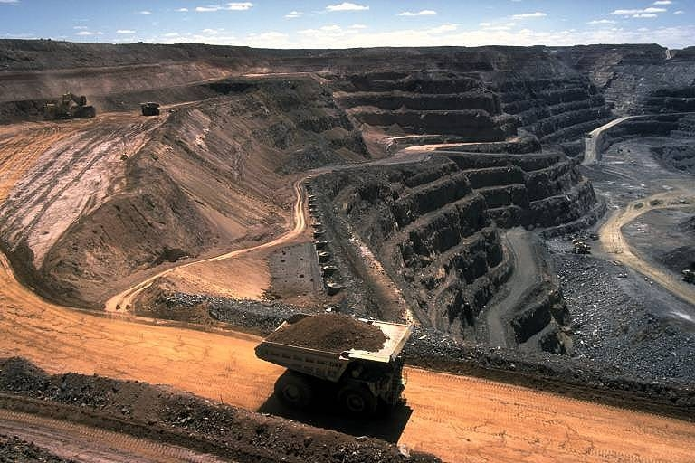
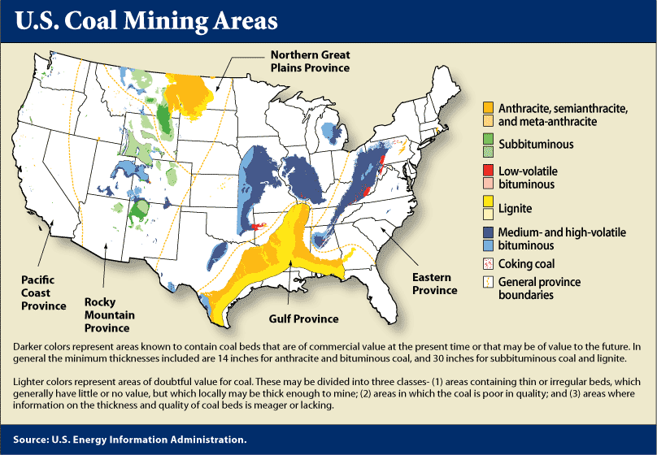
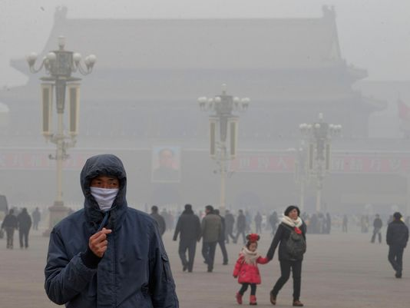

Slide 17
Natural Gas
Mostly methane (CH4)
Usually extracted above deposits of coal or crude oil (gases rise!)
Versatile, clean burning (less CO2 and impurities)
We’ve exhausted the accessible stuff, so now we are fracking and finding it offshore
California, Gulf of Mexico = most potential

Slide 18
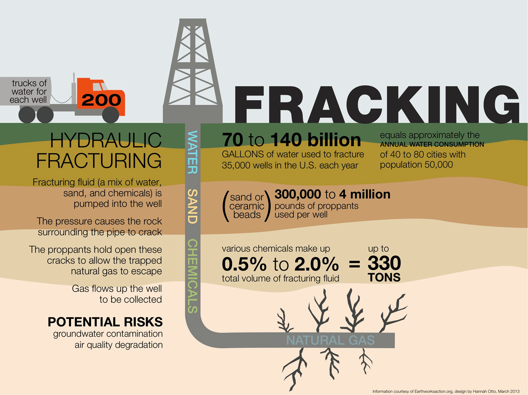
Fracking
Hydraulic Fracturing
Break into rock physically
Pump high pressure salt water underground to crack the rock
Pump up the released natural gas

Slide 19
Consequences of Fracking
Huge amount of water used!
Underground water contamination
Earthquakes
Air quality contamination

Slide 20
Petroleum
“Crude Oil”: liquid mixture of hydrocarbons, sulfur, natural gas
Must be refined to remove impurities/isolate hydrocarbons
Formed underground by deposits of phytoplankton
Most used fuel world-wide
https://www.youtube.com/watch?v=8yASbM8M2vg

Slide 21
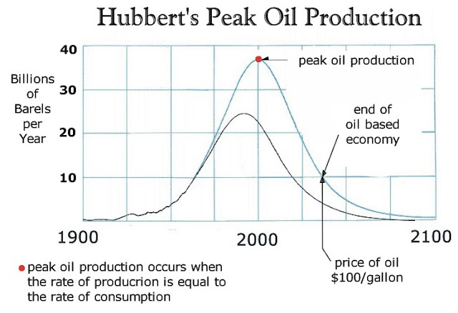
Petroleum: are we running out?
Reserves: Production (R/P Ratio): At current use of 30 billion barrels per year, we have about 40 years left (1.2 trillion barrels)
1 barrel = 42 gallons
Peak Oil = describes point of max. production
Hubbert’s curve shows predicted mathematical rise/fall

Slide 22
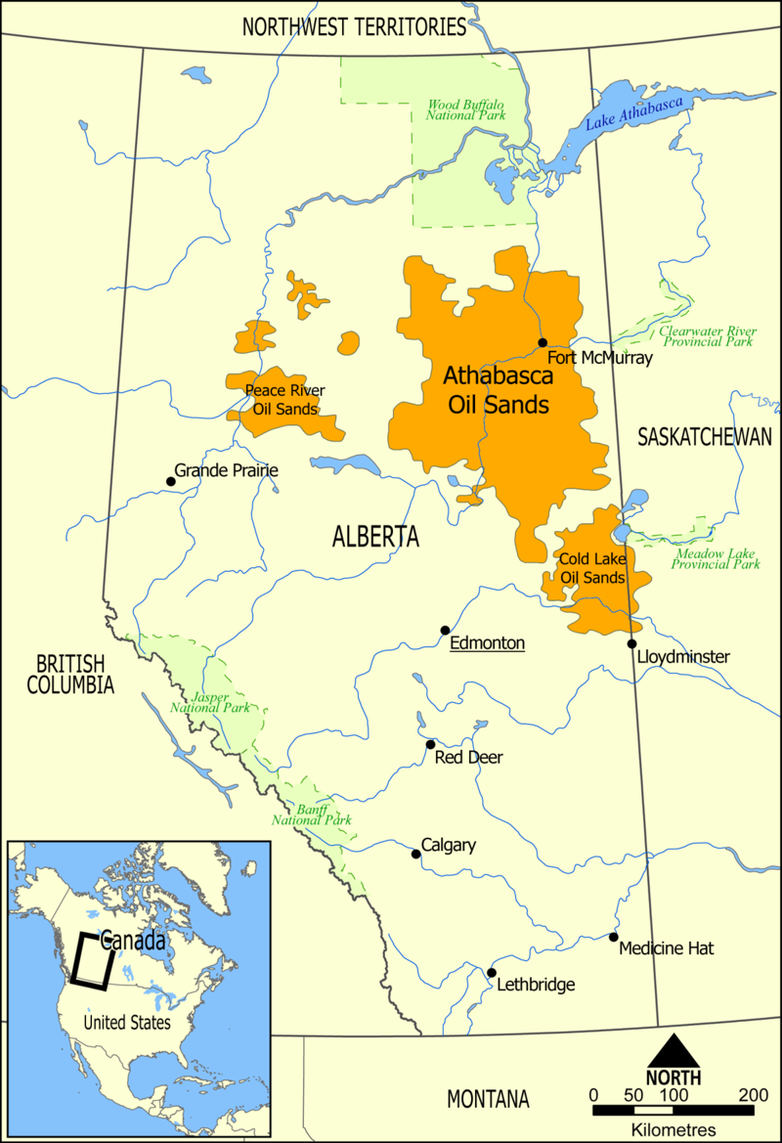
Other Options
Tar Sands/Oil Sands: deposits of moist sand and clay containing 1-20% bitumen
Removed by strip mining and then refined
Oil shale: sedimentary rock that liquid petroleum can be extracted from
Mostly in Colorado, Wyoming

