Slide 1
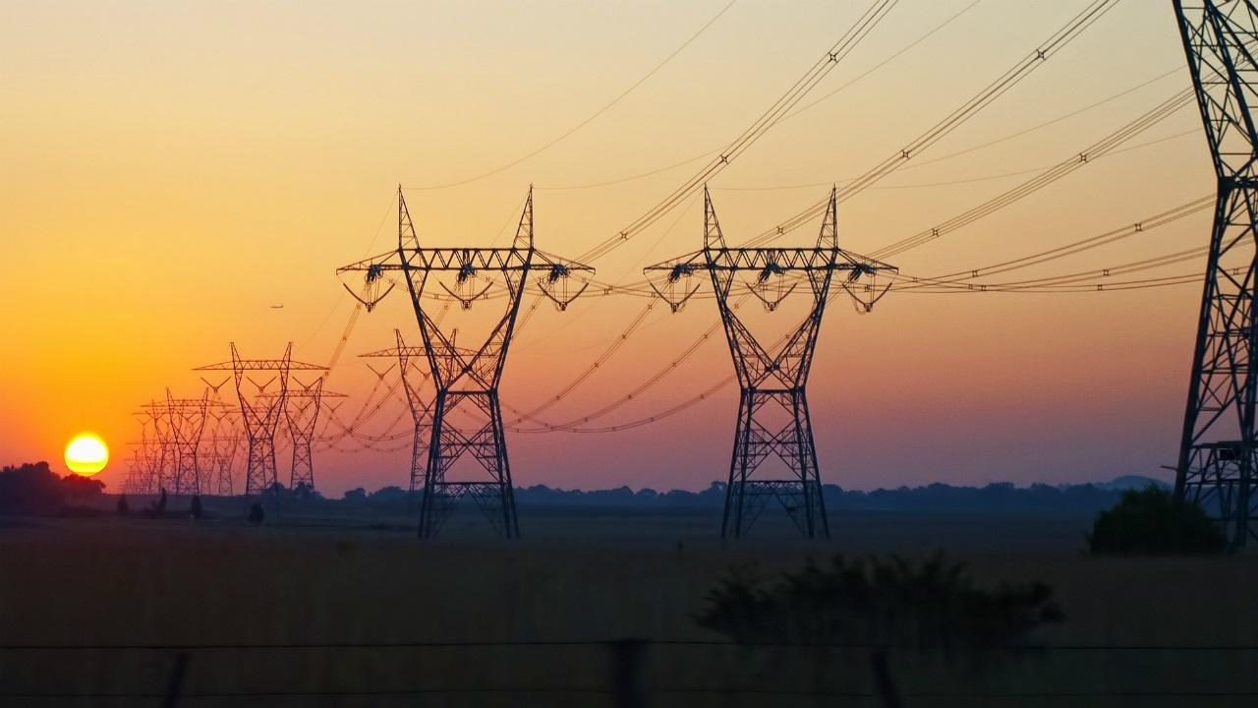
APES 2/8/18
Take out your classroom heating lab to review; get a computer

Slide 2
Mental Warm-Up
What are three sites in North America where we get fossil fuels?
What is (at least) one site that is controversial, and why?

Slide 3
Classroom Heating Lab
Compare the values you got in Table 1 with your table partner
Compare answers to analysis questions #1 and #4

Slide 4
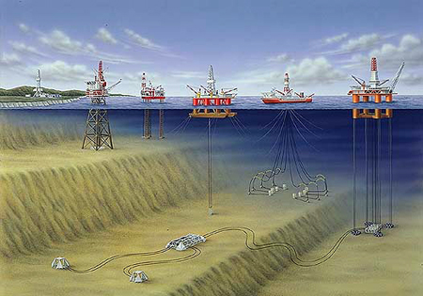
Fossil Fuels

Slide 5
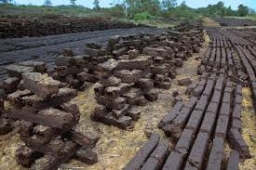
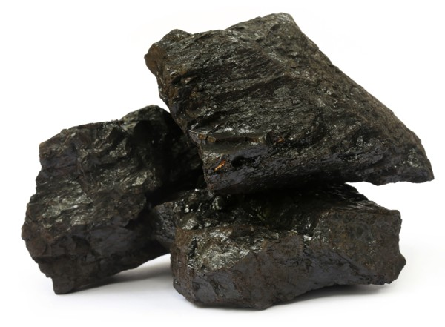
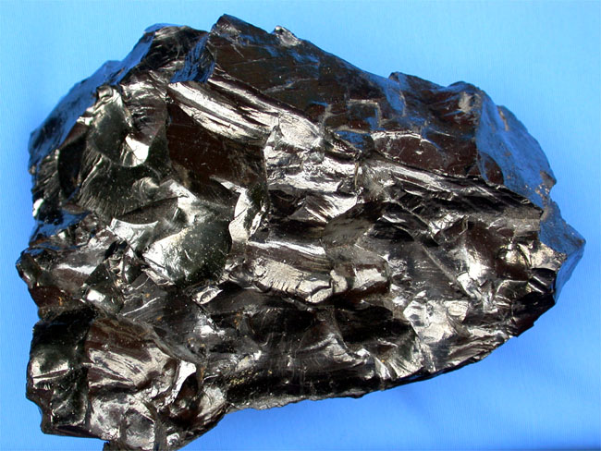
Types of Fossil Fuels: Coal
Most abundant; from decomposed plant materials under high pressure
#1 fuel in China and U.S. for electricity
Varies in potential energy
Peat- least compressed/most water
Lignite
Bituminous (most common in U.S.)
Anthracite- most compressed
Coal also varies in impurities (sulfur, mercury, arsenic)

Slide 6
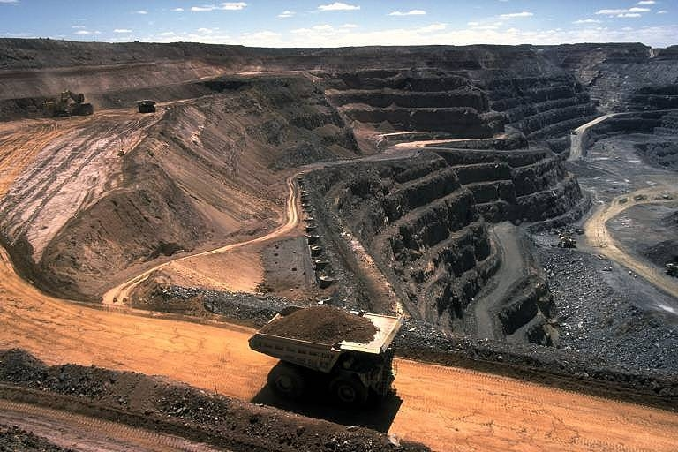
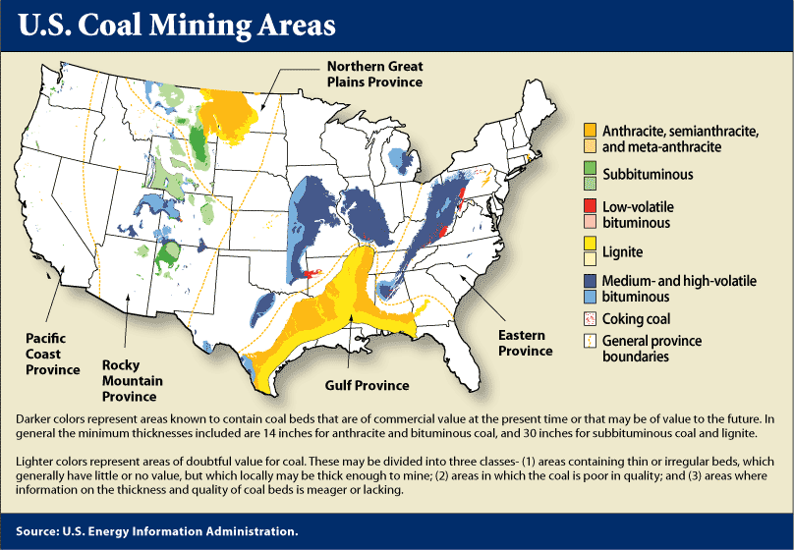

Slide 7
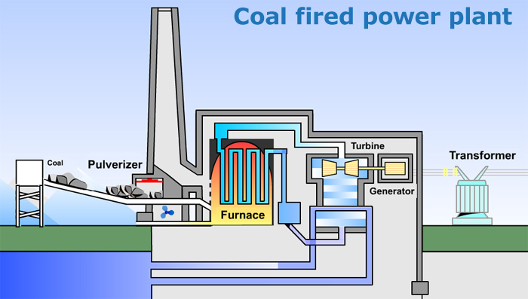
Turbine: spins, generating kinetic energy
Generator: converts kinetic energy to electricity
Transformer: passes electricity from plant to power lines

Slide 8
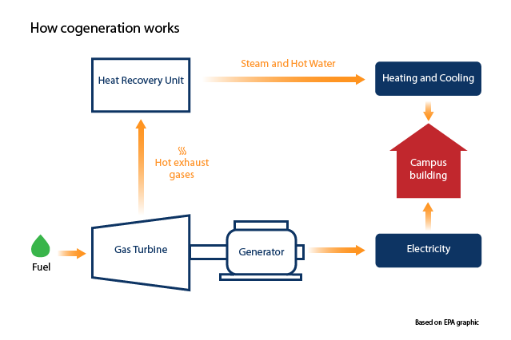
Cogeneration of electricity and heat increases efficiency Cogeneration = capturing escaping heat energy and using it to heat water or air

Slide 9
Natural Gas
Mostly methane (CH4)
Usually extracted above deposits of coal or crude oil (gases rise!)
Versatile, clean burning (less CO2 and impurities)
We’ve exhausted the accessible stuff, so now we are fracking and finding it offshore
California, Gulf of Mexico = most potential

Slide 10
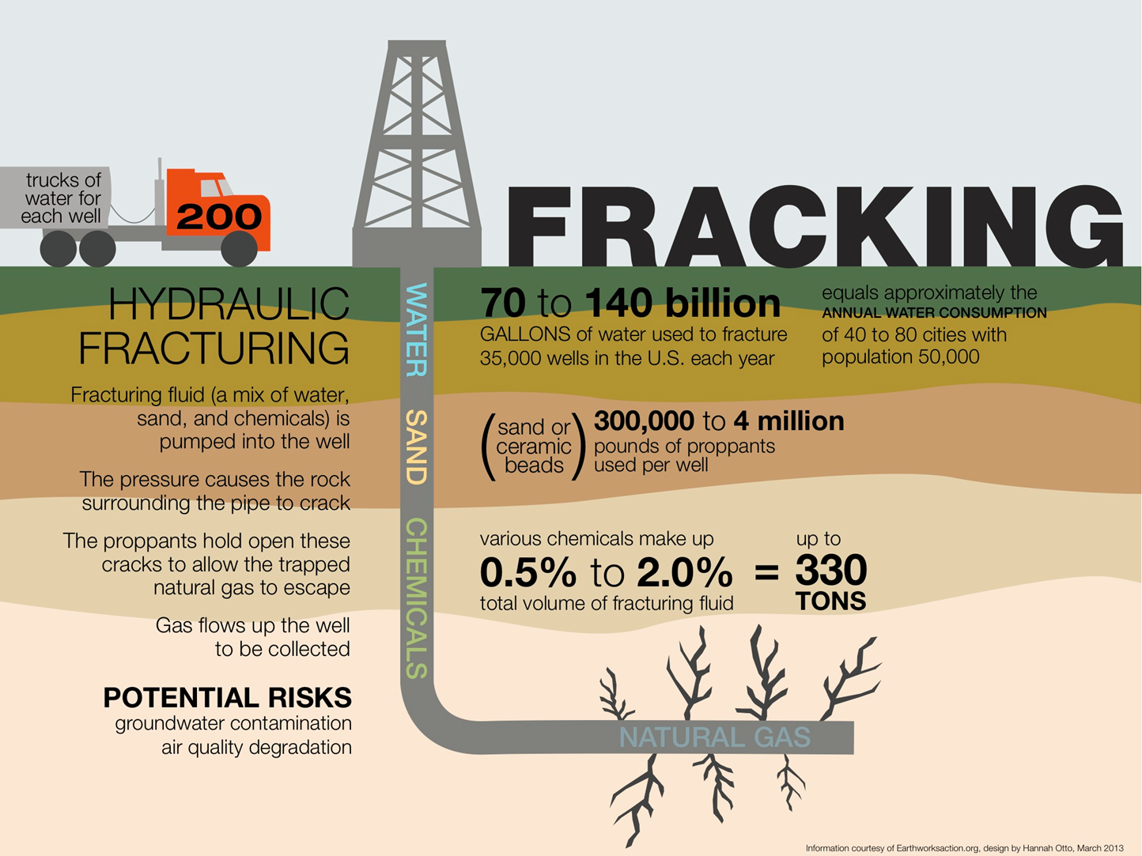
Fracking
Hydraulic Fracturing
Break into rock physically
Pump high pressure salt water underground to crack the rock
Pump up the released natural gas

Slide 11
Consequences of Fracking
Huge amount of water used!
Underground water contamination
Earthquakes
Air quality contamination

Slide 12
Petroleum
“Crude Oil”: liquid mixture of hydrocarbons, sulfur, natural gas
Must be refined to remove impurities/isolate hydrocarbons
Formed underground by deposits of phytoplankton
Most used fuel world-wide
https://www.youtube.com/watch?v=8yASbM8M2vg

Slide 13
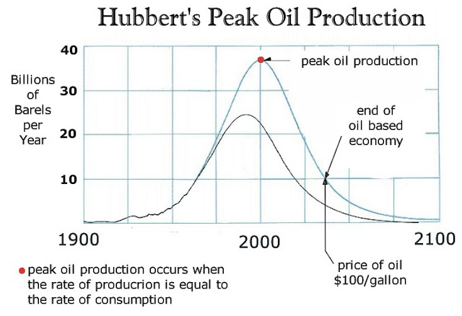
Petroleum: are we running out?
Reserves: Production (R/P Ratio): At current use of 30 billion barrels per year, we have about 40 years left (1.2 trillion barrels)
1 barrel = 42 gallons
Peak Oil = describes point of max. production
Hubbert’s curve shows predicted mathematical rise/fall

Slide 14
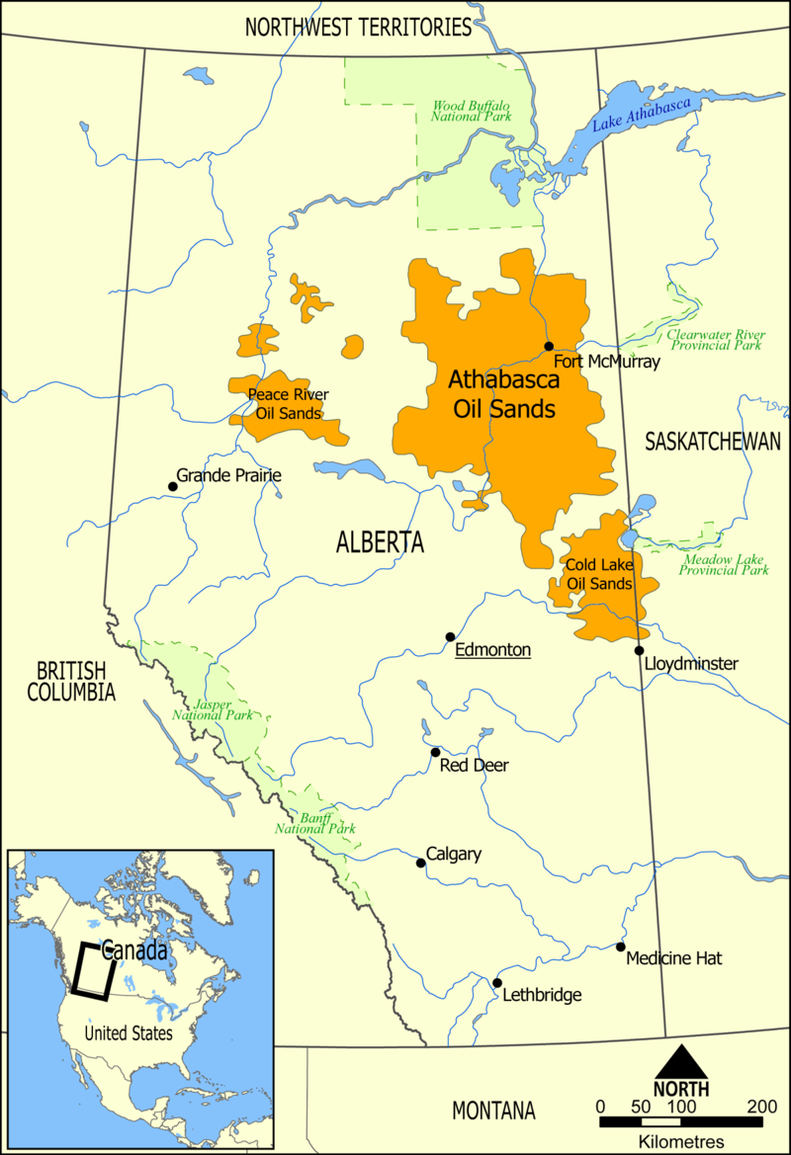
Other Options
Tar Sands/Oil Sands: deposits of moist sand and clay containing 1-20% bitumen
Removed by strip mining and then refined
Oil shale: sedimentary rock that liquid petroleum can be extracted from
Mostly in Colorado, Wyoming

Slide 15
Math Practice
No calculators!

Slide 16
Due Next Time
2004 Math Practice
Module 35 chart

