Slide 1
APES 3/13
Find a partner who WAS NOT in your original Smog Lab Group
Get a laptop for taking notes

Slide 2
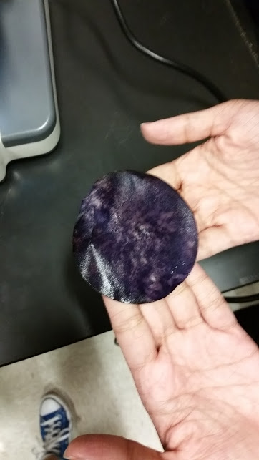
Tropospheric Ozone Lab
With your partner:
Do your answers make sense?
Be prepared to answer how UV index related to tropospheric ozone level.

Slide 3
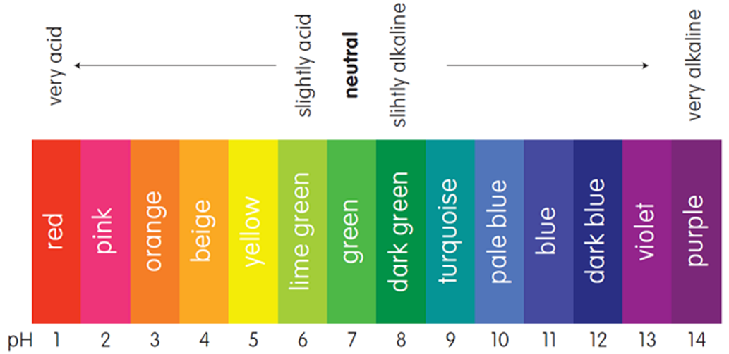
One your half sheet, predicts the pH of each acid (sulfuric, nitric, carbonic)
Write an equation showing how each acid would form in nature.
Come up with at least one anthropogenic source of the gaseous reactant.

Slide 4
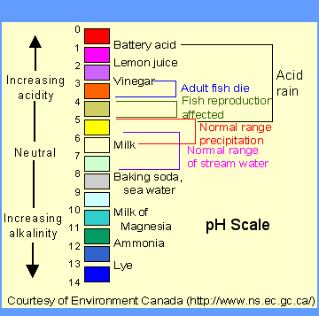
Acid Rain
https://www.youtube.com/watch?v=Nf8cuvl62Vc
Remember, each step on the scale is 10 fold increase in acidity or basicity!

Slide 5
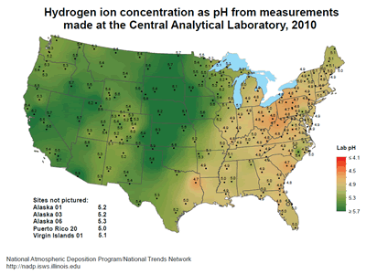
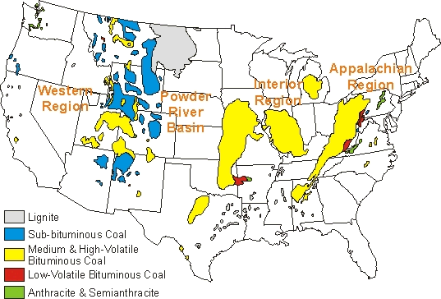

Slide 6
Acid Rain/Deposition
Rain is naturally slightly acidic because of the reaction of CO₂ and H₂O: H₂O + CO₂ → H₂CO₃
Anthropogenic sources make it more acidic by the reaction of sulfur dioxide (SO₂) and nitrogen dioxides (NO_{x}) with water
Local & Regional effects
1) Premature tree & plant death
2) Fish die offs & decrease in amount of aquatic primary producers
3) Damage to buildings
4) Tall stacks on power plants increases residence times and spread pollution over wider area

Slide 7
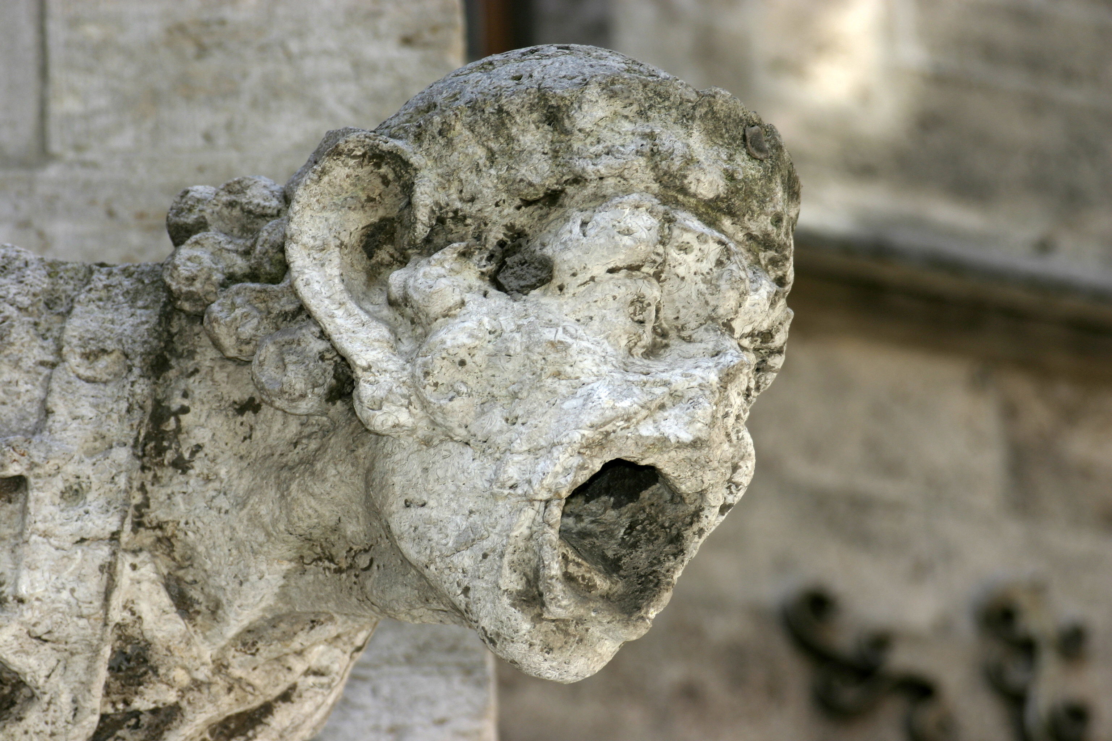
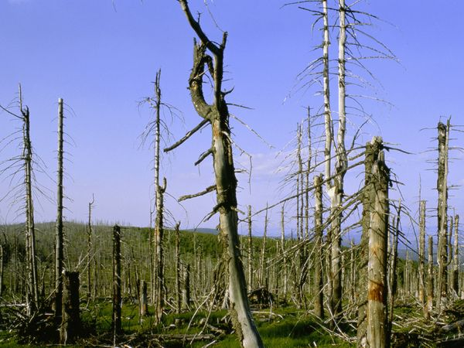
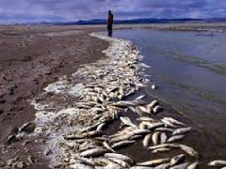

Slide 8
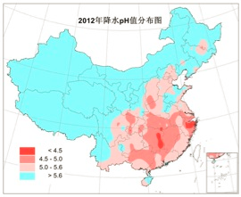
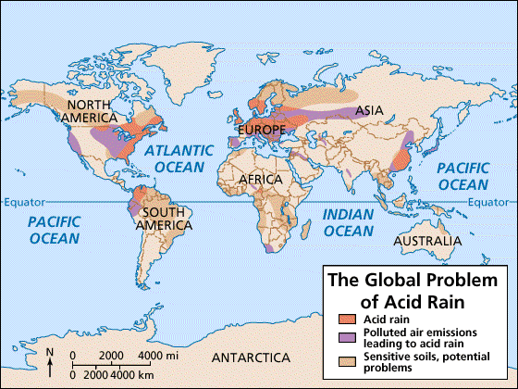
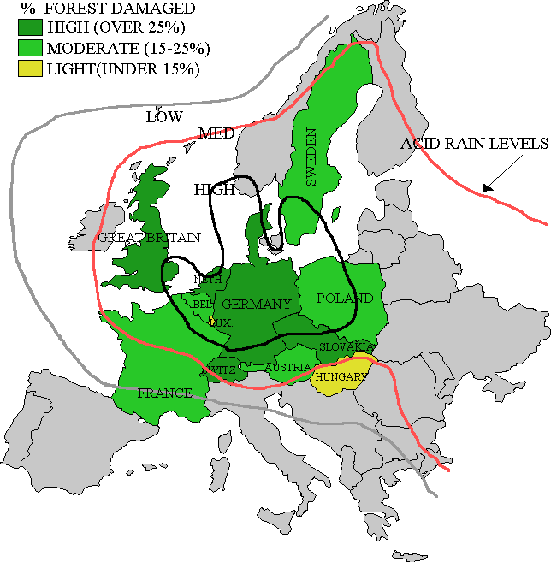

Slide 9
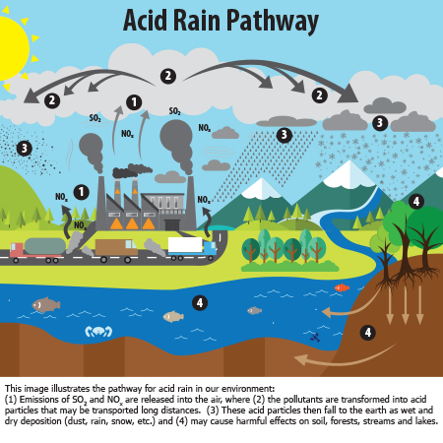

Slide 10
Acid Rain/Deposition Equations
H₂0 + NOx HNO₃ H⁺ + NO³⁻
H₂0 + SO₂ H₂SO₄ 2H⁺ + SO₄²⁻
When the acids dissociate into ions, they cause damage to living tissues and non-living, softer materials

Slide 11
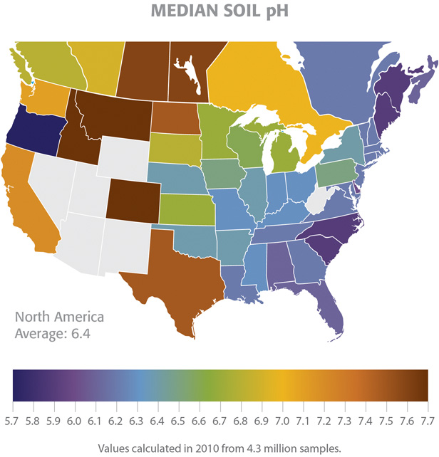
Why do some areas have acid rain and others don’t?
Use of coal
Winds carry emissions to neighboring states/countries
Soil types can contain natural buffers- CaO (lime) or CaCO₃ (limestone) neutralize acids

Slide 12
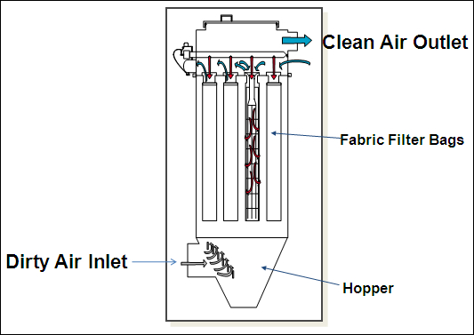
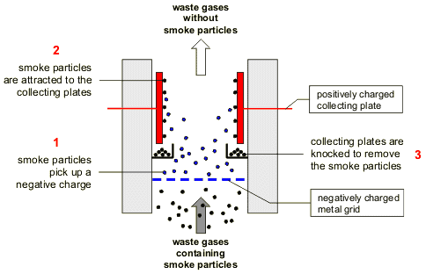
Minimizing Pollution (Module 48)
Removal of Particulate Matter (mostly power plants)
Baghouse filters: use fabric filter to remove PM.
Electrostatic precipitators: give PM a neg. charge, then collect is using pos. charged plates. It “precipitates.”
https://www.nytimes.com/2018/03/13/world/asia/china-xi-jinping-congress-pollution-corruption.html

Slide 13
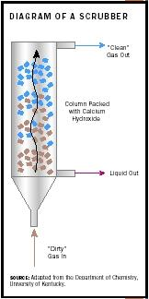
2. Minimizing Effects of Acid Rain
Scrubbing of smoke stacks to remove SO₂
Ionic compounds and/or water are added to react with toxins
Dirty liquid is filtered out as “sludge”
Clean air is emitted
Farmers often add “lye” to fields (NaOH or KOH)
http://www.ehow.com/how-does_5113845_do-smokestack-scrubbers-work.html
Notes:
Buffers → Neutralize acid; calcium carbonate (CaCO₃ - limestone)
Found naturally in some soil/bedrock, many farmers add “lye”

Slide 14
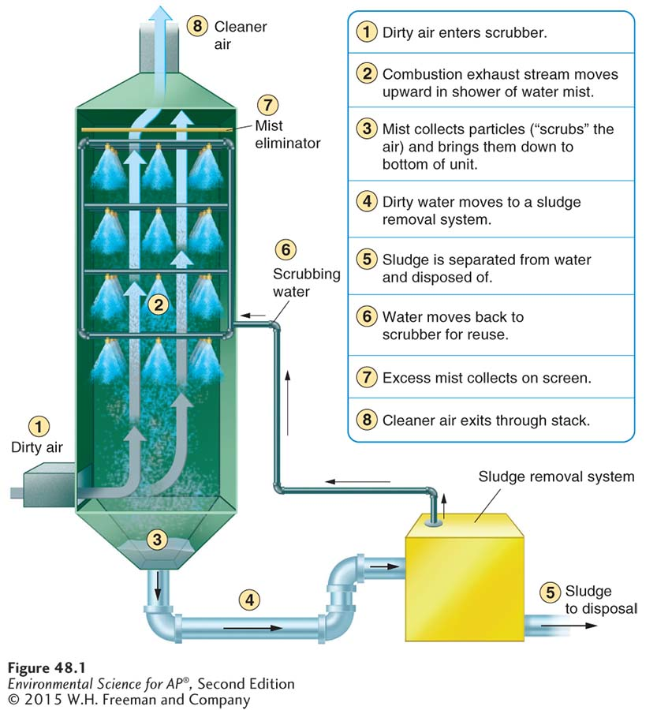
Control of Particulate Matter and SO₂

Slide 15
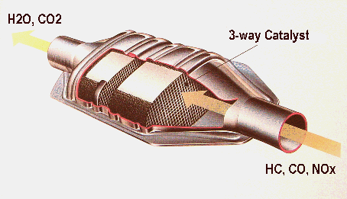
2. Minimizing Effects of Acid Rain
Catalytic Converters on vehicles (required) in U.S.)
Minimize NOx, CO, VOCs
“Catalyst” is typically a metal, like Platinum, contained on a honeycomb structure.

Slide 16
3: Regulating All Air Pollution with Regulations
Carpooling
Required emissions testing/cat converters
Unleaded gasoline, combined with ethanol to make it more clean-burning
Cap and Trade Systems under Clean Air Act
Will discuss during Chapter 19
Required devices at industrial plants

