Slide 1
APES 3/9
Get a laptop for some notes on smog!

Slide 2
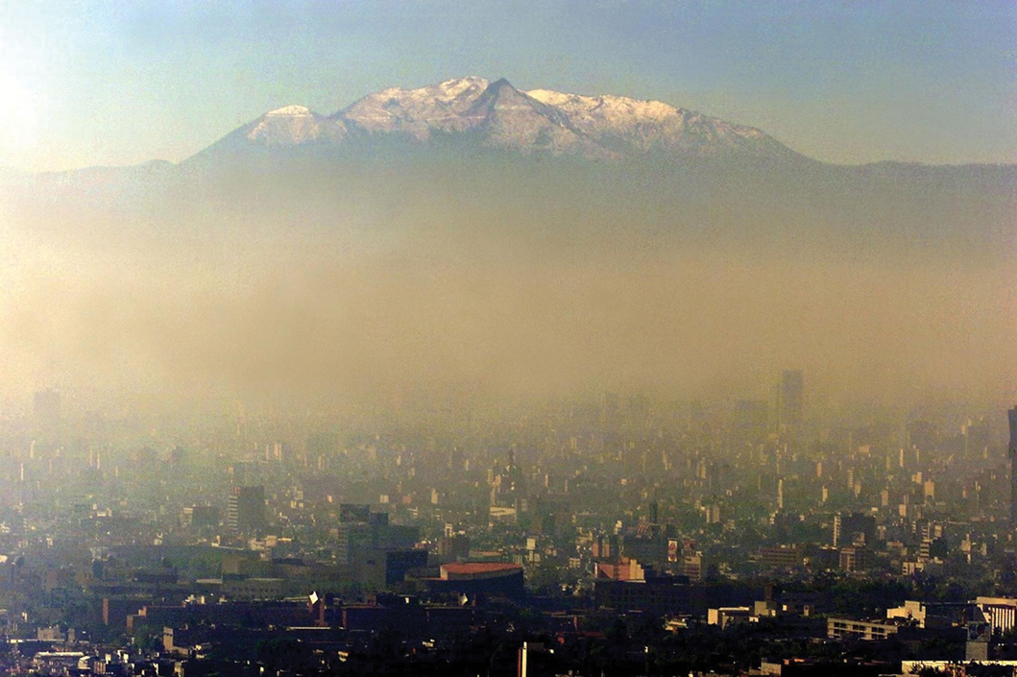
Causes and Effects of Smog

Slide 3
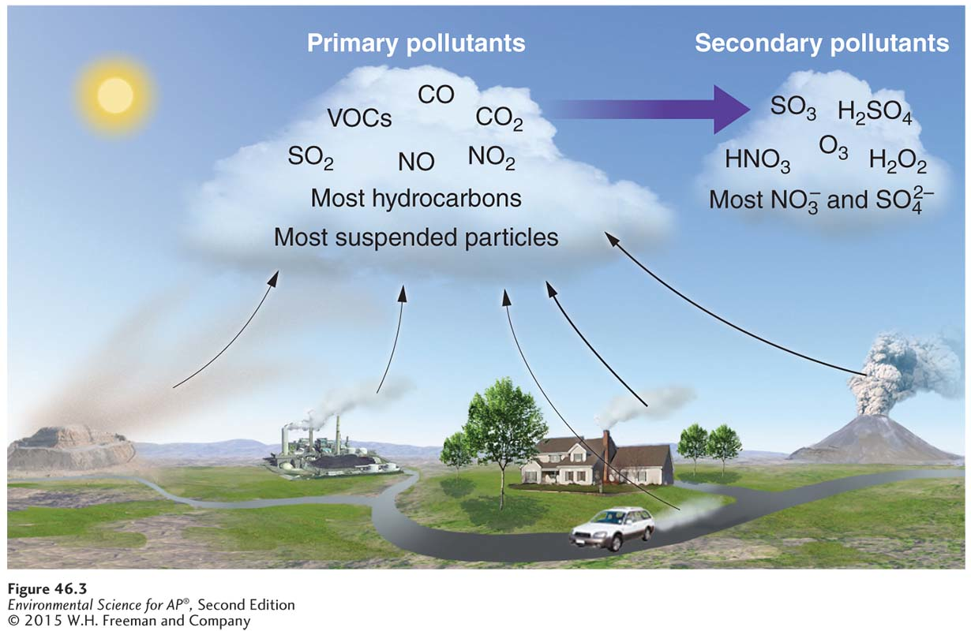
Primary and Secondary Pollutants
Primary and secondary air pollutants. The transformation from primary to secondary pollutant requires a number of factors
including sunlight, water (clouds), and the appropriate temperature.

Slide 4
Measuring U.S. Emissions
The Clean Air Act (1970) and amendments in 1977 & 1990 establishes standards for six “criteria” air pollutants
CO, NO2, SO2, O3, Particulates, Lead
NO, VOCs, CO2 not measured as part of CAA
Enforced by the EPA (Env. Protection Agency)
National Ambient Air Quality Standards (NAAQS): the EPA periodically adjusts amounts allowed for each pollutant

Slide 5
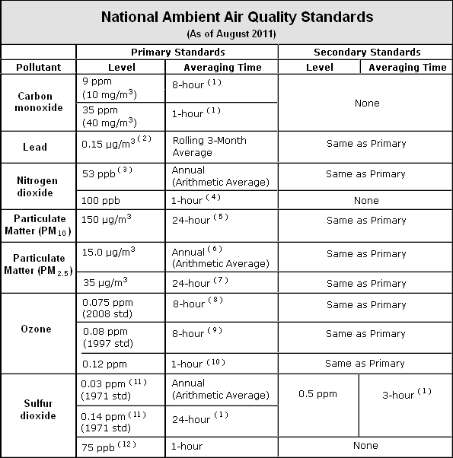

Slide 6
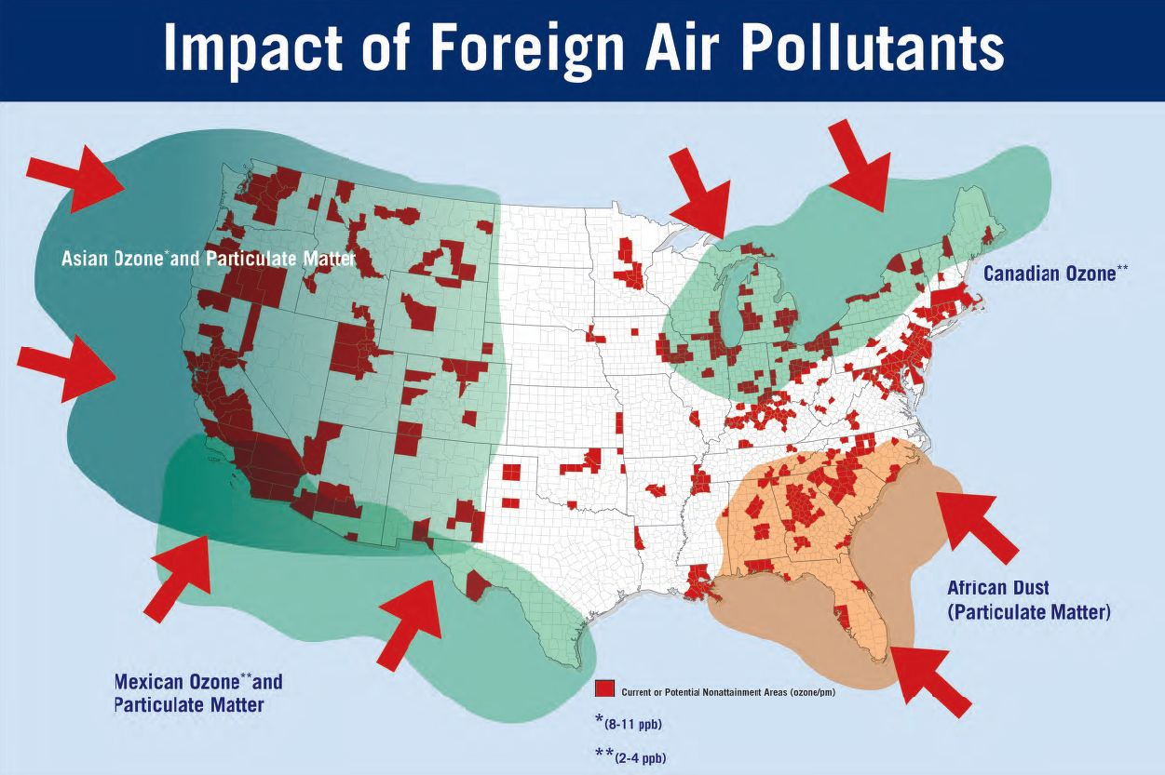
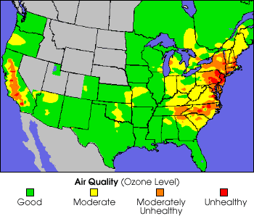

Slide 7
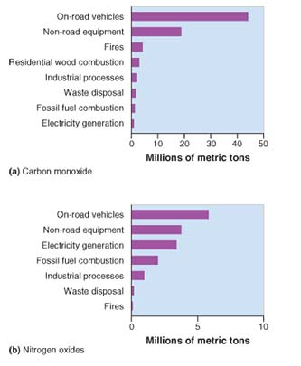
Anthropogenic Emissions
Emission sources of criteria air pollutants for the United States. Recent EPA data show that on-road
vehicles, categorized as “transportation,” are the largest source of (a)carbon monoxide and (b)nitrogen oxides.

Slide 8
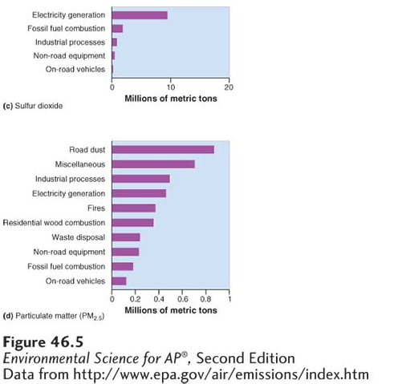
Anthropogenic Emissions
Emission sources of criteria air pollutants for the United States. The major source of
(c) anthropogenic sulfur dioxide is the generation of electricity, primarily from coal. Among the sources of (d) particulate matter are road dust, industrial processes, electricity generation, and natural and human-made fires.

Slide 9
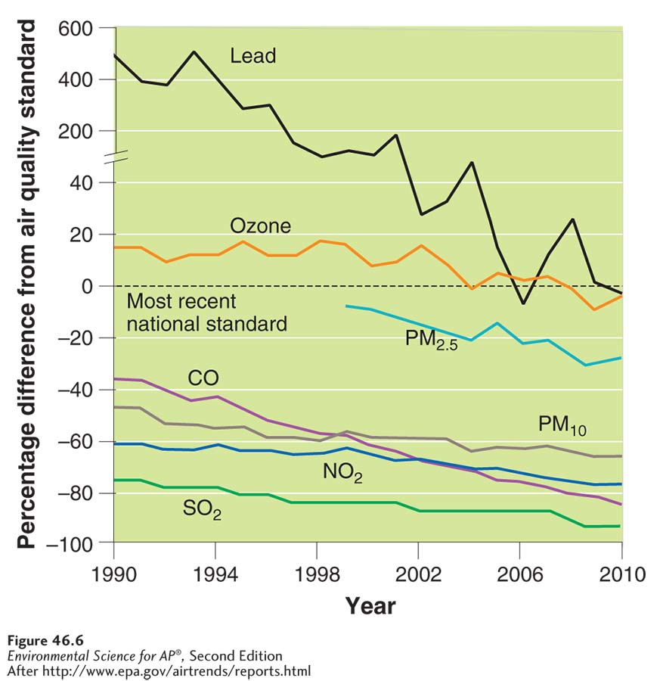
Air Pollution Trends
Criteria and other air pollutant
trends. Trends in the criteria air pollutants in the United States
between 1990 and 2010. All criteria air pollutants have decreased during this time period. The decrease for lead is the greatest.

Slide 10
Classifying Pollutants
Haze Reduced visibility.
Photochemical oxidant A class of air pollutants formed as a result of sunlight acting on compounds such as nitrogen oxides.
Ozone (O₃) A secondary pollutant made up of three oxygen atoms bound together.
Smog A type of air pollution that is a mixture of oxidants and particulate matter.
Photochemical smog Smog that is dominated by oxidants such as ozone. Also known as Los Angeles–type Smog; Brown smog.
Sulfurous smog Smog dominated by sulfur dioxide and sulfate compounds. Also known as London-type smog; Gray smog; Industrial smog.

Slide 11
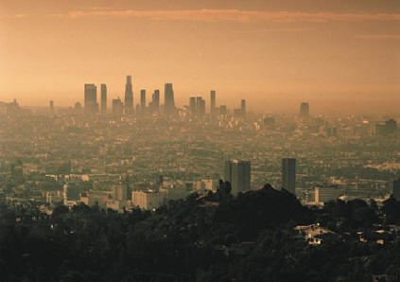
How does photochemical smog form?
1. NO, NO2, and VOCs are given off by cars
2. Sunlight causes a series of reactions that creates many dangerous oxidants!
Ozone (most abundant)
Peroxyacyl nitrates (PANs)
Aldehydes
Higher temps = more reactions = more smog

Slide 12
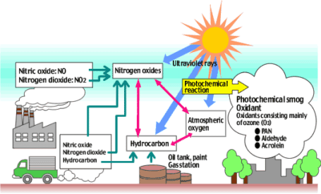
NOx + VOCs O3 + PANS

Slide 13
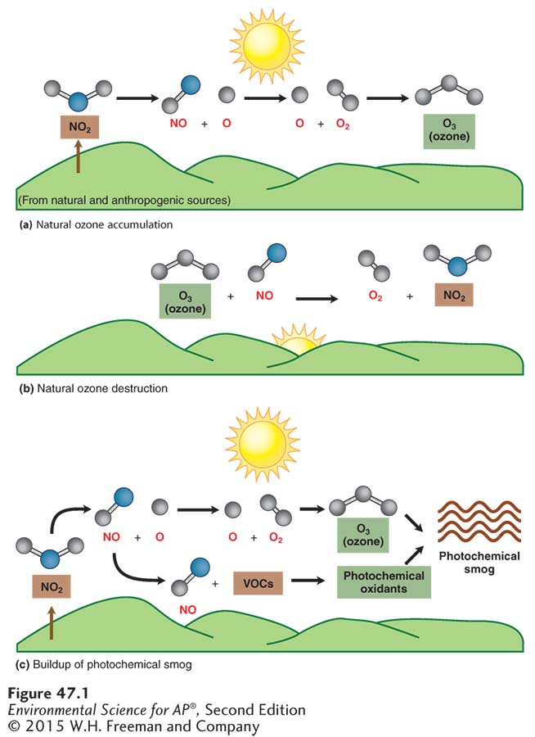
The Chemistry of Ozone Formation
Tropospheric ozone formation
(a) In the absence of VOCs, ozone will form during the daylight hours.
(b) After sunset, the ozone will break down.
Even without VOCs, we make more ozone by releasing NOx

Slide 14
How does the actual brown/orange smog form?
With the addition of VOCs (like methane, benzene), new oxidants like PANS form
These mix with ozone to create smog

Slide 15
Urban Heat Islands
Concentration of ozone, PANS, aldehydes peak when the sun is highest and drop off at night
Lots of NO2 in exhaust, plus sun, during the day
Cities maintain smog longer because of heat-absorbing materials used in buildings
Creates “urban heat islands” where smog is perpetual because heat is always present

Slide 16
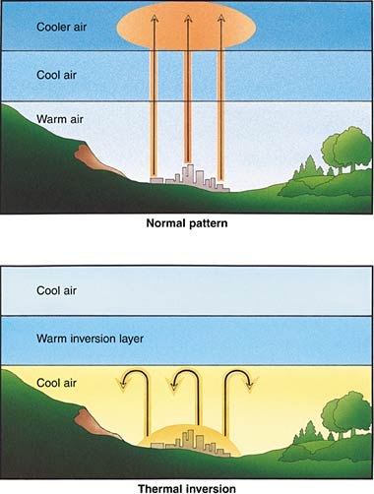
Thermal Inversions
Thermal inversion: A relatively warm layer of air at mid-altitude covers a layer of cold, dense air below.
Inversion layer: The layer of warm air that traps emissions in the layer beneath it.
Due to geography (valleys) and industry combined, some cities are more likely to have prolonged smog.

Slide 17
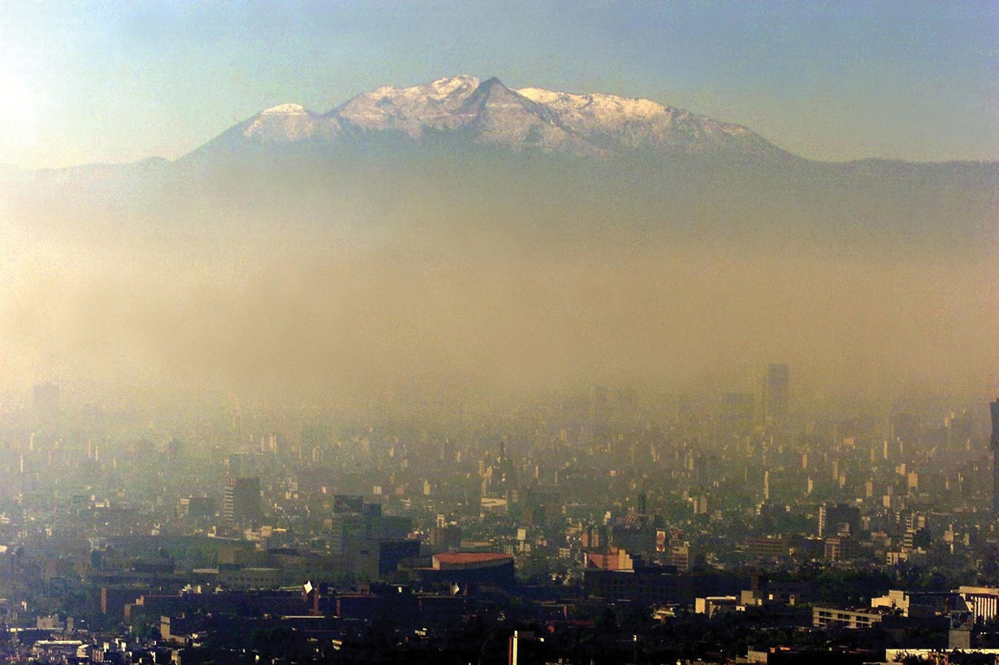
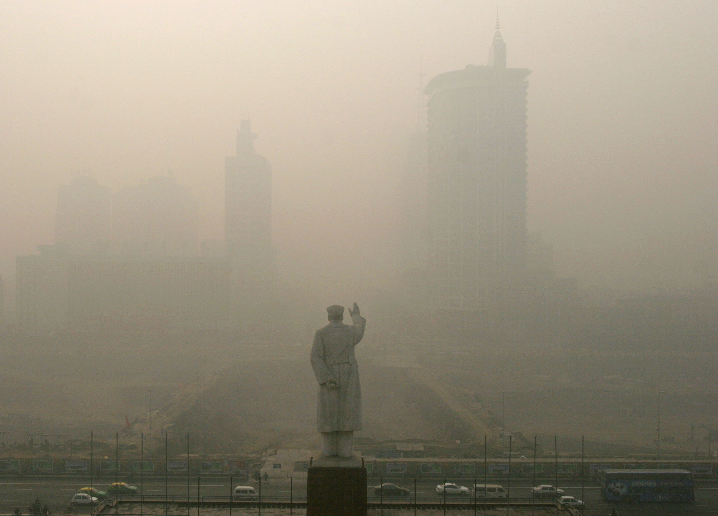
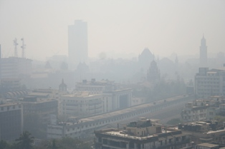
Mexico City, Mumbai, India Chengdu, China

Slide 18
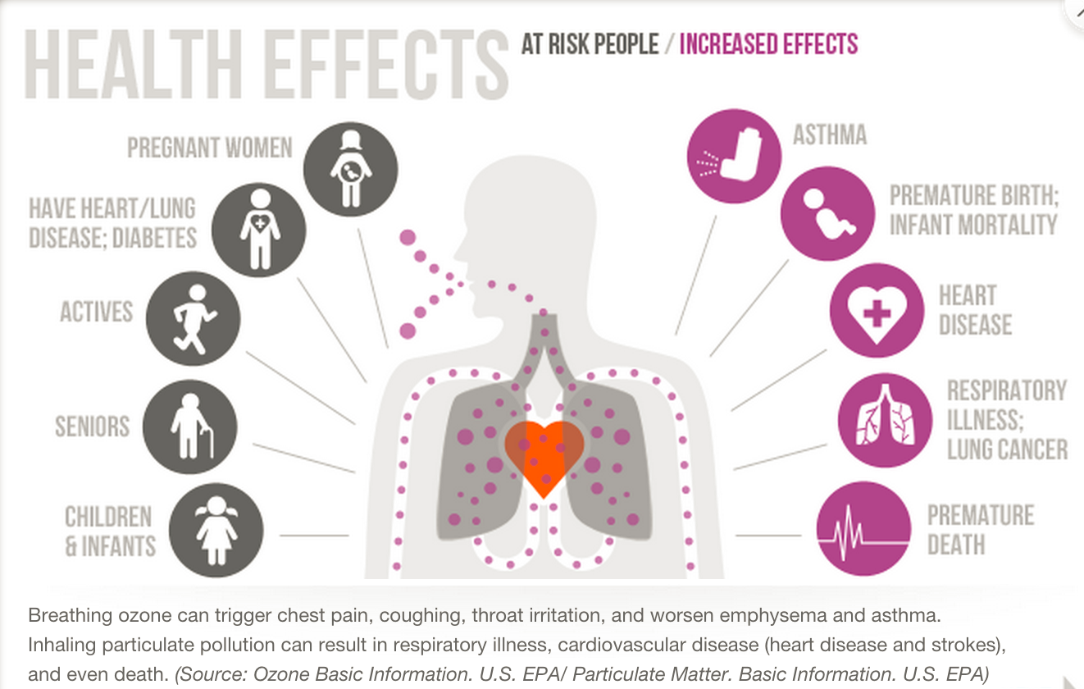
Negative Health Effects of Smog
Reduced lung function, asthma, lung cancer (?)

Slide 19
Smog Review Homework
Now find your Smog Review homework in Google classroom.
Look at your answer to Part A #3- change if needed.

Slide 20
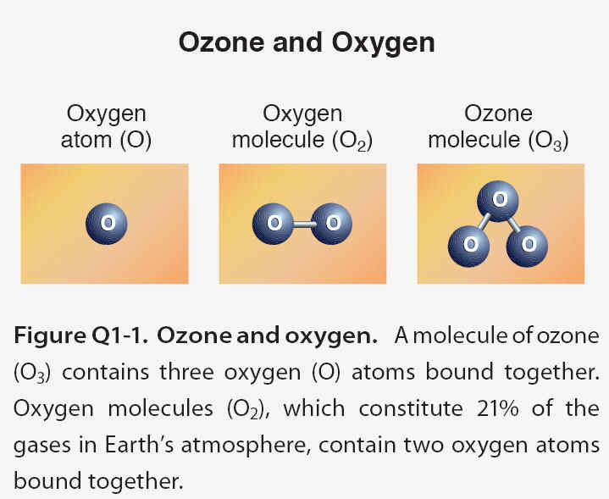
Testing for Ozone
Ozone (O3) is beneficial in the stratosphere but harmful in the troposphere
O3 is a secondary pollutant that is unstable and reacts to form O2 and O
Can cause lung irritation, plant damage, and even disintegrate rubber and plastics

Slide 21
Ozone Lab
Find your lab handout and test strips
Do Testing Procedure #3 (color scale on board)
#7: Go to airnow.gov instead and search for zip code 98038. From there, find the ozone values on the right side.
Skip #8.
This is due next time!!!!

Slide 22
Due Dates Next Week
Tuesday: Finished Ozone Lab
Thursday: Any pollution-related current event
Ch 12/13 Test Retakes must be done by Thursday. I’m available M/W Power Hour and T/Th by appointment.
Mult. Choice: scores of 24 and below
FRQ: scores of 7 and below

