Slide 1
APES 4/19
Get ready for a vocab quiz!
Take out your review activities (two stamps due)

Slide 2
Water Pollution II Notes

Slide 3
Industrial Chemicals
Organic chemicals: oil, plastics, pesticides, cleaning solvents
Inorganic: acids/bases, salts, metals
PCBs
We will cover these more in detail in the toxins mini-unit

Slide 4
Heavy Metals
Mercury: comes from burning coal and mining; bacteria convert it toxic methylmercury in water; causes neurological damage
Lead: comes from old paint, leaded gasoline, mining; causes neurological damage

Slide 5
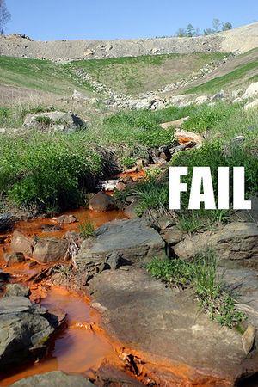
Mining and Water Pollution
Mining exposes large areas of earth’s surface to water and wind, creating runoff
Sediments
Naturally occurring heavy metals (mercury, lead)
Sulfuric acid, arsenic, cyanide used to extract gold

Slide 6
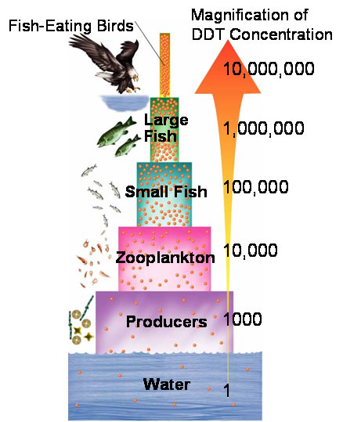
Bioaccumulation and Biomagnification
The accumulation of toxins (pesticides, metals, industrial chemicals) in tissues of larger consumers as you move up the food chain
Causes a 10x magnification in the amounts of toxins as you go up the food chain
Why? Organisms at top of food chain need to eat huge amounts of smaller organisms to survive

Slide 7
Clean Water Act
Passed Congress 1972, amended 1977, & 1987
Individuals or corporations have to obtain permits before releasing any pollutants in waterways
The EPA creates point source discharge limits for pollutants in waterways (non-point sources are not addressed)
GOAL: Clean water for swimming, fishing, and habitat

Slide 8
Federal Safe Drinking Water Act
Passed congress in 1974, amended 1996
Assures safe drinking water for Americans
Gives the EPA the right to oversee and set standards for all water suppliers.

Slide 9
Comprehensive Environmental Response, Compensation, and Liability Act (CERCLA)
Also called Superfund legislation
Enacted in 1980 in response to toxic waste disaster at Love Canal, NY
Established monetary fund and rules governing responsibility for cleaning up hazardous waste disposal sites → Greatly improved issues regarding groundwater pollution

Slide 10
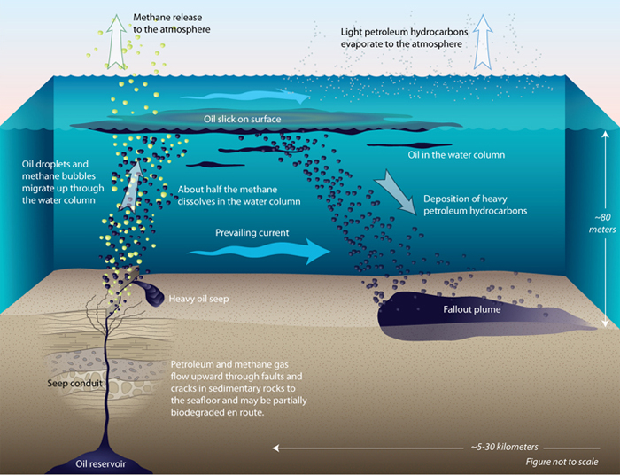
Oil Spills!
45% of oil found in the ocean is from natural oil seeps from the crust
The rest is from human activity
https://www.youtube.com/watch?v=pZKBDVurCdk

Slide 11
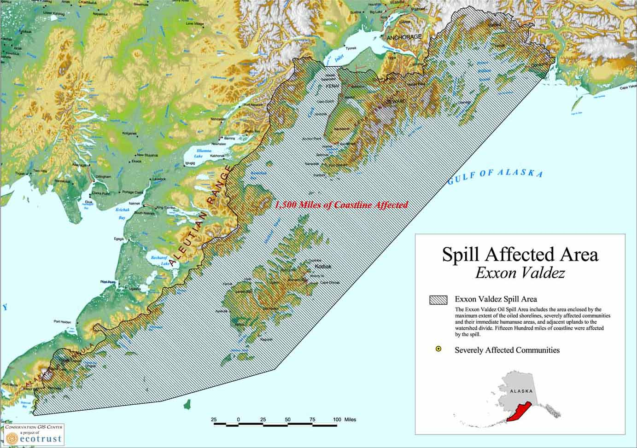
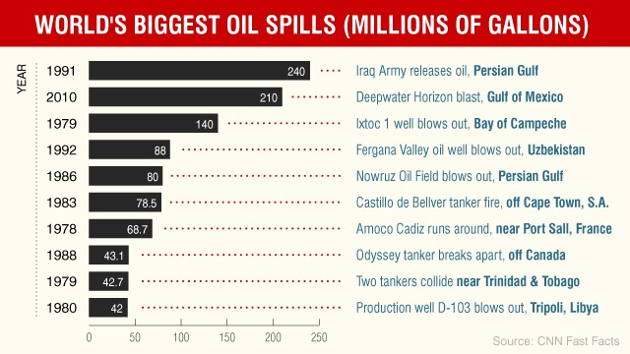
Major Oil Spills to know

Slide 12
Due Next Time
Be prepared for a test on Chapters 9 and 14!
Four possible FRQs:
2015 #3 Oil Spills
2013 #1 Eutrophication
2004 #1 Bioaccumulation of Mercury
2007 #1 Sewage Treatment

