Slide 1
APES 4/25
Please take out your Flint Case Study for check-off
Time for Vocab Quiz F-J!

Slide 2
Toxic Tap:The Poisoning of an American City
I will assign your group to be an expert on one box from the handout
Share info. and prepare to share in 5 minutes!

Slide 3
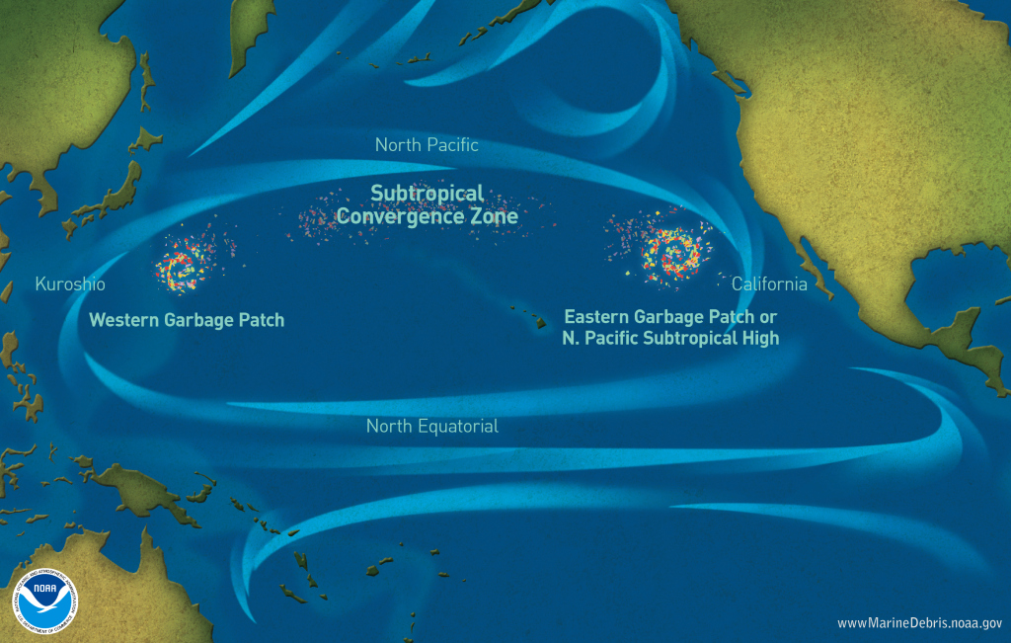
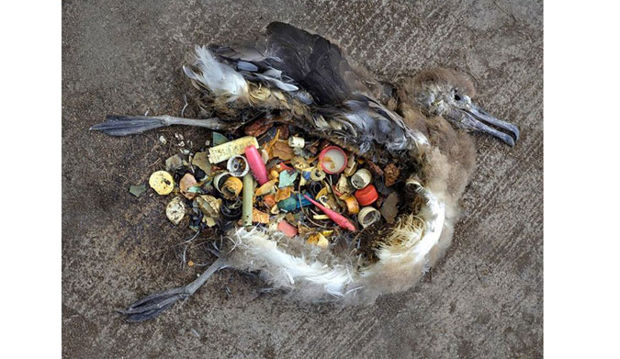
Microplastic Pollution!
https://www.youtube.com/watch?v=FjT8GG0ETQg

Slide 4
Chapter 16 Notes: Waste Generation and Disposal

Slide 5
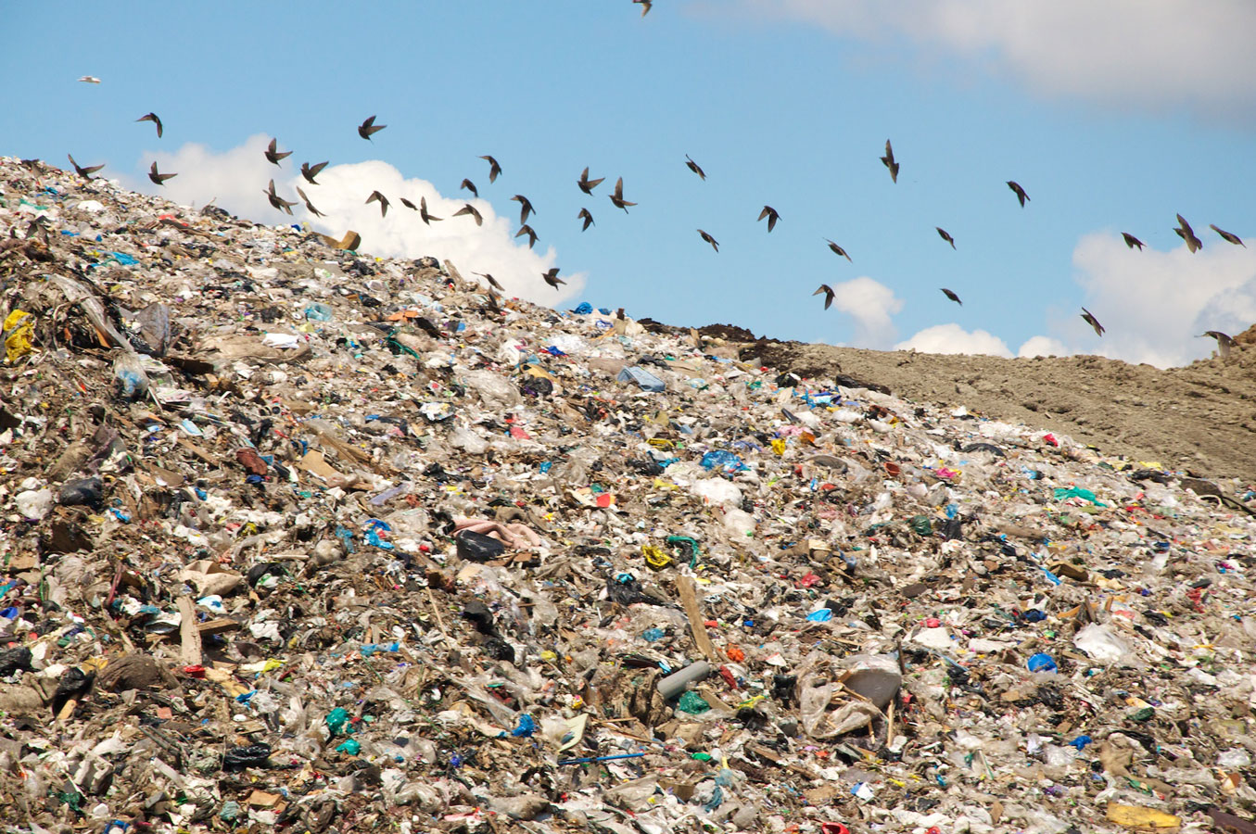
Municipal Solid Waste: Why Care?
It takes immense energy to make consumer goods
Production of goods creates tons of CO₂!
Bacteria in landfills create methane (CH4)
Landfills can create toxic leachate that contaminates our water supply
Electronics, hazardous waste

Slide 6
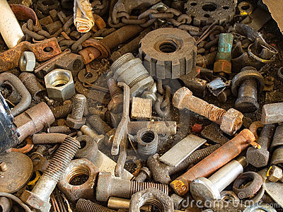
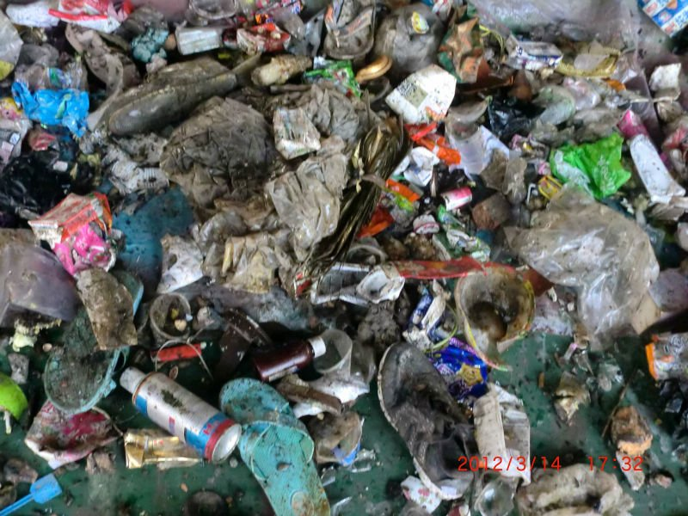
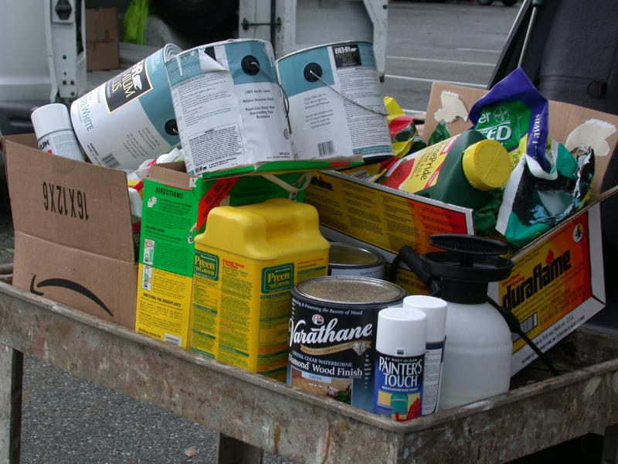
3 Types of Waste Management
Municipal Solid Waste
Sanitary Landfills
Incineration
2. Industrial Solid Waste
3. Hazardous Waste

Slide 7
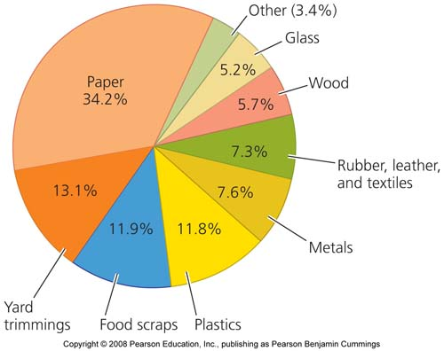
Types of Municipal Solid Waste
Notes:
http://www.epa.gov/osw/conserve/materials/organics/food/fd-basic.htm

Slide 8
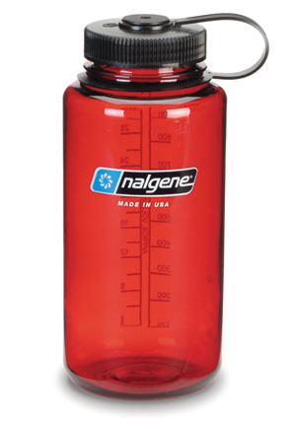
What are the 3 R’s?
Reduce
Reuse
Recycle
What is the most
Important of the
three R’s?
Why is recycle written last?

Slide 9
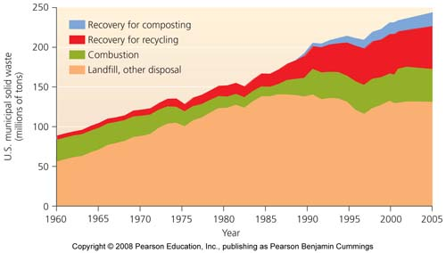
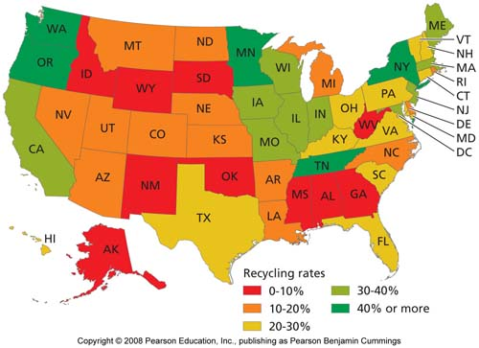

Slide 10
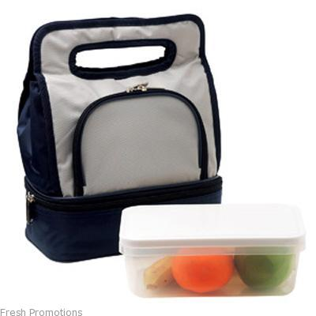
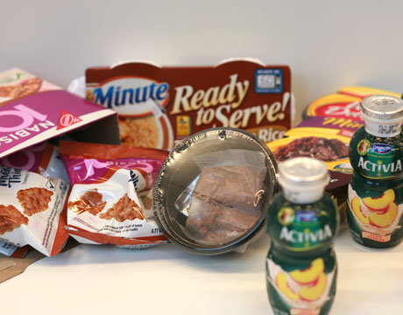
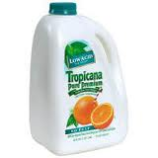
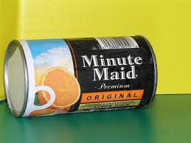
Waste Management –Source Reduction

Slide 11
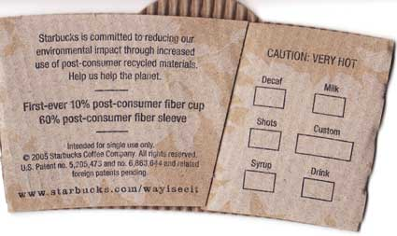
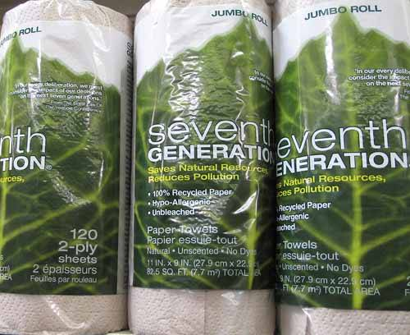
Waste Management – Recovery & Recycling
What products are the easiest (and often most efficient) to recycle?
Glass and Metals
Why?
Just melt them down & save on energy used to mine/make more
Notes:
http://your.kingcounty.gov/solidwaste/garbage-recycling/what-happens-to-my-recyclables.asp?mfile=KCrecycling.wmv&loc=server#video
http://your.kingcounty.gov/solidwaste/garbage-recycling/multimedia.asp

Slide 12
Types of Recycling
Closed loop recycling: recycling a product into the same product
Cans, bottles, paper
Open loop recycling: recycling a product into a different product
Plastics
http://www.terracycle.com/en-US/about-terracycle?utm_campaign=admittance&utm_medium=menu&utm_source=www.terracycle.com
http://www.dwellsmart.com/TerraCycle

Slide 13
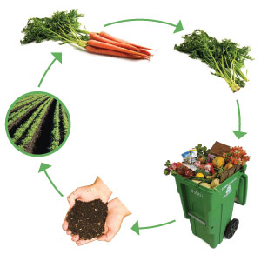
Composting
Makes a closed loop for organic resources

Slide 14
Due Next Time
Vocab Quiz K-O
Two Review Stamps
Finished microplastics assignment (Google classroom)
FYI, the FRQ Quiz is moved to Wednesday, 5/9

