Slide 1
Apes 5/21
You will need a laptop today!

Slide 2
Asphalt Plant Letters
Use the template on Google classroom
Done with your letter? Print two copies to TH 250 (convert to Word first) and then sign them.
See addresses on the board
I’ll mail them all as a group

Slide 3
Toxicology intro.
Examine the magazine add- the pictures, font, colors, words used
What impression are they trying to give you of their product?
How do they say (subconsciously or overtly) the product will make you feel?

Slide 4
Product research
Choose a product from the front table and split up the ingredient list with your group
Research 3-4 ingredients per person:
What is it used for?
What group of chemicals is it in?
Is it toxic? If so, categorize it as a carcinogen, teratogen, endocrine disruptor, neurotoxin, or allergen (if you can)
Make a chart in a Google doc to record all this info.

Slide 5
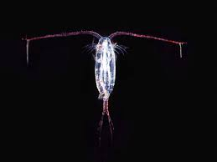
Toxicology Lab Design
Choose a product
You will expose copepods to your product and determine the LD50
You have petri dishes, a dissecting microscope, pipettes
You will need to test 5 different dilutions of your product:
1:1, 1:10, 1:100, 1:1000, 1:10000
1:1 is the full strength product
You will make the dilutions using distilled
water and test tubes
- You will then pour the dilutions into Petri dishes with your copepods (Wed.)

Slide 6
Individual Lab report part one
Title (describes specifically what you’re finding out)
Hypothesis (include because statement)
Background
Why did you choose this product?
Does it contain toxins? What are they and what category do they fit in? (max 3)
What is this product used for?
Does this product have a published LD50/LC50 already? What is it?
Procedure

