Slide 1
Apes 5/7/18
Take out your ld50 lab and toxins organizer
With a group of 2-3: what math and concept issues did you have with this lab?

Slide 2
Aquatic biome examples

Slide 3
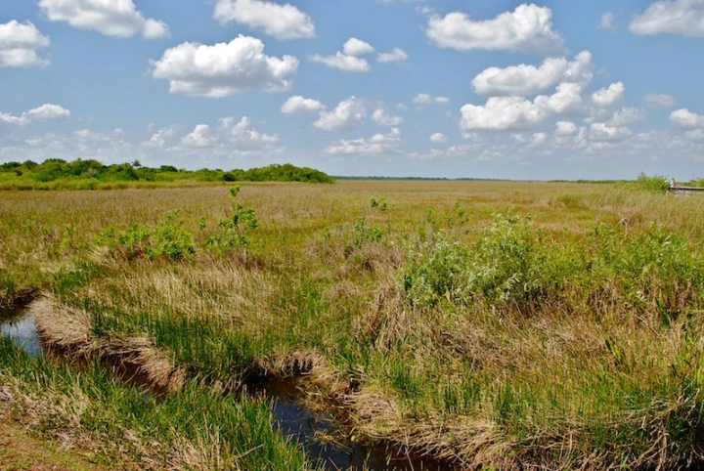
Freshwater: wetlands
Everglades
Also contains Mangrove, Salt Marsh/Estuarine, among other biomes

Slide 4
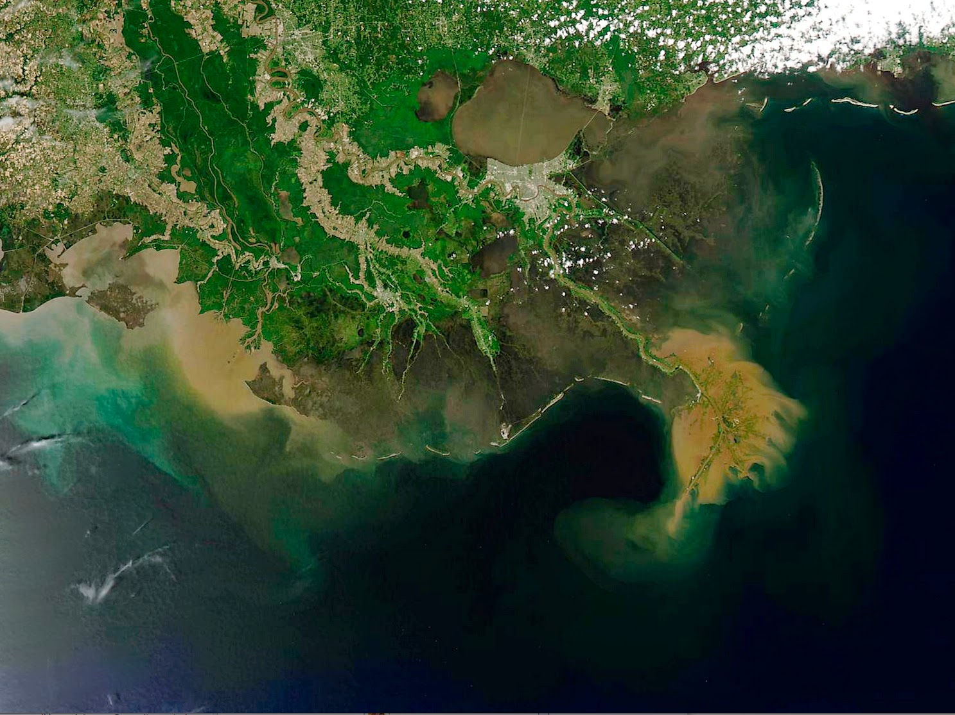
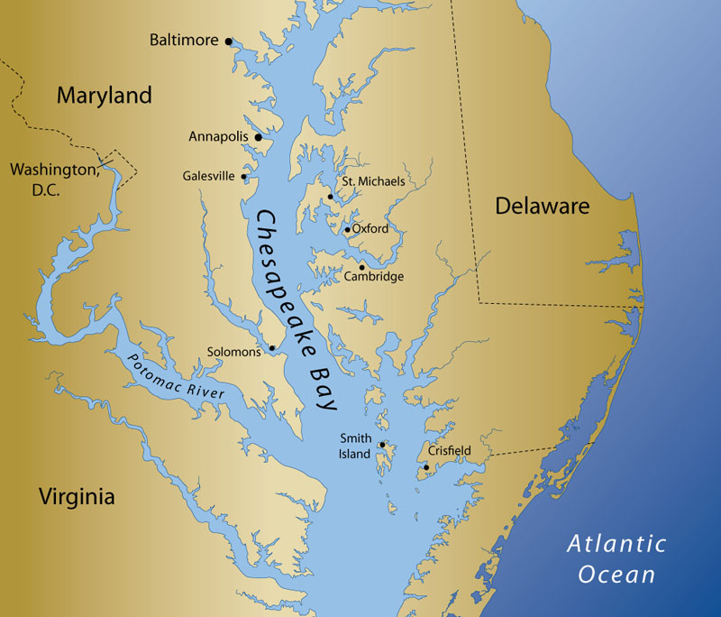
Marine: salt marshes
Coastal, grassy wetlands that get flooded with ocean water
Part of estuaries
Upper intertidal zone
Chesapeake Bay,
Mississippi River Delta

Slide 5
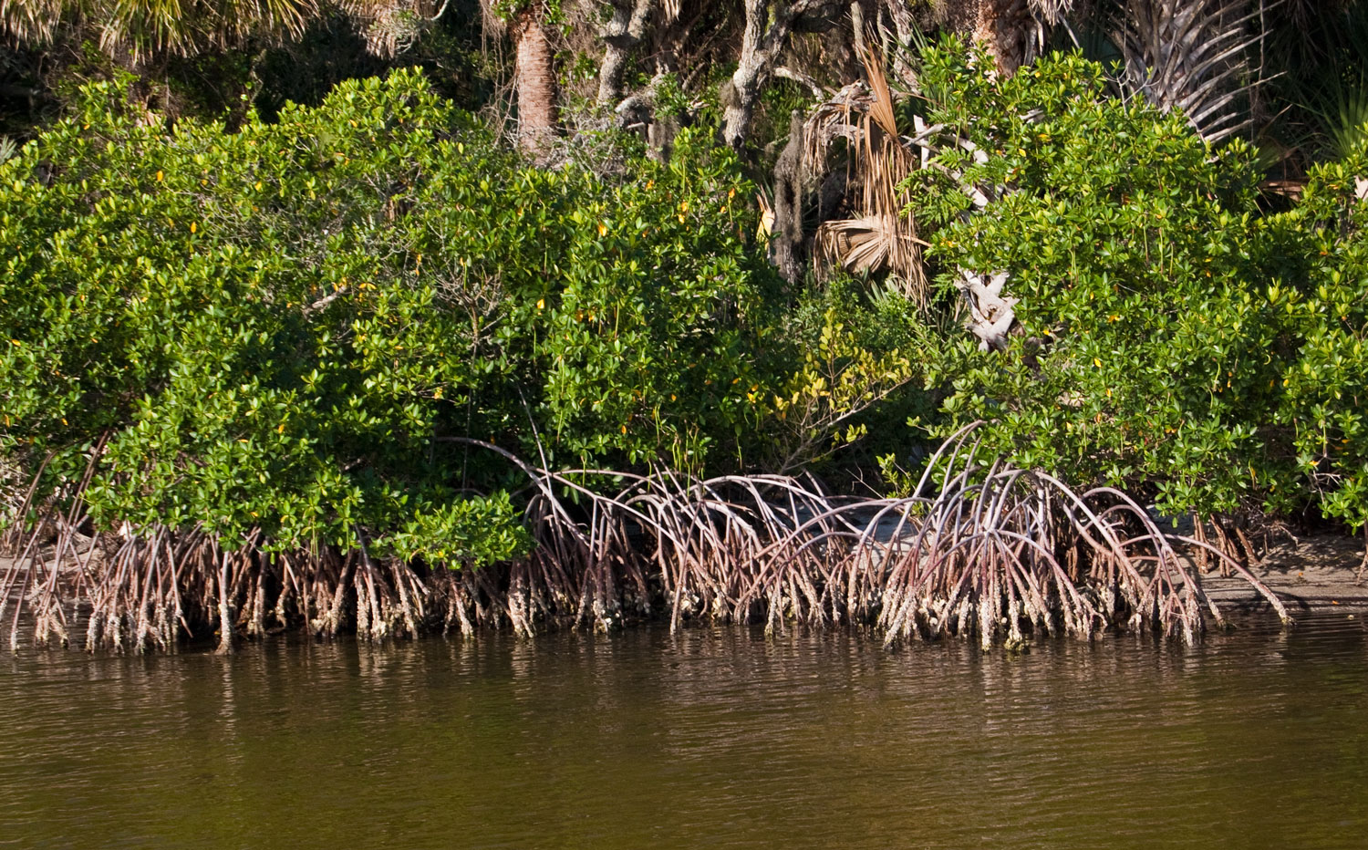
Marine: mangrove swamps
Coastal wetlands full of specialized trees
Florida mangrove forest

Slide 6
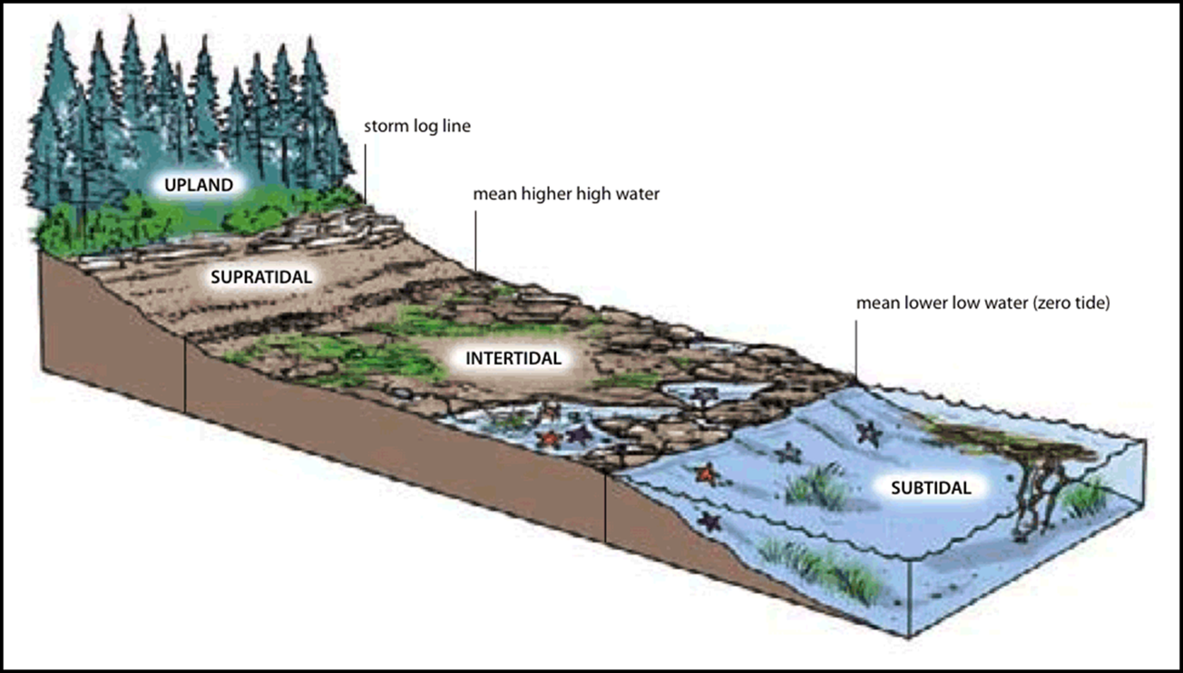
Marine: intertidal zones
Where would we find our mangroves and salt marshes on this diagram?

Slide 7
Case studies to read, if interested
Page 55 (Everglades)
Page 64 (Mono Lake, CA)
Page 481 (Chesapeake Bay)
Page 293 (Klamath River)
Just Remember…
Habitat destruction
Invasive species
Pollution
Population
Climate change
Overexploitation
It applies to everything!

Slide 8
Biomes card game

Slide 9
2018 Hot Topics
Drought (i.e. California, with El Nino)
El Nino
Hurricanes (related to climate change)
Flint, Michigan
Keystone XL Pipeline
Experimental Design – see 2012 FRQ, #3, for an example
BPA/Endocrine disruptors
Palm Oil
Thawing permafrost/change in albedo
Wind power with calculations
See my SWIFT site for a complete list

Slide 10
Due Wednesday
All stamps!
Major Laws Quiz

