Slide 1
Apes 9/12/17
Take out your chapter 1 reading guide for check off
Log in to a computer and access google classroom

Slide 2
Chapter 1 multiple choice
1. D 7. E
2. B 8. B
3. B 9. E
4. B 10. D
5. C 11. A
6. C
FRQ: see photocopy
No need to score today…are you in the ball park of a good score?

Slide 3
Learning targets
I can explain the terms ‘tragedy of the commons’ and ‘sustainable’ and provide examples of each

Slide 4
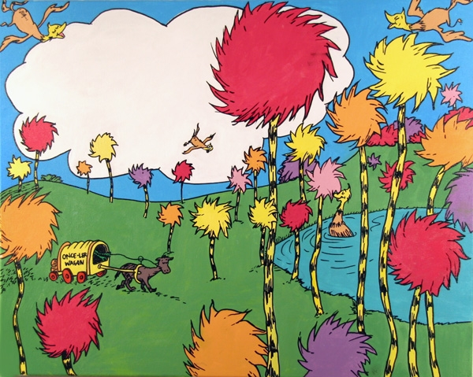
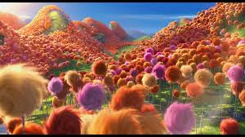
Tragedy example: the lorax
Listen intently as I read aloud “the lorax” by dr. seuss
At the end of each section, answer the questions on the lorax document found in google classroom- due today!

Slide 5
The lorax discussion + Defs.
What is meant by the terms sustainable development and tragedy of the commons?
How could the onceler have changed his practice to be more sustainable?
Sustainable development = using resources in a way that allows them to replenish themselves for future generations
Tragedy of the commons = use of shared resources in an unsustainable way

Slide 6
Tragedy of the commons (notes)
Professor Garrett Hardin, an Ecology professor at UCSB, published a famous paper in 1968 called “The Tragedy of the Commons”.
The “commons” are resources that we have access to, but no one owns
Examples = the atmosphere, the oceans, grazing pastures, fish stocks, forests….any others?

Slide 7
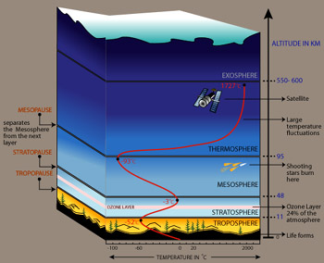
We’ve created Two layers of trouble!
Our atmosphere
CFC’s creating ozone depletion in the stratosphere
Smog, acid rain, particles, excess CO2 in the troposphere

Slide 8
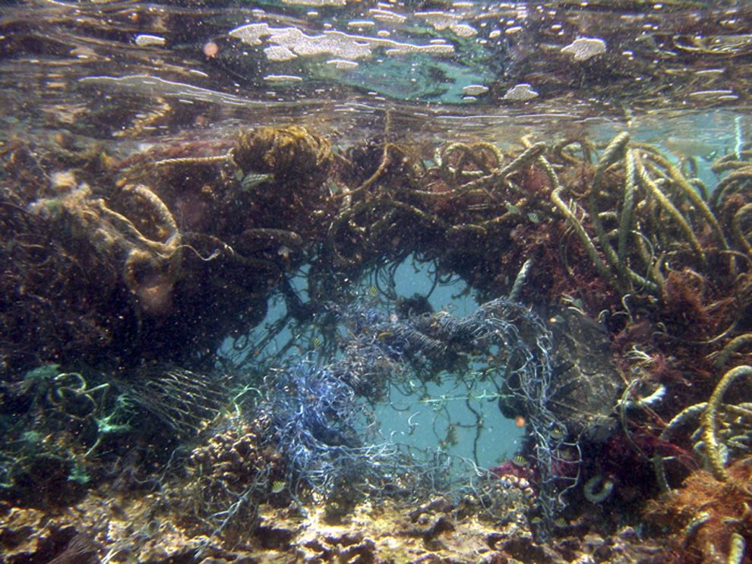
Worldwide garbage patches

Slide 9
The tragedy of over-fishing
You need:
A group of 4
A bowl of candy
Four straws
One spoon
Four cups
Two textbooks
Two copies of “the tragedy of the commons” by garrett hardin

Slide 10
Due next time
Fishing Lab
The article excerpt is online

