Slide 1
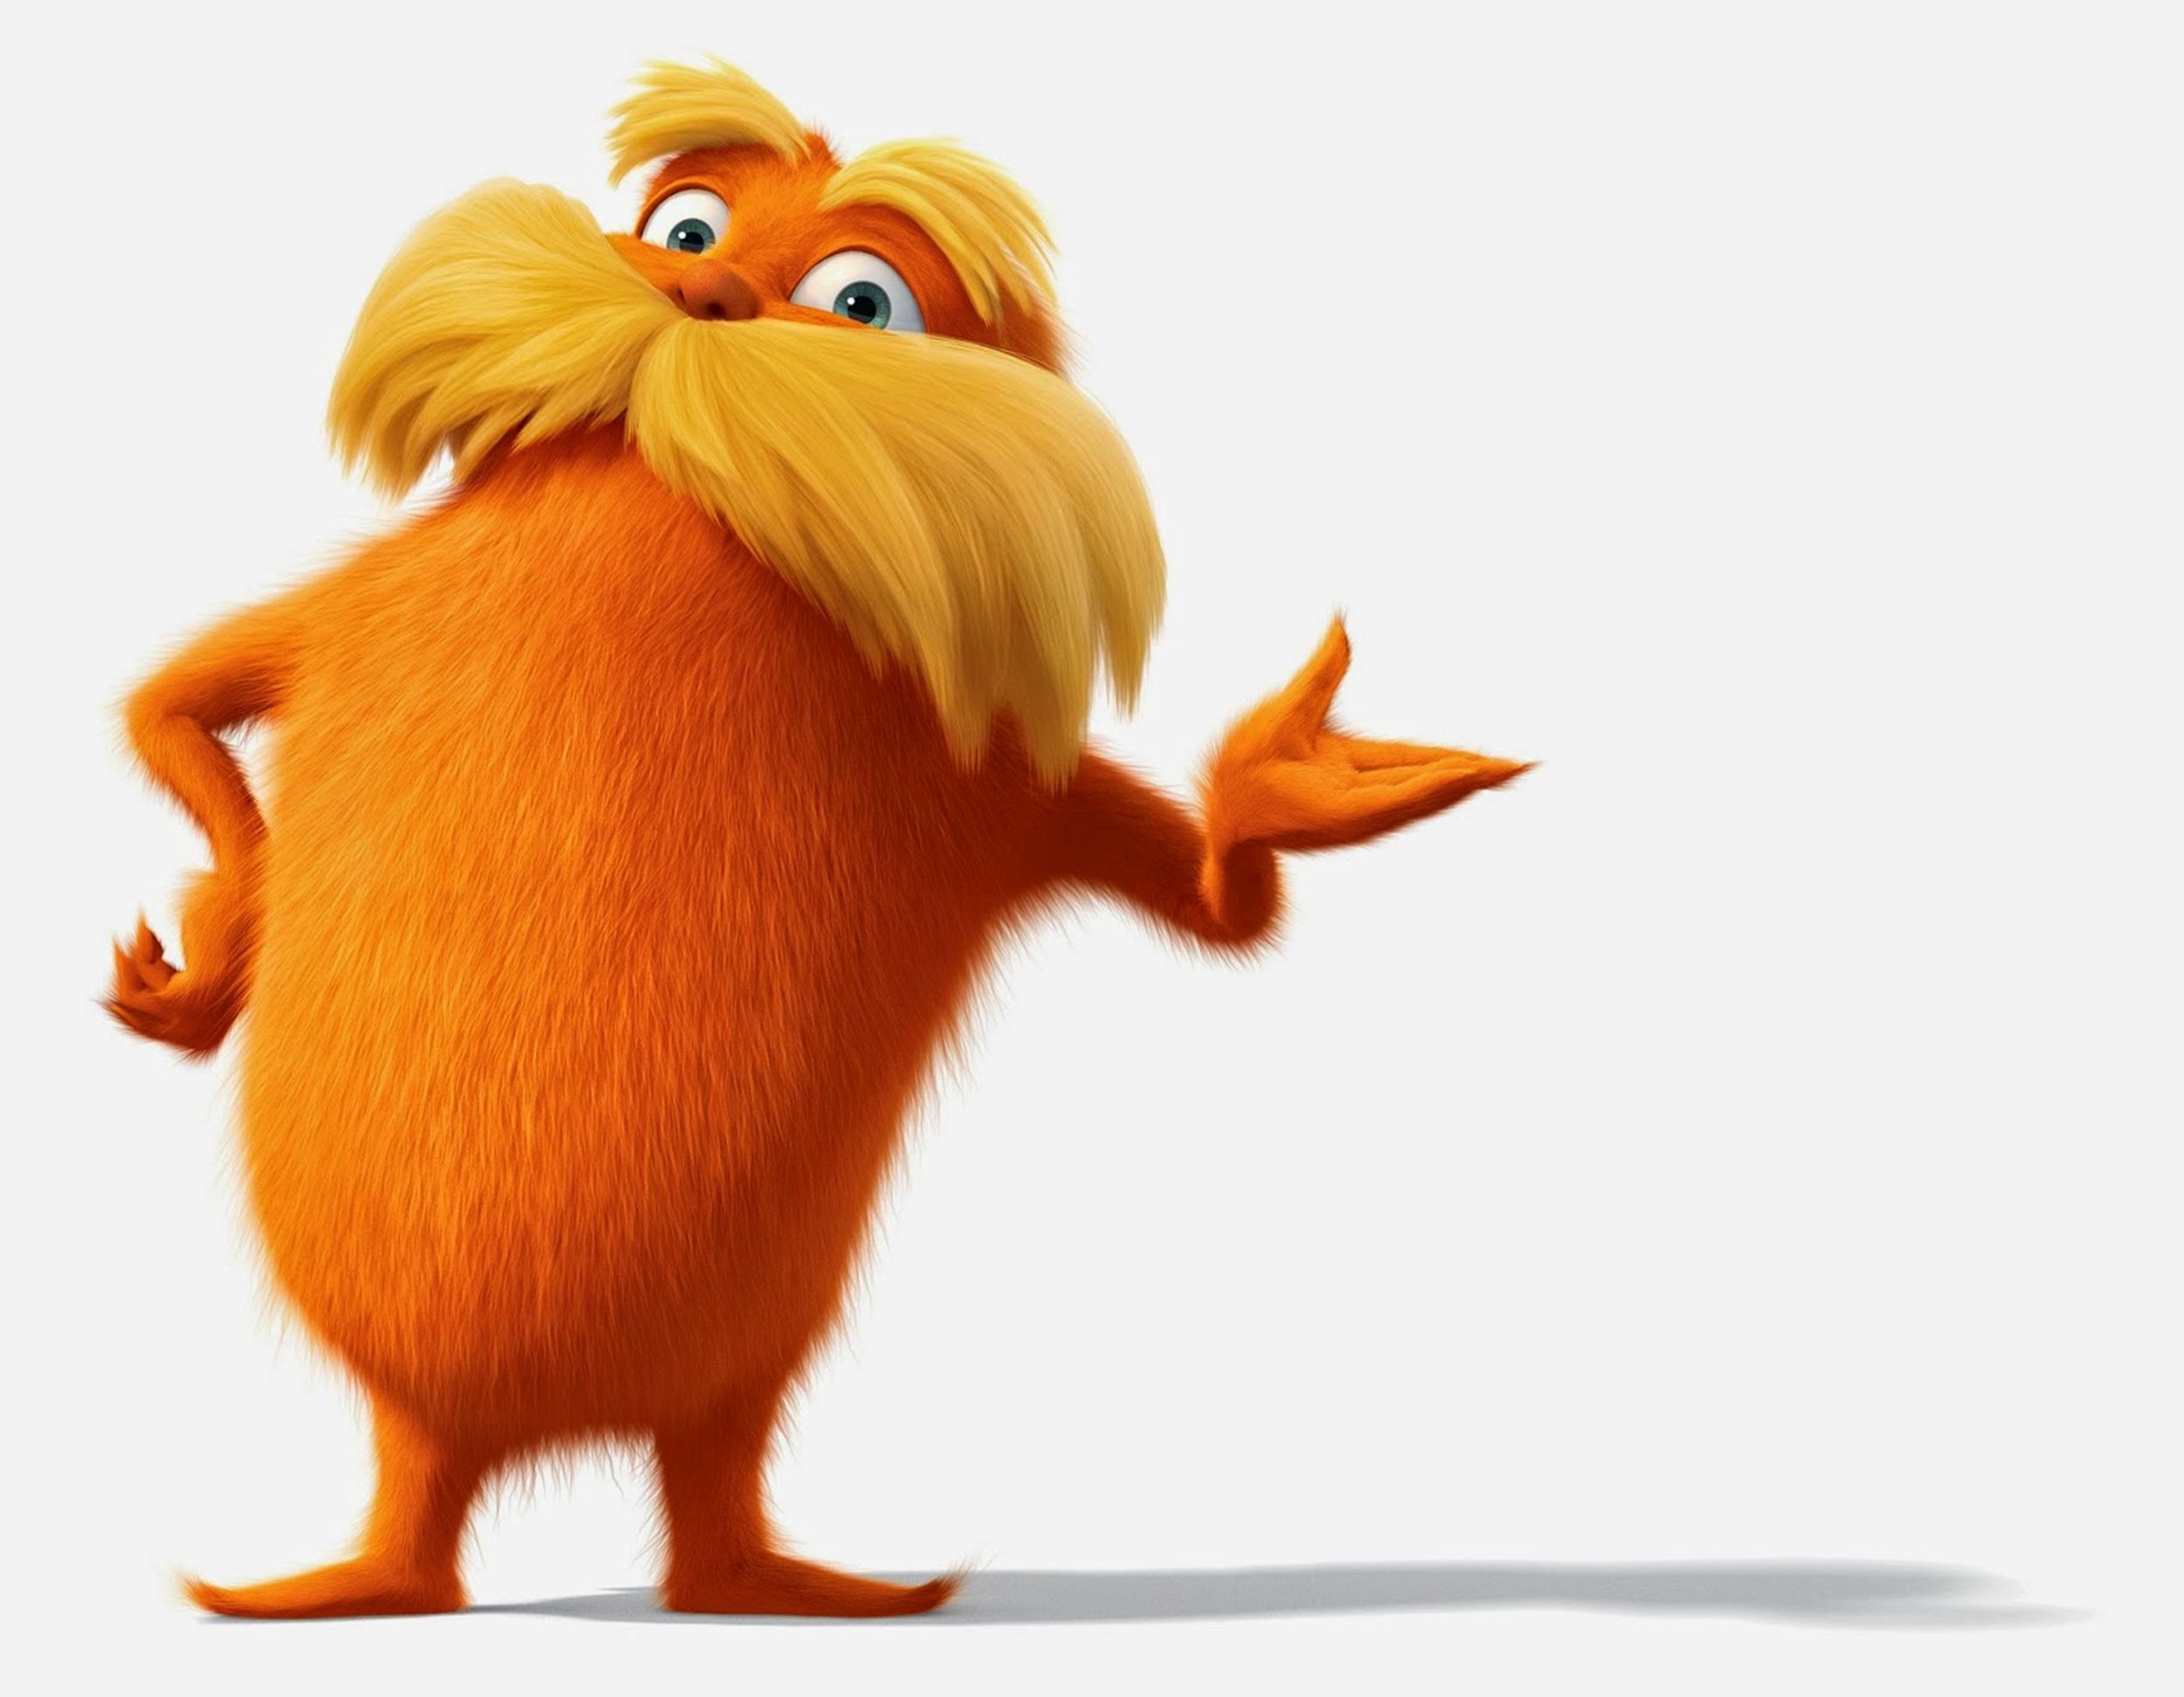
APES 9/14/17
Please take out your Fishing Lab
Get a laptop and share your Lorax activity if you didn’t last time

Slide 2
New Seats!
Rules: you can only take one person with you.
All of the tables must be full before lab stations.

Slide 3
Learning Targets
I can illustrate the principle of sustainability and earth’s resources within an ecosystem
Please get a laptop for note-taking!

Slide 4
Fishing Lab Recap
As I come around to stamp your lab, take turns sharing answers to the discussion questions.
You will have a “team captain” who leads this rotation. They are the person who got the most candy last time!
In 5 minutes, I’ll take whole group questions.
Then, put your lab in the inbox.

Slide 5
Principles of Sustainability and Earth’s Resources
Chapter One Key Learning

Slide 6
Principles of sustainability
How has earth sustained a huge, healthy diversity of life for so long?
Principle one: dependence on solar energy
There is a constant, one-way flow of energy
Principle two: genetic biodiversity and evolution
Life has evolved to use resources and adapt to change
Principle three: cycling of water and nutrients
Molecules needed for life are available in many forms and recycle
The earth is a sustainable ecosystem with its own natural systems for maintaining balance.

Slide 7
Natural Capital = value of the earth
Natural capital, the earth’s value to us, consists of natural resources and ecosystem services
Natural resources = matter and energy vital to human existence
Renewable = regenerate if given enough time (i.e, forests, topsoil, fishes, clean air, fresh water)
Inexhaustible = won’t run out in our lifetime (i.e. sunlight)

Slide 8
More on Natural Resources
Sustainable yield = highest rate at which we can use resource without reducing its supply
i.e. if only 1,000,000 new cod are born each year, taking only half
Tragedy of commons = overfishing, overharvesting, overgrazing, etc. of natural resources
Non-renewable/exhaustible resources = fixed quantity or regenerates very slowly
Natural gas, oil, metallic minerals (iron, copper, etc.), non metallic minerals (salt, sand, clay)

Slide 9
Ecosystem Services
Processes provided by the earth
that make our lives possible:
Cycling of important molecules
Food production
Climate control
Water purification
UV protection
Natural Resources are the things
We use; ecosystem services are the
Natural processes that help us.

Slide 10
Monitoring our Impact
Env. scientists study environmental indicators to measure our impact on natural capital
Biodiversity
A. Ecosystem diversity – number and types of healthy habitats
B. Species diversity- number and types of individual species
Compare current extinction rate to background extinction rate
(what’s actually happening vs. what should happen over a long time)
C. Genetic diversity- number and types of genes in existence

Slide 11
Environmental indicators, cont..
2. Food production (land use unit)- can we feed our exploding population?
3. Average global surface temps. And CO₂ concentrations (air pollution unit)
4. Human population growth/decline
5. Resource depletion (land use unit)

Slide 12
Ecological Footprints = how much land it takes to sustain your level of resource consumption.

Slide 13
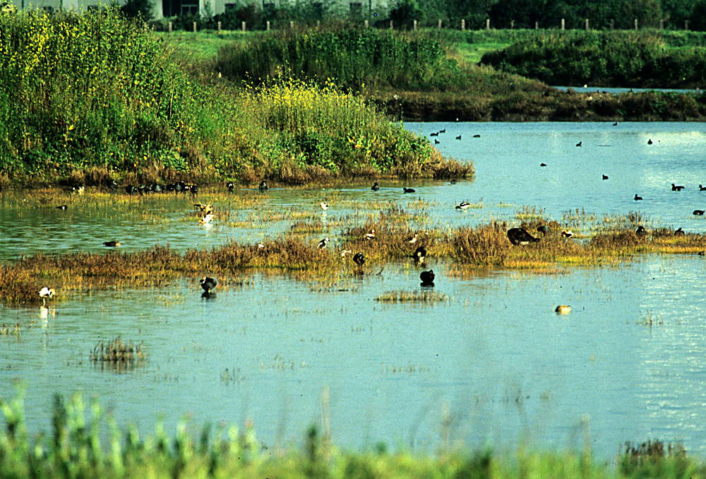
Applying Chapter One Concepts
With your table group, choose a biome from module 12
Illustrate and include a brief explanation for:
Natural capital (just define this)
Natural resources (2)
Ecosystem services (1)
Renewable resource (1)
Inexhaustible resource (1)
Non-renewable/exhaustible resource (1)
Sustainable yield (1)
Ecological Footprint (1)
Avg. temp. + precip. in your biome
(climatogram)
Water filtration by wetlands is an ecosystem service because it filters out pollutants

Slide 14
Due Next Time
Finish your diagram!
FYI, the Chapter 2 reading guide is
due Friday, 9/22

