Slide 1
APES 9/18
P. 1: Choose a new seat! You may only take one person with you, and must fill in center tables

Slide 2
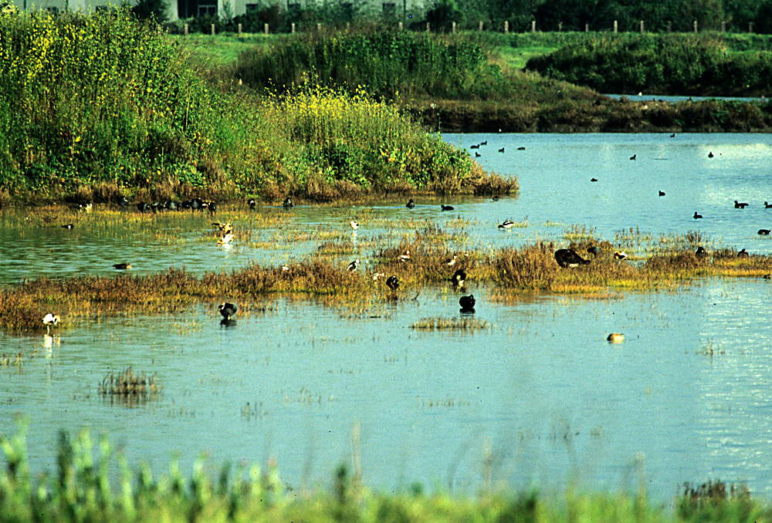
Applying Chapter One Concepts
With your table group, choose a biome from module 12
Illustrate and include a brief explanation for:
Natural capital (just define this)
Natural resources (2)
Ecosystem services (1)
Renewable resource (1)
Inexhaustible resource (1)
Non-renewable/exhaustible resource (1)
Sustainable yield (1)
Ecological Footprint (1)
Avg. temp. + precip. in your biome
(climatogram)
Water filtration by wetlands is an ecosystem service because it filters out pollutants

Slide 3
Learning Targets
I can describe the process of soil salinization and design an experiment to test the effects of salinity on seed germination.
Why? Chapter 2 is all about experimental design and science concept review. There’s no better way to review science skills than to design an experiment!

Slide 4
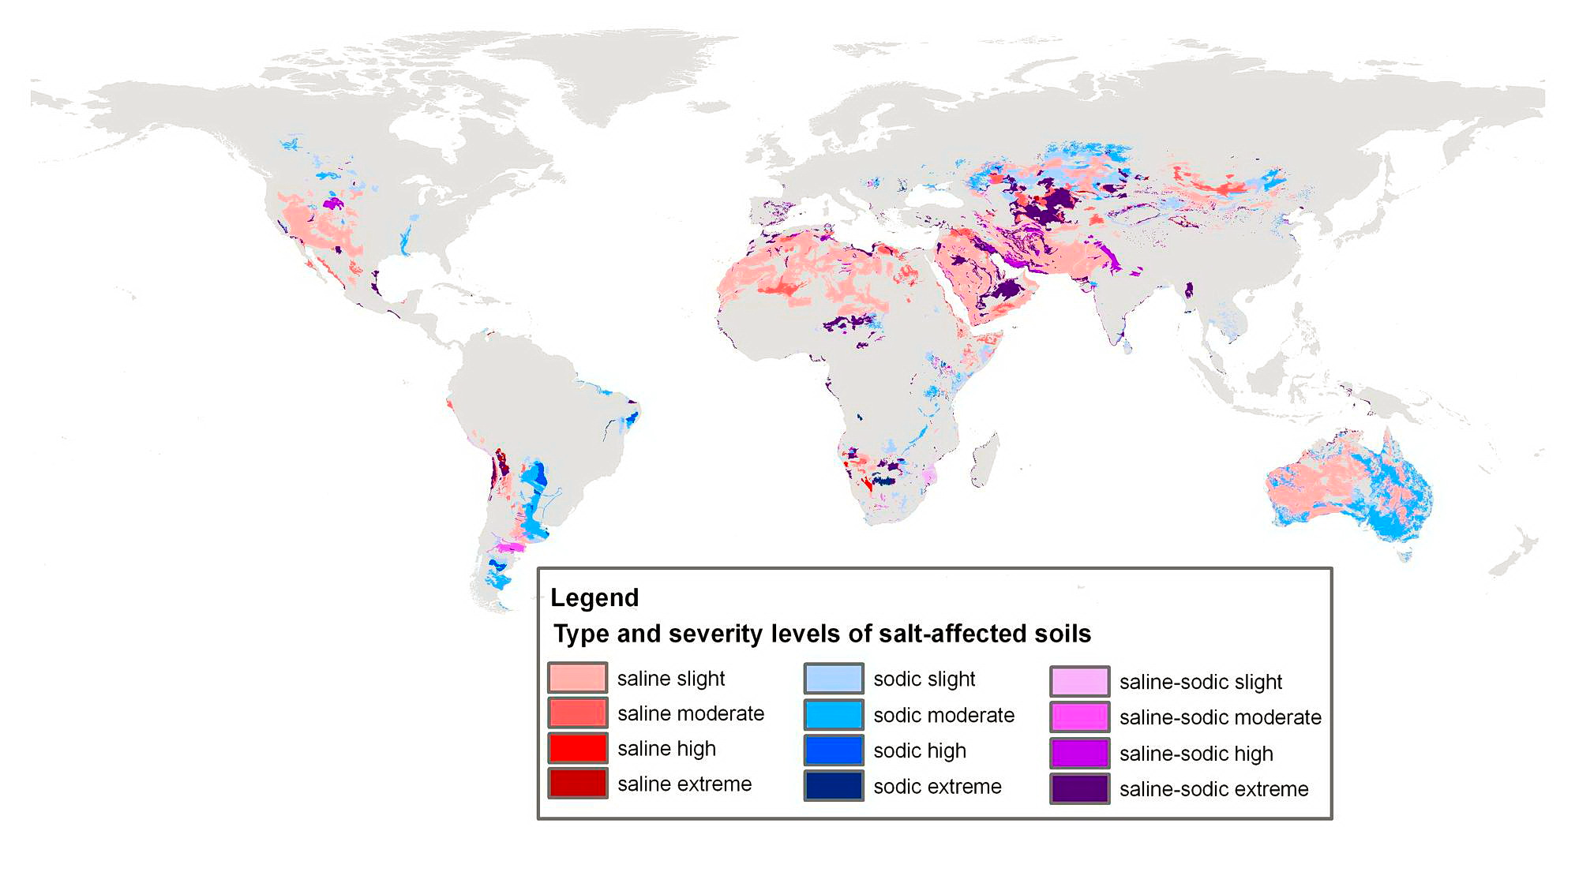
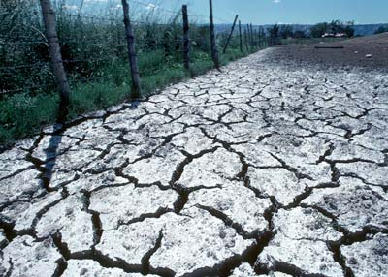
Soil Salinization Lab
Soil Salinization is the process of salt becoming concentrated in areas where irrigation is used to make soil fertile.

Slide 5
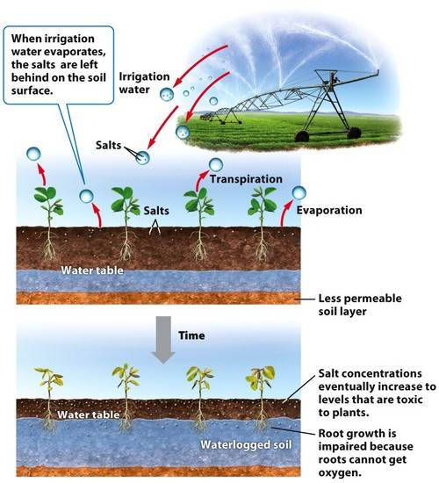
How?
Irrigation water usually come from underground aquifers, which have a lot of minerals dissolved in them. In dry areas, the water evaporates, leaving behind salts in high levels.

Slide 6
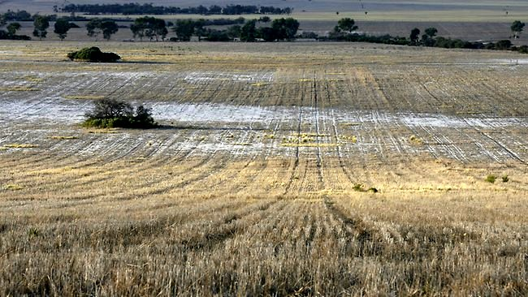
How does salt concentration affect seed germination (sprouting)?

Slide 7
Soil Salinization Lab
Pre-Lab: complete 1-4 on graph paper (lab on SWIFT).
Lab: complete on the provided graph paper and staple it.
a. decide on your 8 concentrations
b. figure out how to make them
c. split up- one pair makes baggies, other makes solutions
d. leave your labeled baggies on my bookshelf
e. work on your lab report (#1-5)

Slide 8
Materials
Salt
2 beakers
Tap water*
Mung beans or radish seeds (your choice)
Baggies
Paper towels
Electronic Balance
Graduated cylinders for measuring
Sharpies

Slide 9
Sample solution
2% salt solution:
98 mL water + 2 g salt
Why? 1 g of water = 1 mL of water
2g of salt out of 100 g of solution = 2%!

Slide 10
Due next time…
Parts 1-5 under “Lab Report Requirements”
FYI: the Chapter 2 study guide is due Friday!
Chapter 1-2 Test next Tuesday the 26th (more info to follow)

