Slide 1
APES 9/22/17
Please take out your Chapter 2 Reading Assignment
for check off! Grab a book to check answers.
Turn in your soil salinization lab if it’s ready- or by tuesday

Slide 2
Chapter 2 Multiple Choice
Team Captain gets a book and leads the discussion of the reading guide and the questions below!
B 2. D 3. E 4. C 5. A 6. B
7. E 8. C 9. B 10. E 11. D 12. C
13. A 14. E
Team Captain = person who can’t name 3 current Seattle Mariners
I will go over the ones highlighted in RED in detail.
I will also be following up with some instruction on energy efficiency and feedback loops.

Slide 3
Science Concept Review
Find your paper and your partner.
Use the information in Chapter 2 and your prior knowledge to complete the chart!
This is due Monday (today would be great!)

Slide 4
Stretch Break- Get a computer

Slide 5
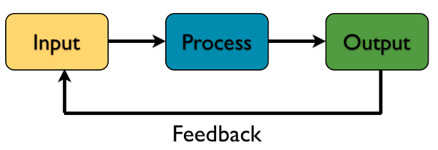
Systems, Inputs and Outputs
All systems (environmental, biological, business, etc.) have inputs, outputs, and flows/processes within the system
Closed systems do not allow new matter in; do exchange energy
Open systems allow new matter and energy in
Systems often reach a “steady state” where inputs = outputs

Slide 6
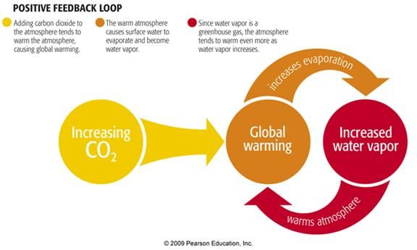
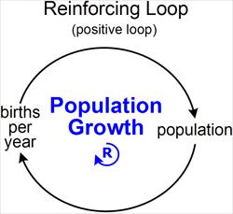
Positive Feedback Loops
Systems are governed by feedback loops
Positive feedback loop: causes a system to move further in the same direction.

Slide 7
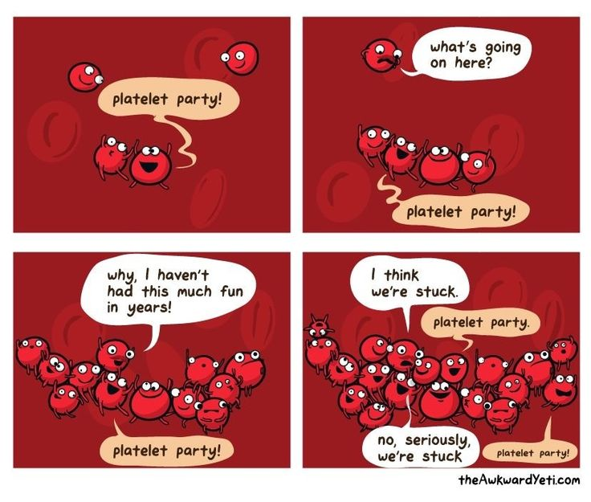
Positive Feedback Loops
Women in labor! The hormone oxytocin is produced in labor, leading to contractions, leading to more oxytocin, leading to more contractions…
Scabs/blood clots: platelets cling to an injured blood vessel, releasing chemicals that attract more platelets…more chemicals…
You work hard in class and your teacher notices. You work harder!

Slide 8
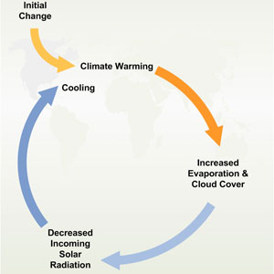
Negative Feedback Loops
Negative (corrective) feedback loops cause the system to change in the opposite direction from how it is moving.
Examples: body temperature (you get hot, you sweat to cool off. You get cold, you shiver to heat up.)
Recycling/reusing materials: outputs of aluminum cans become inputs, reducing the amount of aluminum that has to be mined.

Slide 9
Ted Ed Feedback
https://www.youtube.com/watch?v=inVZoI1AkC8

Slide 10
Energy Units of Measurement
Joule (J) = energy used by 1 watt lightbulb in 1 second (not that useful)
Calorie (cal) = energy it takes to heat 1 g of water 1 degree Celsius
Energy we use is given in kilowatt hours (kilowatts to run appliance x time it ran)
kWh = kilowatt hours MJ = megajoules
1000 watts in a kW 1,000,000 joules in a megajoule
1000 calories in a kilocalorie 1 kcal = 4,184 J
We will learn more about this in the energy unit. Don’t panic!

Slide 11
Energy Efficiency and Quality
Energy efficiency = actual amount of energy gained by converting one type of energy to another.
Ex: if a coal plant that contains 100,000 MJ of potential energy makes only 45,000 MJ of electricity, it has 45% energy efficiency.
Energy quality = how easily an energy source can be used to do work (converted to another, more useful energy source). NO MATH here.

Slide 12
Due Tuesday!
Be Ready for the Chapter 1-2 Test
Soil Salinization Lab and Science Concept Review, if needed

