Slide 1
Apes 9/7/17
Please take out your signed syllabus and safety contract for check-off

Slide 2
Learning targets
I can illustrate that environmental events are actually multi-layered, including science, economics, politics, and public health

Slide 3
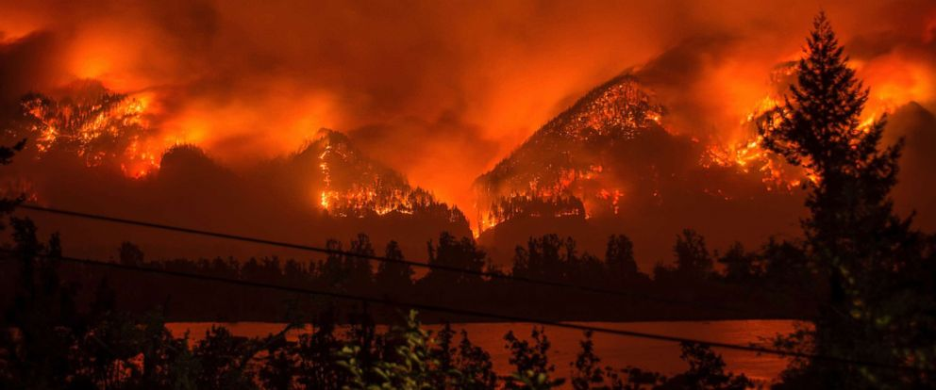
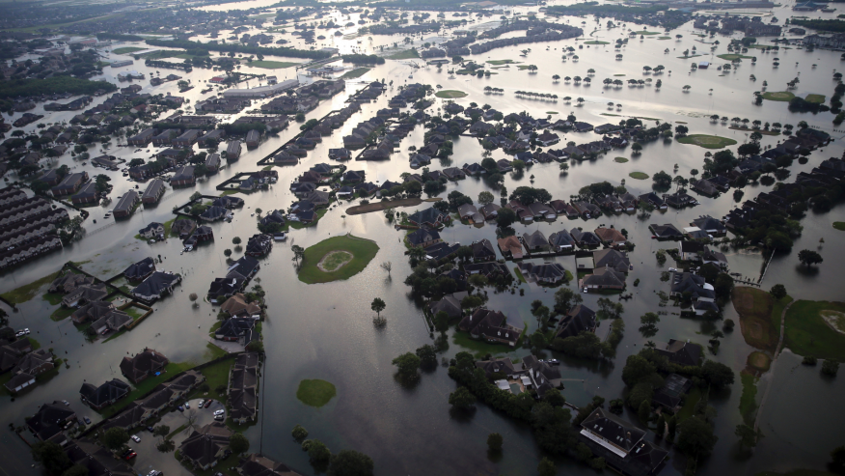
How do I
even
choose?
http://www.climatecentral.org/news/interactive-wildfires-map-tracks-blazes-in-us-17916

Slide 4
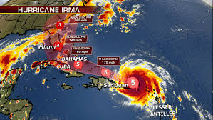
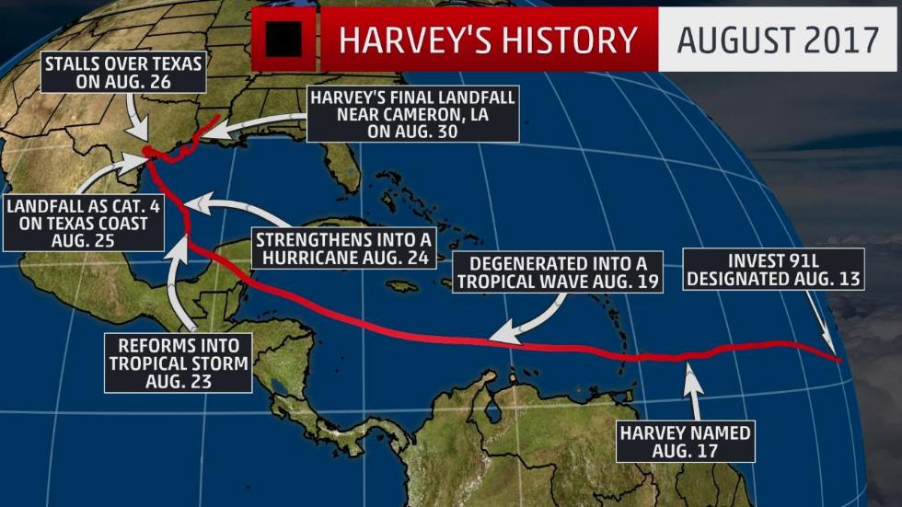
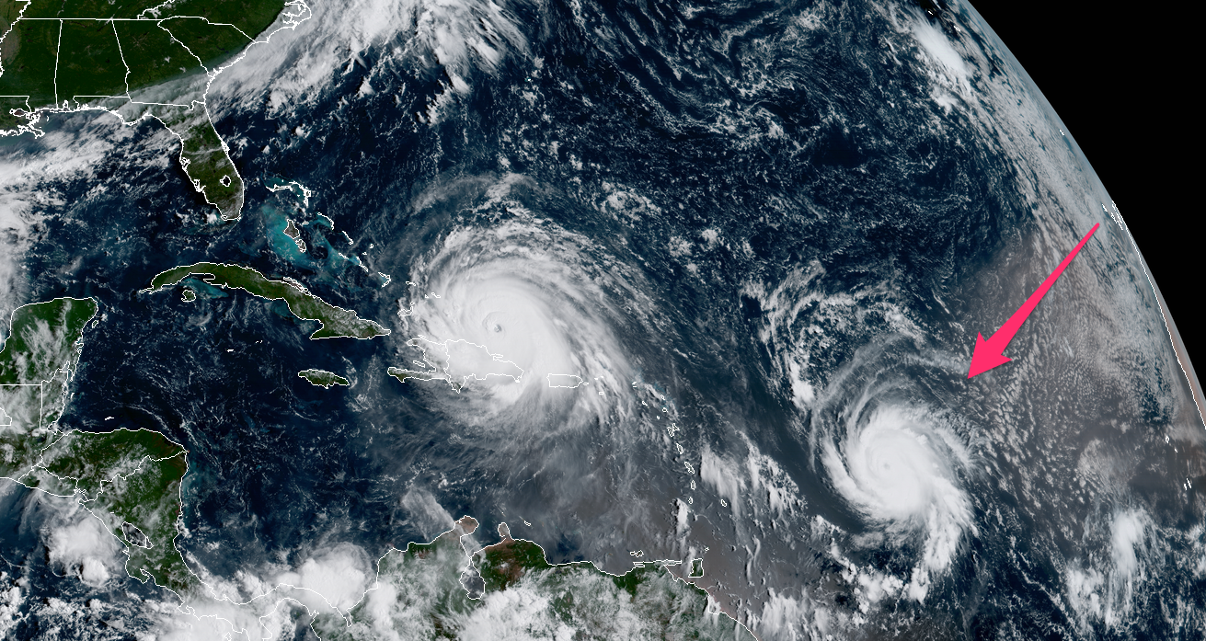
What the heck?
https://www.facebook.com/ABCNews/videos/10156271239353812/

Slide 5
Harvey and apes
APES is about a YUGE variety of topics that are intertwined
Let’s see how Harvey, Irma, Jose, and Katia help us understand the AP Outline
Choose a partner
Find the Harvey articles on my website (APES Online Links) and decide who is partner A and who is B

Slide 6
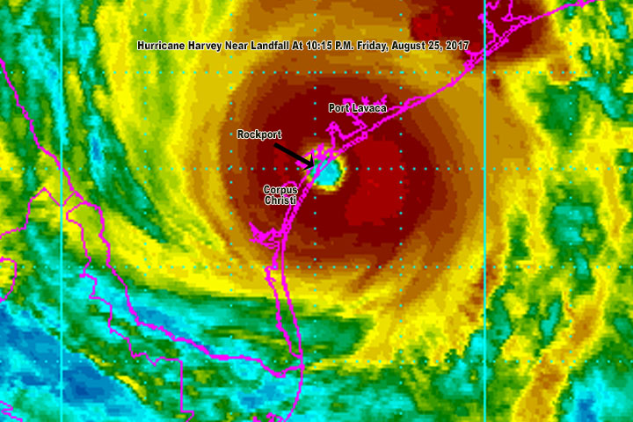
Harvey and apes
Copy my diagram (one per pair)
Include all 10 terms (next slide)
On each arm, write 2 bullet points explaining how the term relates to Hurricane Harvey

Slide 7
Terms to include
Habitat destruction
Water Pollution
Fossil Fuels
Economics
Politics
City planning
Hazardous waste
Climate change
Biological waste
Overpopulation

Slide 8
College Board Outline
Next to each arm, write the chapter and part of the CB outline containing the topic.

Slide 9
Logistics
Please join Google classroom
APES Period 1: o5akz8
APES Period 3: uameip

Slide 10
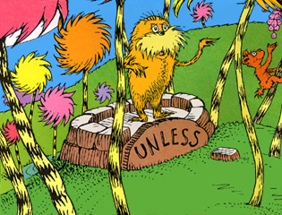
Major Theme: Tragedy of the Commons
Professor Garrett Hardin, an Ecology professor at UCSB, published a famous paper in 1968 called “The Tragedy of the Commons”.
Let’s piece together what the term means, with a story and lab activity!

Slide 11
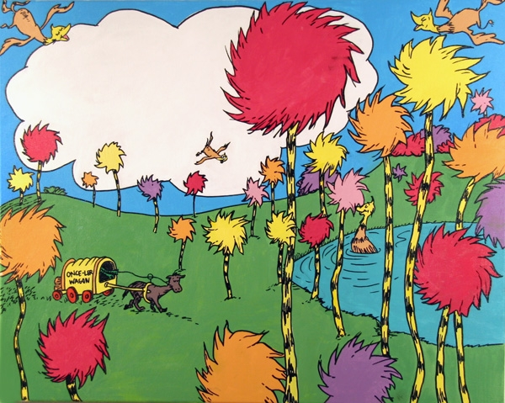
Tragedy example: the lorax
Listen intently as I read aloud “The Lorax” by Dr. Seuss.
At the end of each section, answer the questions on The Lorax document found on Google classroom

Slide 12
Due next time
Chapter One Reading Guide

